Slide 1
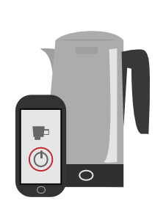


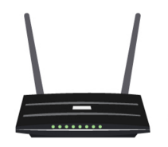




Kettle
To learn More
Name: iKettle
Researcher: Ken Munro
Attack: Key extraction
Description: An app controlled kettle
Attack Information
The attacker first sends a deauth packet and forces the kettle to roam to its own AP. The iKettle provides the wireless (WPA) key of the network it is connected to viatelnet
deauth

Slide 2
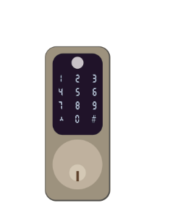
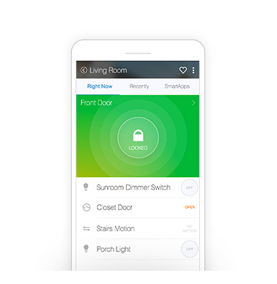



Zigbee Doorlock
To learn More
Name: Yale Doorlock
  Researcher: Tobias Zillner
Attack: Crypto downgrade
Description: A remotely controlled doorlock utilizing the ZigBee protocol
Attack Information
Encrypted
Control & Status
The Link key is negotiated between Hub and lock, but this negotiation is insecure. So an attacker could sniff the key after forcing a new key negotiation
Sniff Link Key
Encrypted ‘Unlock’

Slide 3
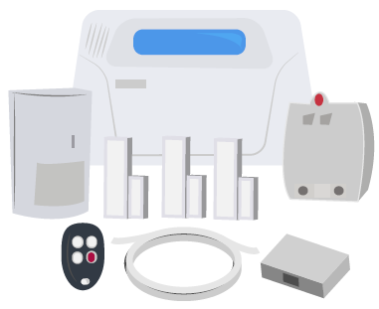



Alarm System
To learn More
Name: Alarm systems
Researcher: Logan Lamb
Attack: jamming, man-in-the-middle
Description: Alarm systems operating using proprietary unsecured protocols
Attack Information
Common alarm systems are composed by sensors and detectors. These sensors transmit data using unencrypted, unprotected channels at well known frequencies. An attacker can Jam those frequencies or send fake data to disable the sensors, thus disabling the alarm

Slide 4
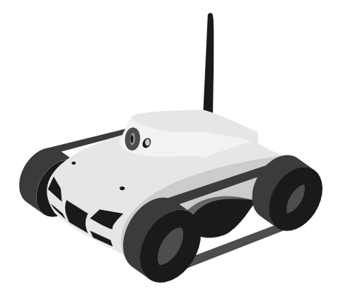
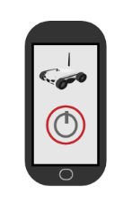
WiFi camera tank
To learn More
Name: I-spy-tank
Researcher: Ken Munro
Attack: hard-coded credentials
Description: A remote controllable tank with a camera
Attack Information
The credentials on the I-Spy are hardcoded in the controller app. By using them in the embedded web server, the attacker takes total control of the tank, allowing to execute actions such as network reckoning, or switching on the camera at specific times
Login
Pass
Login
Pass

Slide 5

Cayla Doll
To learn More
Name: Cayla
Researcher: Ken Munro
Attack: insecure authentication
Description: A talking Bluetooth doll
Attack Information
Toys for kids require specific security considerations. Ironically, most connected toys provides little security. Cayla provides no security out of the box, allowing an attacker to use it as a microphone or to make the toy say arbitrary things including profanity
PIN:0000

Slide 6


Thermostats
To learn More
Name: NEST
Manufacturer:
Researcher: Grant Hernandez et all.
Attack: Local Software Modification
Description: An intelligent thermostat with connected home capabilities
Attack Information
The NEST proposes a very sound security model, but earlier models could be modified by physical attacks. The attacker could plug a USB thumbdrive and replace the operating system with custom software

Slide 7

Baby Monitors
To learn More
Name: Baby monitors
Manufacturer:
Researcher: Rapid 7
Attack: Diverse
Description: Cameras geared to monitor infants
Attack Information
Several monitors have been faulty of provided very low security. Attacks range in severity, from poor cloud security to hardcoded credentials. Some manufacturers have resolved the issues, but others still ship insecure devices
Get hardcoded Credentials
Modify camera
Attack Cloud

Slide 8
Hello Barbie Doll
To learn More
Name: Hello Barbie doll
Researcher: Andrew Hay
Attack: Cloud based attacks
Description: A Siri type doll that can record conversations
Attack Information
The Hello Barbie connects with a server to store the communications. The server was susceptible to a range of attacks, that have been already patched. While the security of the toy has proven pretty good, it definitely impacted the usability, with a very complex registration process.
Cloud
communication
Cloud Attacks

Slide 9
Light Bulbs
To learn More
Name: Hue lightbulbs
Researcher: Tobias Zillner
Attack type: Crypto downgrade
Description: connected bulbs controlled by a remote application
Attack Information
Hue lightbulbs have the same problems as the doorlock. The Link key is negotiated between Hub and bulbs, but this negotiation is insecure. So an attacker could force a reset on the bulb and then sniff the key after forcing a new key negotiation.
Encrypted
Control & Status
Sniff Link Key
Encrypted ‘Switch off’

Slide 10


RF Toys/Shock collar
To learn More
Name: Shockcollar
Researcher: Tim K
Attack type: Insecure communication
Description: A remotely controllable shock collar for dogs
Attack Information
RF toys and devices usually ship with no security. Software Defined Radio allows an attacker to sniff the protocol, decode it and control the device remotely. In this case, the researcher sniffed the sock collar set for vibrate, and after three times send a shock instead of a vibration
SDR

