Slide 1

Yarra Valley Sustainable Gardens

Slide 2
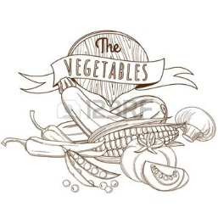
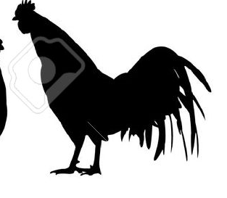
Yarra Valley Sustainable Gardens

