Slide 1
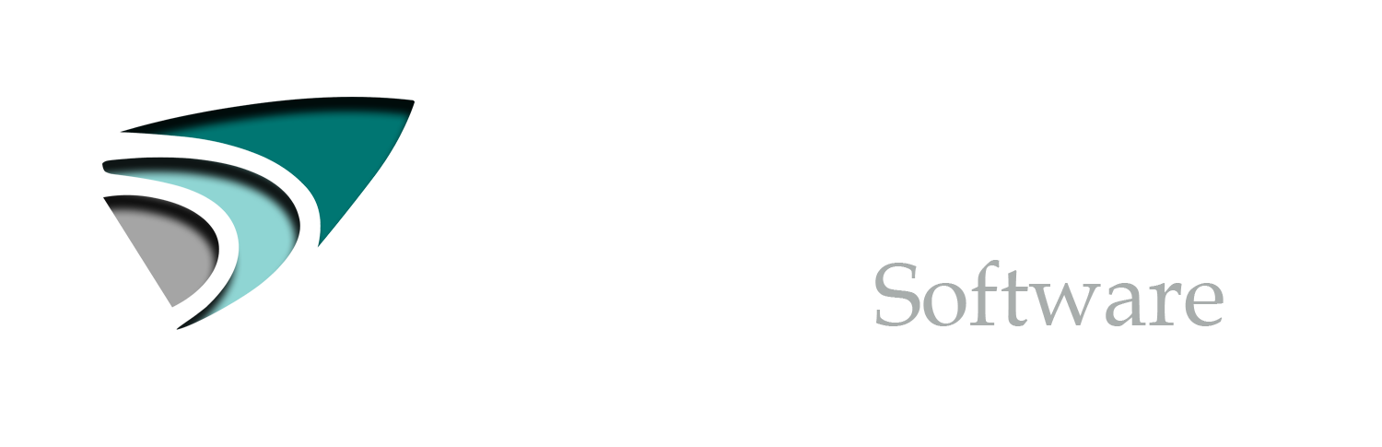
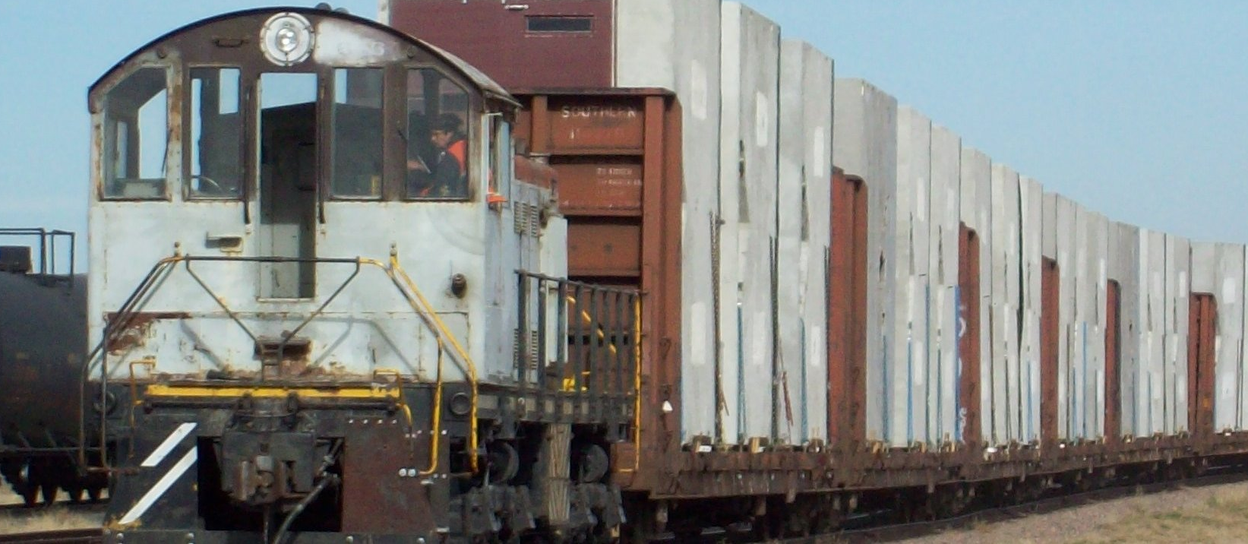
Rail terminal management Software

Slide 2
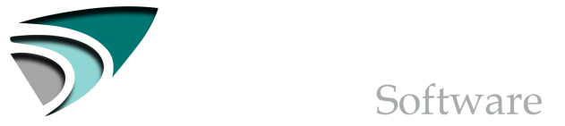

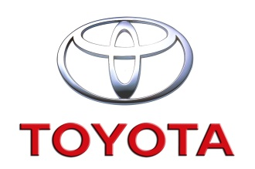
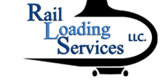
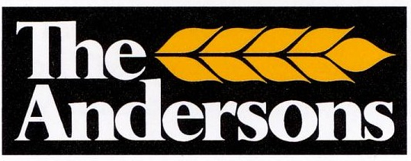
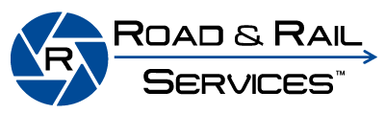

Corporate Overview
Founded as a result of direct experience owning and managing a rail yard.
Software cost must be scalable to the terminal that is using it.
Open the lower end market and provide competitive pricing for the higher end market.
Prepare our client to use the software and understand its functionality. The transition to our software must be easy and seamless. The client needs to understand completely and confidently how to use the software before purchasing it.
Confirm and determine that the client understands the cost of the software upfront.
Continue to grow our client base while never loosing the commitment to providing quick, honest answers, and cost effective solutions.
Our current clients will attest to and our future clients will unquestionably receive the most user-friendly and robust software solutions available to manage their rail terminals.

Slide 3
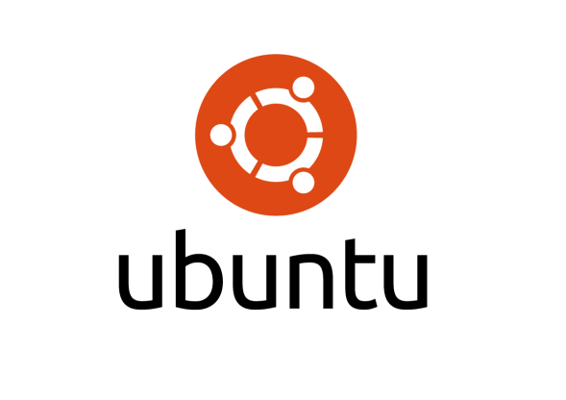
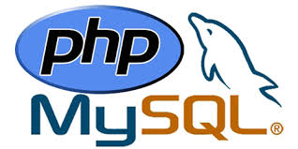
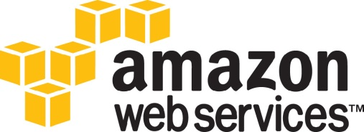
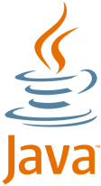

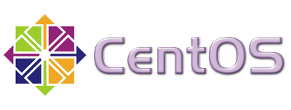
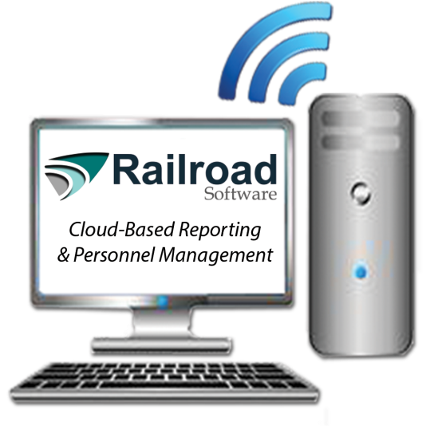
Product Overview
Technology
Easily operated and strait forward dashboard with drop down menus for uncomplicated management of your rail terminal.
Detailed inspection component with current and state of the art easy to use technology
Compelling transloading software. Mobile Data Collection, ERP Integration, Custom Ad-Hoc Reporting, Transload Customer Portal, and Scale House Integration.
Comprehensive and accurate corporate reporting
Web-Based Application

Slide 4
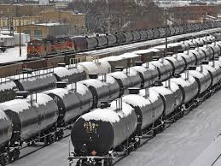
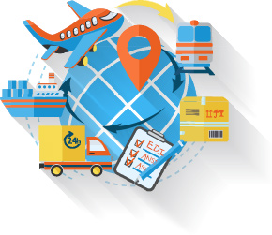
Software Features
Know where every rail car is all the time. Managing rail car locations within your terminal becomes simple and fast using our web-based or tablet application.
Manage rail transloading activities to and from a truck or vessel. The software allows the transload terminal operation to effectively and efficiently manage each transaction, decrease paper processing, and provide customers with live inventory and access to transactions.
Automated railcar inspections are now affordable and reliable. You can create unlimited inspection forms and assign specific inspections to individual users. No more paper, no more going back for photos, and no more sorting through the daily inspection sheets.
Built-in demurrage management functionality that maintains key data to track and respond to demurrage challenges.
Railroad Software has built a robust system for handling and generating EDI messages in order to automate data entry and communicate key pieces of data with the carrier.

Slide 5
Cost Savings & Efficiencies
Improved Yard Control
Corporate Analytics and Dashboards
Railcar Inspections
Maintain Railcar Statuses
Reduction in Human Error
Demurrage Management
Customer Portals
Functionality
Organization
Automation

