Slide 1
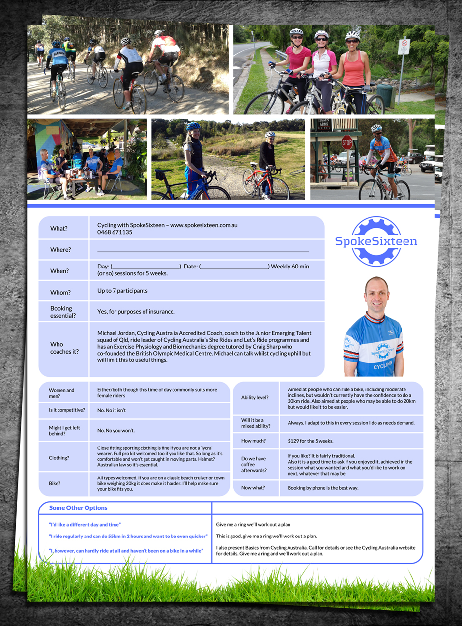

Hello,
This orange outlined box has a white fill for me to put things in.
Logo here please so we can have the grass and the top 5 photos in the same place as before please.
Thank you.

