Slide 1


HOME | BE PROPELLED | ABOUT US | APP GUIDE | CONTACT US
CHEMOWAVE helps give cancer patients more control over the ups and downs of chemotherapy.
LEARN MORE

Slide 2

HOME | BE PROPELLED | ABOUT US | APP GUIDE | CONTACT US
Cancer patients do not have to feel overwhelmed by chemotherapy any longer.
A lot can be done to control what you experience while undergoing treatment - many negative side effects can be significantly reduced, if not eliminated all together.
Our goal is to help you manage the emotional and physical rollercoaster of chemo - to provide some control in a seemingly out-of-control situation - to help you feel better and avoid feeling worse - to help propel you though chemotherapy.

Slide 3
HOME | BE PROPELLED | APP GUIDE | APP GUIDE | CONTACT US
CHEMOWAVE makes it easy to record and monitor every aspect of your chemotherapy experience and helps you understand how actions and activities impact the ups and downs of your condition.
CHEMOWAVE gives me the extra push I need to exercise, even when I can barely get out of bed, because I can see how tied my exercise is to whether I feel good or bad.
CHEMOWAVE made my children visit and call me a lot more because they could actually see how much better I felt after their visits.
CHEMOWAVE helped my doctor notice a medication I was taking was making me constipated. He prescribed me a different medication and my constipation was gone.

Slide 4
HOME | BE PROPELLED | ABOUT US | APP GUIDE | LEGAL | CONTACT US
DETAILS
A Daily Log to record how you feel and when you feel it - along with any symptoms, actions or activities you want to keep a record of.
A Timeline automatically updates to highlight when symptoms or condition shifts occur and tracks other important actions or experiences, like medication times, meals, sleep, appointments, exercise and more.
Trend insights help you identify potential relationships between your symptoms and how you feel with any logged activities and encounters.
Customizable Charts illustrate the ups and downs of your experiences for any given time period.
Sharable Reports can be printed or shared via email.
PRIVACY
We respect your privacy. All data saved to CHEMOWAVE is 100% confidential.

Slide 5

HOME | BE PROPELLED | ABOUT US | APP GUIDE | LEGAL | CONTACT US
CHEMOWAVE WAS CREATED BY PEOPLE WITH CANCER, FOR PEOPLE WITH CANCER.
We’ve been there. We understand.
A video from our founders, Ric and Matt. (coming soon)

Slide 6
HOME | BE PROPELLED | ABOUT US | APP GUIDE | LEGAL | CONTACT US
CHEMOWAVE IPHONE APP PRIVACY POLICY
ChemoWave (“We”) are committed to protecting and respecting your privacy.
This policy sets out the basis on which any personal data we collect from you, or that you provide to us, via the ChemoWave iPhone app will be processed by us. Please read the following carefully to understand our views and practices regarding your personal data and how we will treat it.
INFORMATION WE MAY COLLECT FROM YOU
We may ask you for information when you report a problem to us.
If you contact us, we may keep a record of that correspondence.
We will never disclose your information to third parties without your express consent, unless legally obliged to do so.
GOVERNING LAW
This Policy is governed by U.S. law and any dispute arising under or in connection with it shall be subject to the jurisdiction of the United States/California Courts.
WHAT WE DO WITH YOUR INFORMATION
ChemoWave provides a record keeping service, and personal insights based on the information collected.
Whether or not you decide to let ChemoWave write to your Apple device calendar (and permit it to be available through iCloud), or share information with your personal contacts is up to you.
You may at any time review, modify or remove any information you have inserted on your device or into your iCloud calendar. Please be aware that your data CANNOT be retrieved once deleted.
We cannot not be held responsible for the loss of any data specifically deleted by you.
CHANGES TO OUR PRIVACY POLICY
Any changes we may make to our privacy policy in the future will be updated in your app via the standard Apple app update process. We will not necessarily automatically inform you of any changes to this privacy policy, and accordingly you are responsible for checking for any changes.
CONTACT
Questions, comments and requests regarding this policy should be addressed to info@chemowave.com

Slide 7





HOME | BE PROPELLED | ABOUT US | APP GUIDE | LEGAL | CONTACT US
Sign up for updates or to be notified when CHEMOWAVE app is available.
Email Address (required)
First Name (required)
Last Name (required)
Questions or Comments
SUBMIT

Slide 8
alt home page options

Slide 9

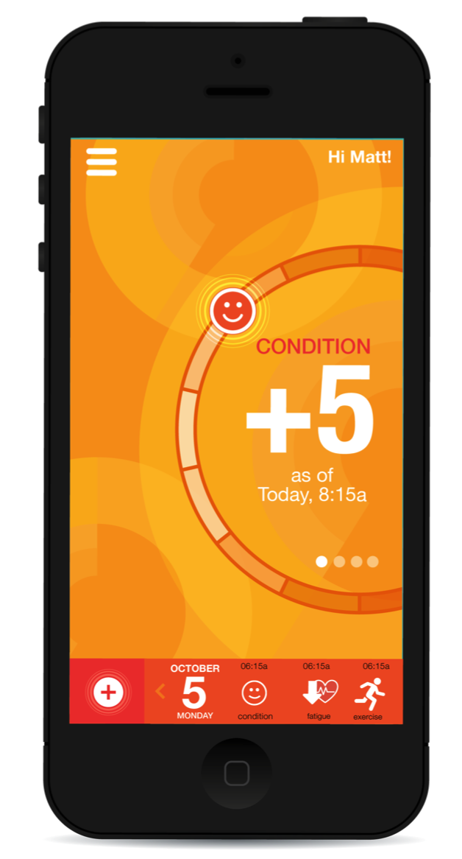
HOME | BE PROPELLED | ABOUT US | APP GUIDE | LEGAL | CONTACT US
CHEMOWAVE is a mobile application that propels cancer patients with more control over the ups and downs of chemotherapy.
LEARN MORE
ChemoWave was created by people affected by cancer – for people affected by cancer.

Slide 10

HOME | BE PROPELLED | ABOUT US | APP GUIDE | LEGAL | CONTACT US
CHEMOWAVE is a mobile application that propels cancer patients with more control over the ups and downs of chemotherapy.
LEARN MORE
ChemoWave was created by people affected by cancer – for people affected by cancer.

Slide 11
alt end page options

Slide 12

HOME | BE PROPELLED | ABOUT US | APP GUIDE | LEGAL | CONTACT US
Sign up for updates or to be notified when CHEMOWAVE app is available.
Email Address (required)
First Name (required)
Last Name (required)
Questions or Comments
SUBMIT
STAY CONNECTED

Slide 13

HOME | BE PROPELLED | ABOUT US | APP GUIDE | LEGAL | CONTACT US
Sign up for updates or to be notified when CHEMOWAVE app is available.
Email Address (required)
First Name (required)
Last Name (required)
Questions or Comments
STAY CONNECTED
SUBMIT

Slide 14

HOME | BE PROPELLED | ABOUT US | APP GUIDE | LEGAL | CONTACT US
Sign up for updates or to be notified when CHEMOWAVE app is available.
Email Address (required)
First Name (required)
Last Name (required)
Questions or Comments
STAY CONNECTED
SUBMIT

Slide 15
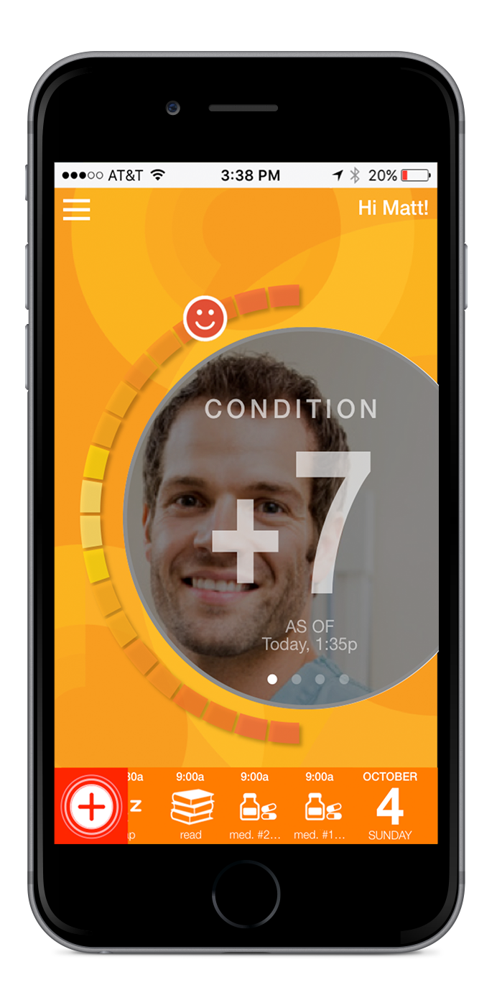
HOME | BE PROPELLED | ABOUT US | APP GUIDE | LEGAL | CONTACT US
CHEMOWAVE is a mobile application that propels cancer patients with more control over the ups and downs of chemotherapy.
LEARN MORE

Slide 16
HOME | BE PROPELLED | ABOUT US | APP GUIDE | LEGAL | CONTACT US
CHEMOWAVE is a mobile application that propels cancer patients with more control over the ups and downs of chemotherapy.
LEARN MORE

