Slide 1


Slide 2

Cancer patients do not have to feel overwhelmed by chemotherapy any longer.
A lot can be done to control what is experienced while undergoing treatment - many negative side effects can be significantly reduced, if not eliminated all together.
ChemoWave makes it easy to keep track of ups and downs and to identify the activities and experiences that are tied to feeling better and worse.
Our goal is to help patients, caregivers and doctors better manage the emotional and physical rollercoaster of chemo - to provide some control in a seemingly out-of-control situation – to help patients feel better and avoid feeling worse.

Slide 3

ChemoWave equips patients, caregivers and their doctors with valuable insights and easy tools to help better control the ups and downs of chemotherapy treatment.

Slide 4
A Daily Log helps keep track of your condition and any symptoms, actions or activities you experience.
NOTE: ChemoWave V1.0 requires manual entry, V2.0 will sync with peripheral devices and tracking apps.

Slide 5
A Timeline automatically updates to highlight when symptoms or condition shifts occur and also tracks other important actions or experiences, like medication times, meals, sleep, appointments, exercise and more.
Note: Entries are editable.

Slide 6
Trend Insights and Customizable Charts help you monitor your condition and identify potential relationships between symptoms, how you feel and any other logged activities and encounters.
NOTE: V1.0 Insights will highlight personal trend information. After enough data is collected, ChemoWave Insights will involve more sophisticated analysis (i.e. correlations, predictive analytics, etc.)

Slide 7
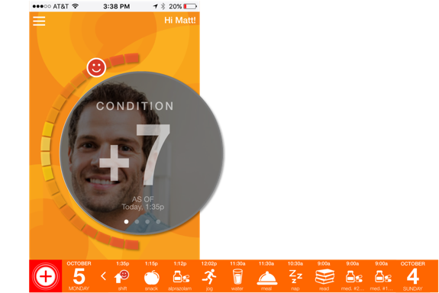
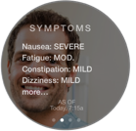

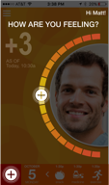
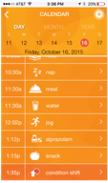
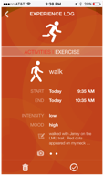
HOME SCREEN – MAIN
Touch Hamburger Menu Icon – Main Menu slides in from left.
Swipe Left on Main Menu to get back to Home Screen
Touch Greeting to access “Log Out” Screen
Touch Condition Status Icon (OR) Touch Condition Status to update shifts in User’s Overall Condition .
Swipeable
Swipeable
Touch Entry Shortcut Icon to log activities, experiences, etc. Experience Log Menu moves in from Right.
Touch Calendar Shortcut to access Detailed Calendar. “Today” moves in from Right.
Touch Logged Entry Icons on Bottom Tray to edit past entries. Editable Experience Entry moves in from Right.
MAIN MENU
HRU SCREEN
EXP. LOG MENU
CALENDAR
EDITABLE ENTRY

