Slide 1
BE PROPELLED ~ IMAGES

Slide 2




Hi Ric!
••••
OCTOBER
1:30p
1:28p
1:25p
5
⌃
MONDAY
shift
snack
medicine

Slide 3
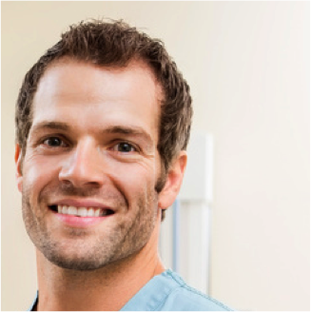


Hi Jeff!
••••
NOVEMBER
8:05p
6:30p
6:30p
10
⌃
TUESDAY
shift
water
meal

Slide 4
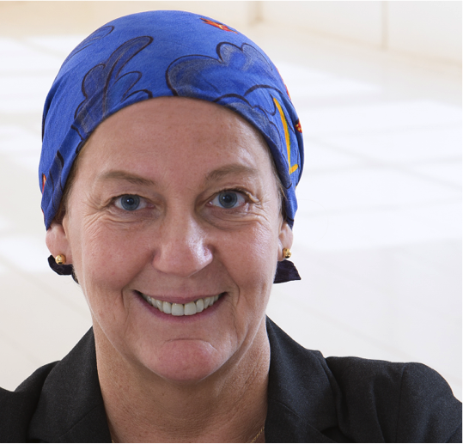


Hi Nancy!
••••
APRIL
12:30p
1:10p
12:00p
2
⌃
THURSDAY
nap
read
shift

Slide 5


Hi Michael!
••••
FEBRUARY
10:30a
10:00a
9:46a
2
⌃
TUESDAY
jog
shift
meal

Slide 6
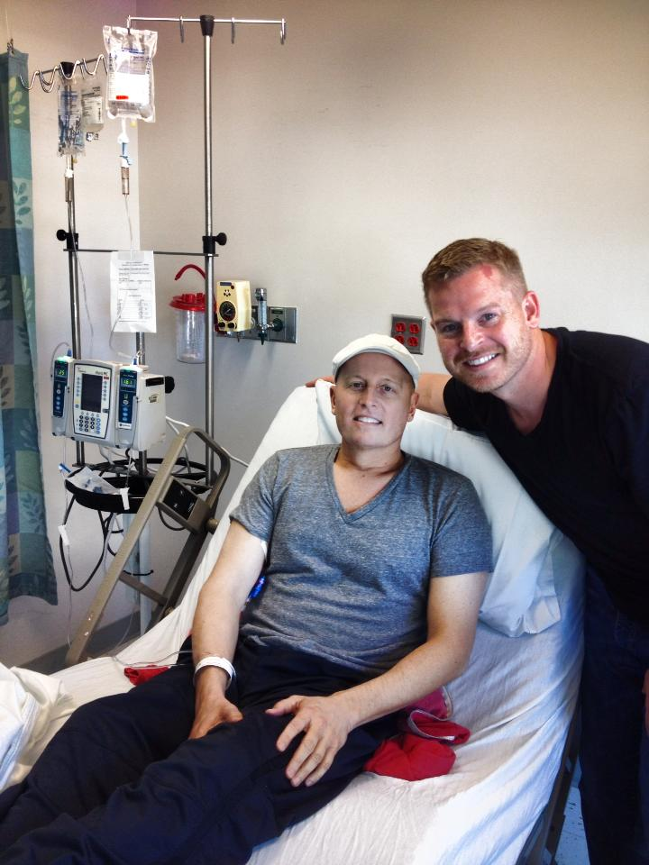
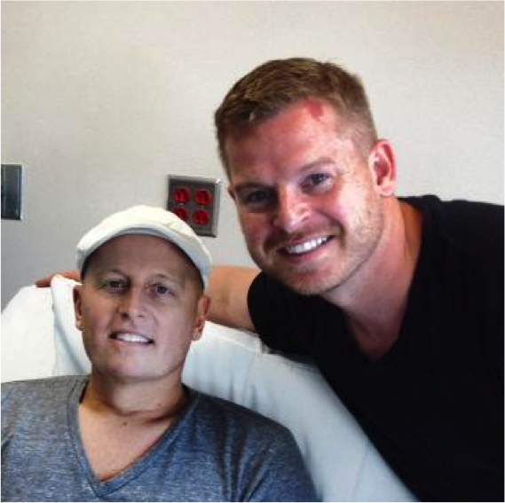
ABOUT US ~ IMAGES

Slide 7
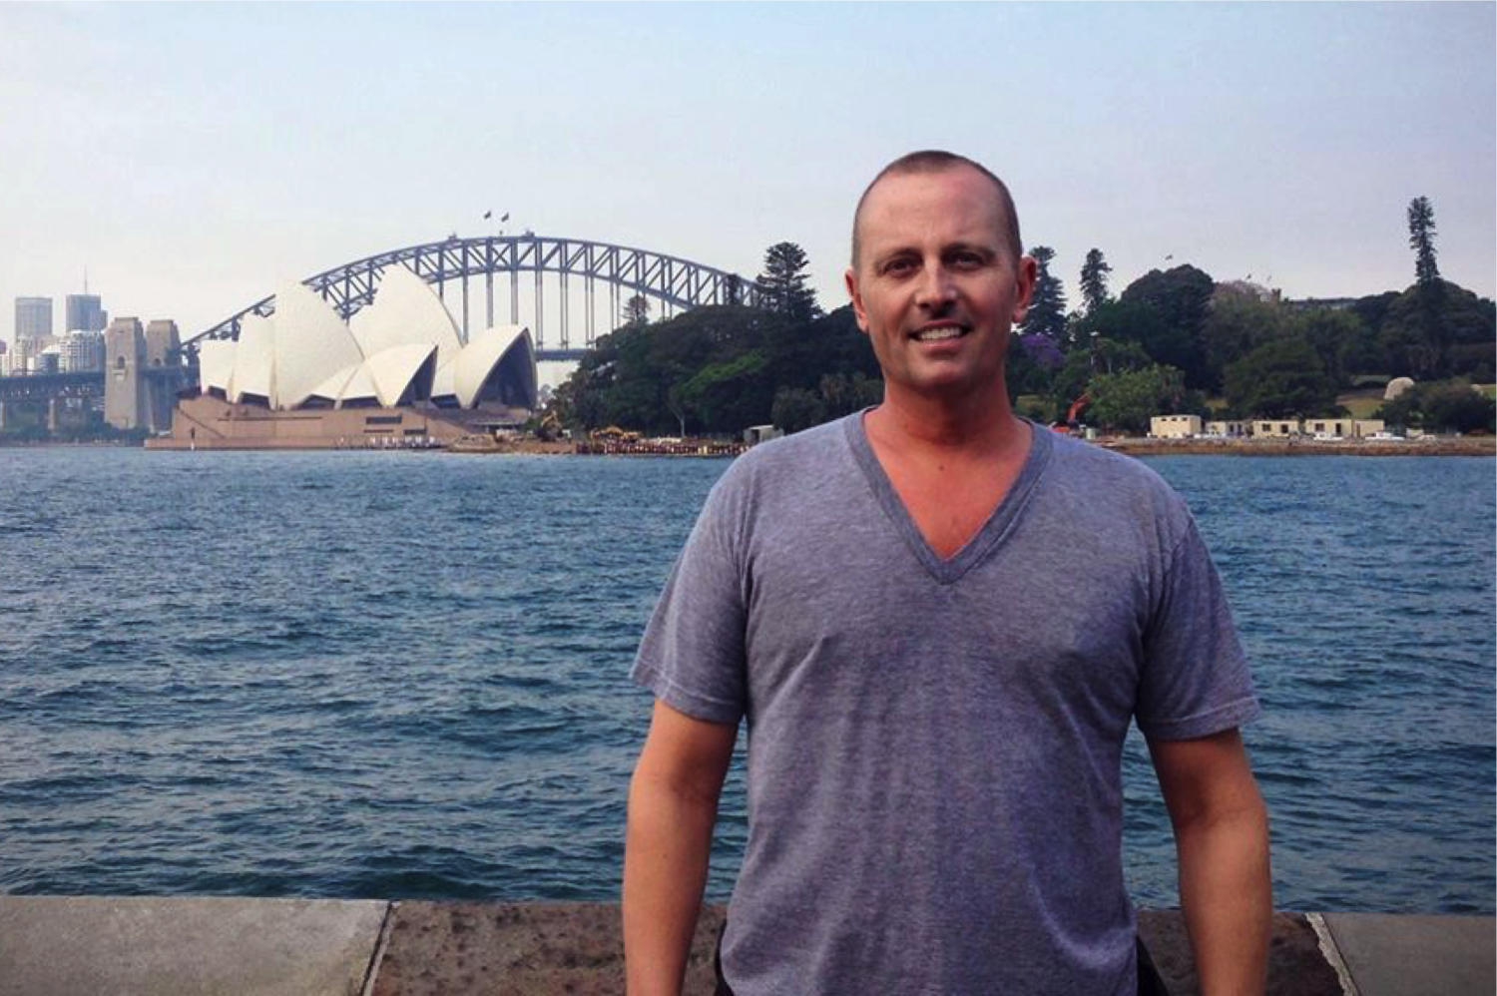
ABOUT US ~ IMAGES

Slide 8
APP GUIDE – TOP IMAGE

Slide 9
APP GUIDE – DAILY LOG IMAGE

Slide 10
APP GUIDE – TREND INSIGHTS IMAGE

Slide 11
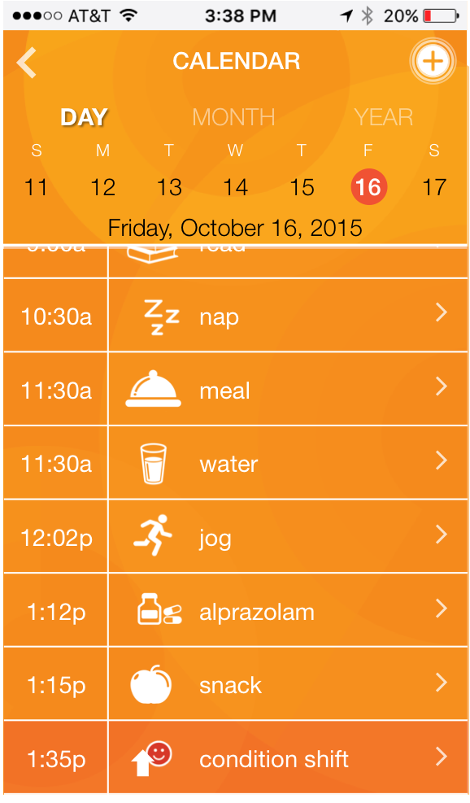
APP GUIDE – TIME LINE IMAGE

Slide 12
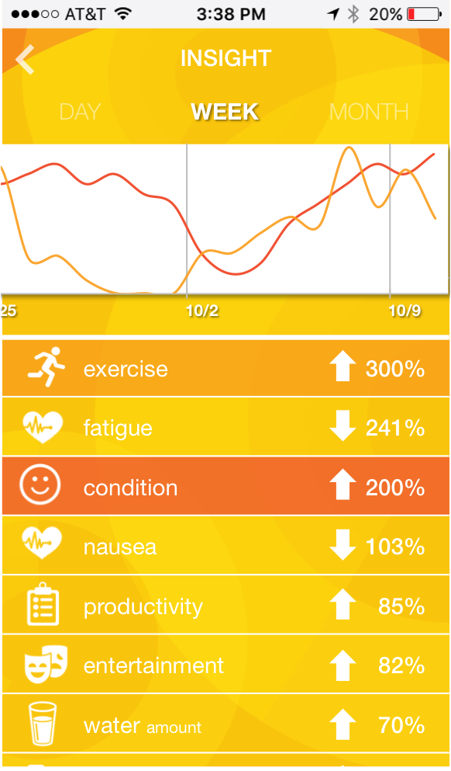
APP GUIDE – Custom Charts IMAGE

