Slide 1
BUDDY
Feeddback & Gamification Based Performance Management System

Slide 2
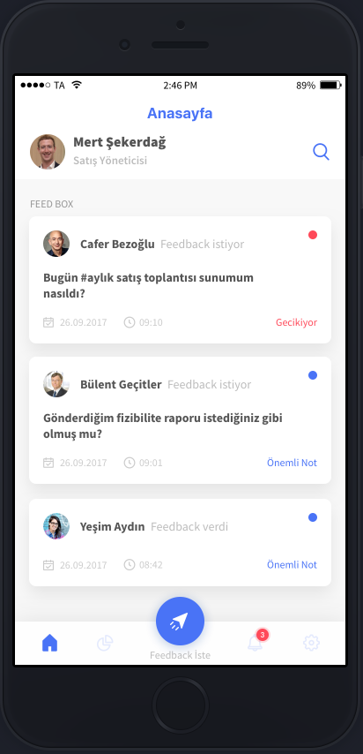
Buddy
«Timely Feedback» and «Gamification» based new generation Performance Management System

Slide 3
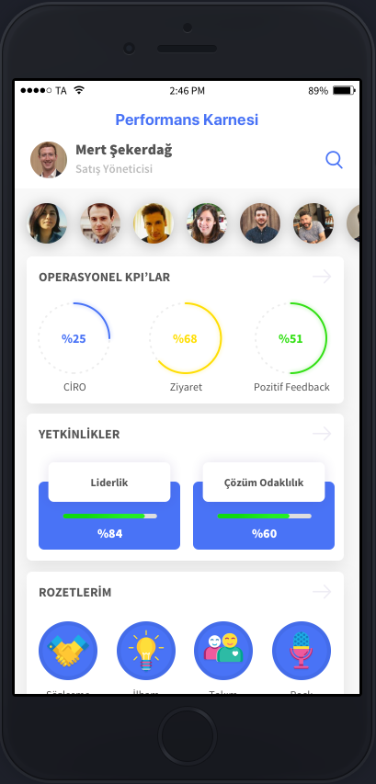
Buddy
The main aim is to measure behavioral performances of employees by enabling them give&receive timely, actionable feedback and adding FUN to the performance evaluation process

Slide 4
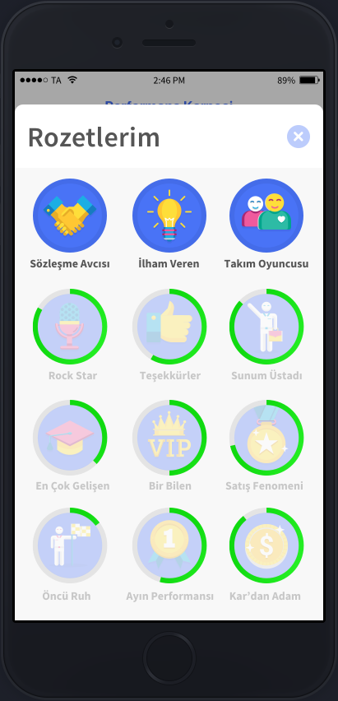
Buddy
After each presentation, report, meeting or a corporate event, people ask their managers,peers and teammates their opinion and receive a feedback attached to their competency targets.

Slide 5
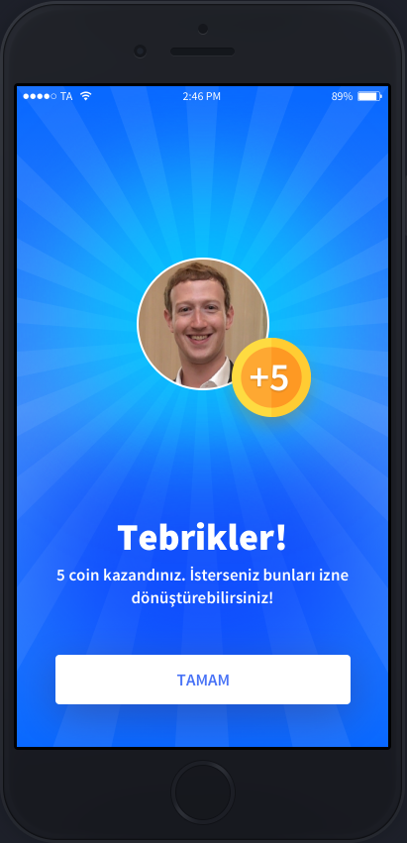
Buddy
These feedback activities bring employees several awards: performance points, coins and badges.

Slide 6
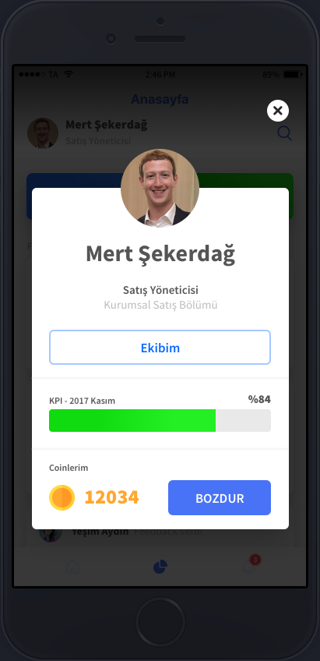
Buddy
Performance Points, Coins, and Badges can be converted to different type of benefits. (additional vacation, gift card, club memberships etc.)

Slide 7
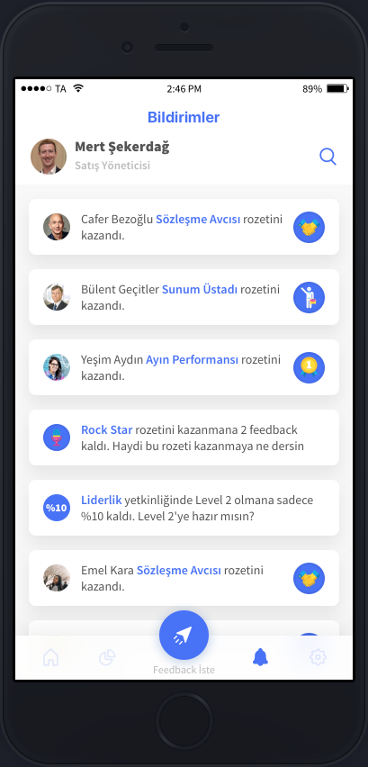
Buddy
Also their performance points and badges can be seen as a notification (similar to feeds in Facebook) by the rest of the organization which means that their work is appreciated and recognized by the company and their teammates.

Slide 8

Buddy
Buddy combines & provides similar user experiences with some of the popular social media apps like; Facebook, Instagram, Tinder, LinkedIn and Twitter to its’ users.
So our expectation from the logo is to contain similar elements from these app logos so people can receive friendly messages from Buddy.

Slide 9
Buddy
THANK YOU !

