Slide 1
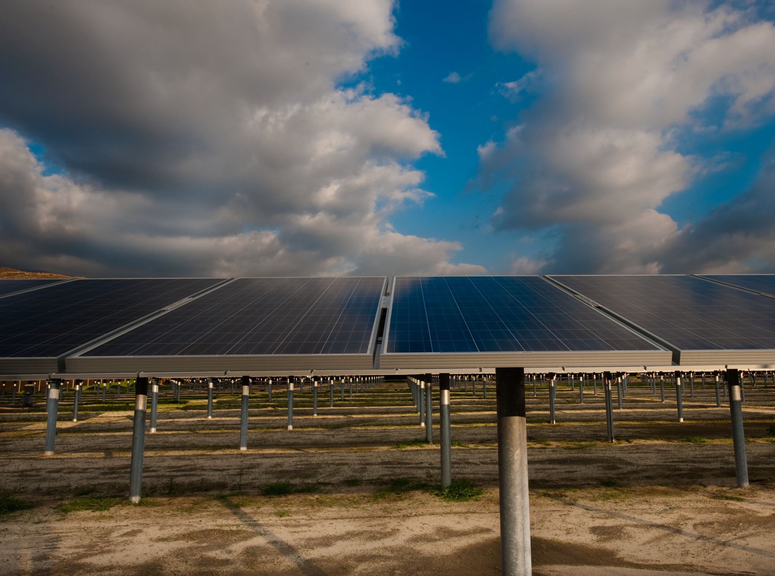
Notes:
Harrah’s

Slide 2
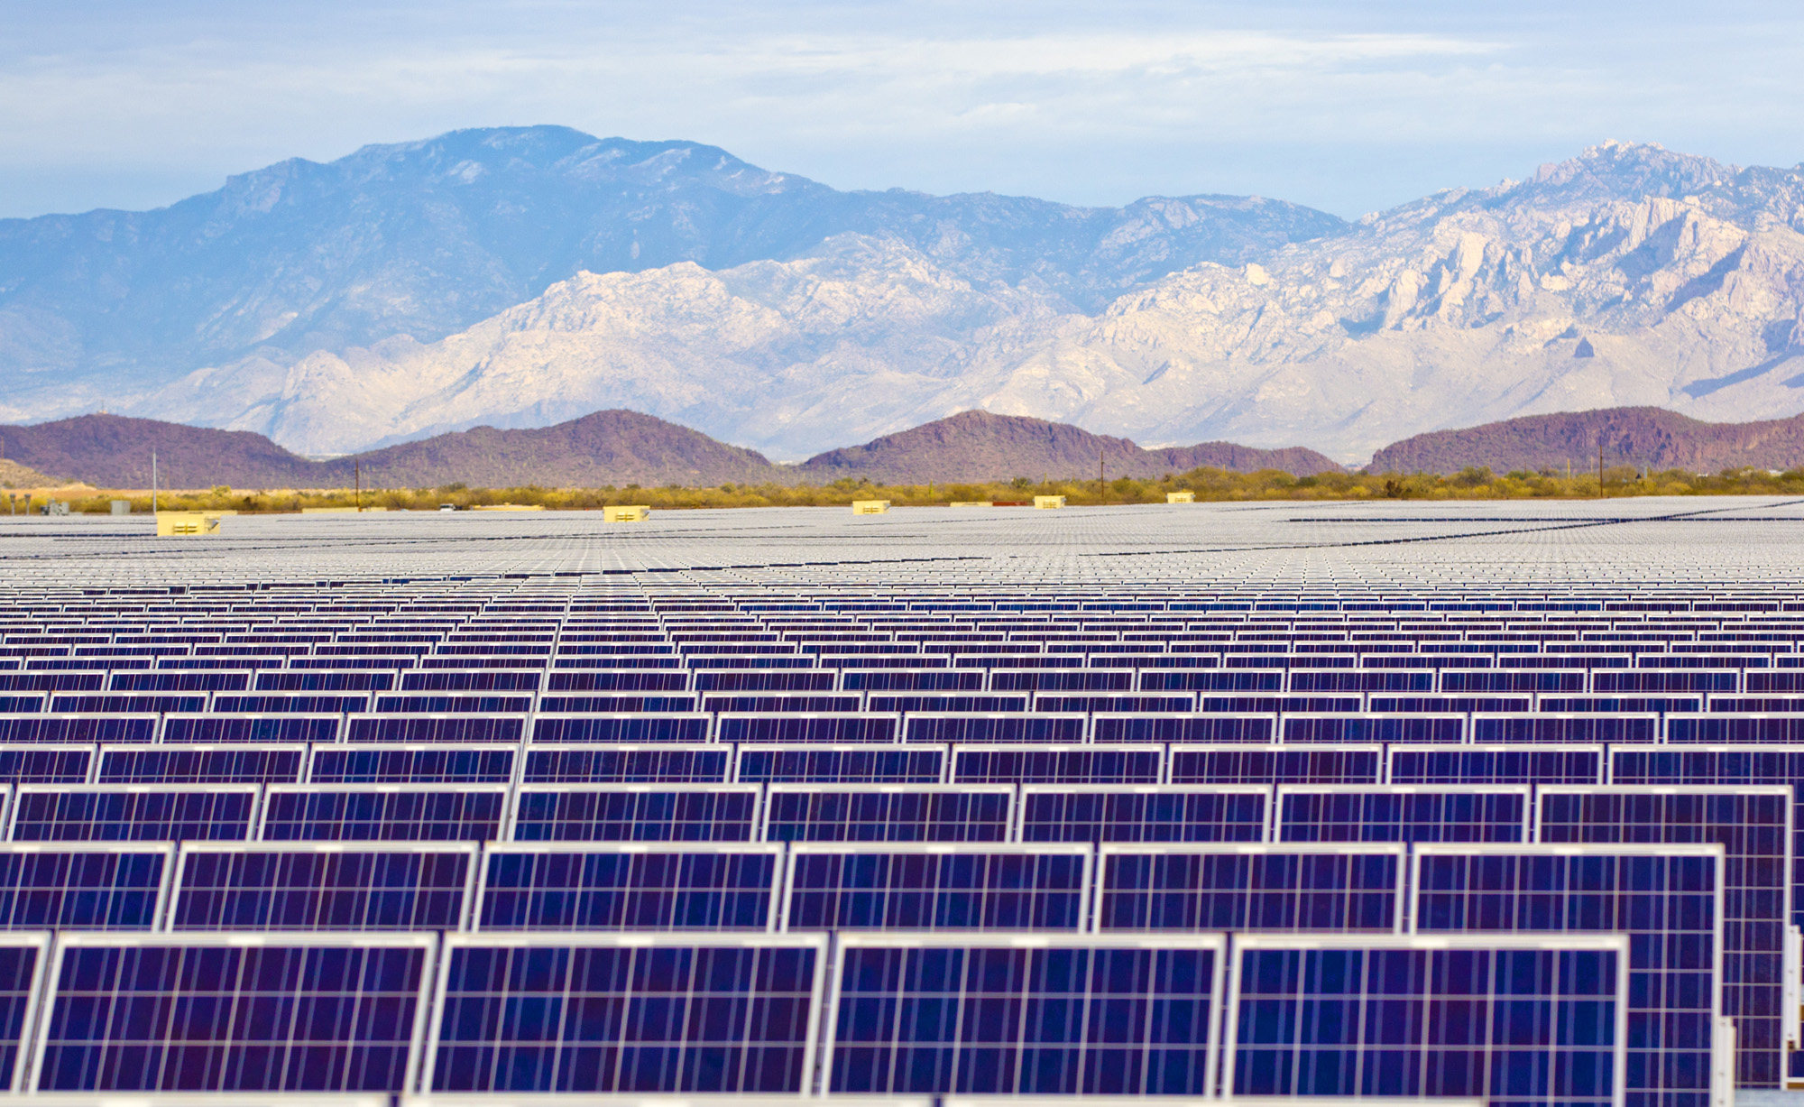

Slide 3
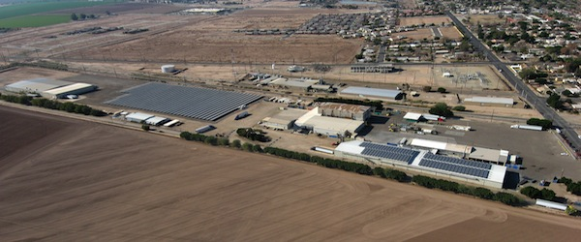
Notes:
2.2MW Five Crowns Cooling

Slide 4
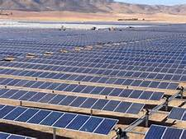
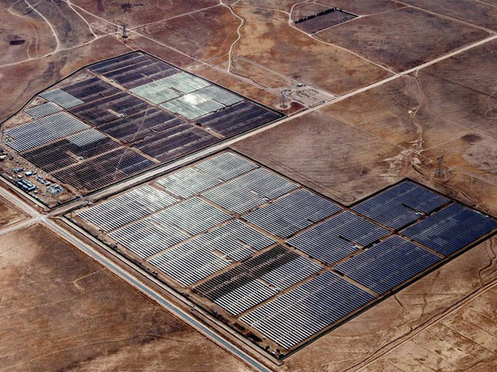
Notes:
TA Acacia

Slide 5
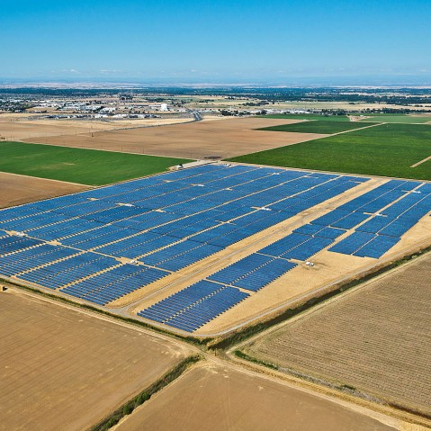
Notes:
SMUD Kammerer

Slide 6
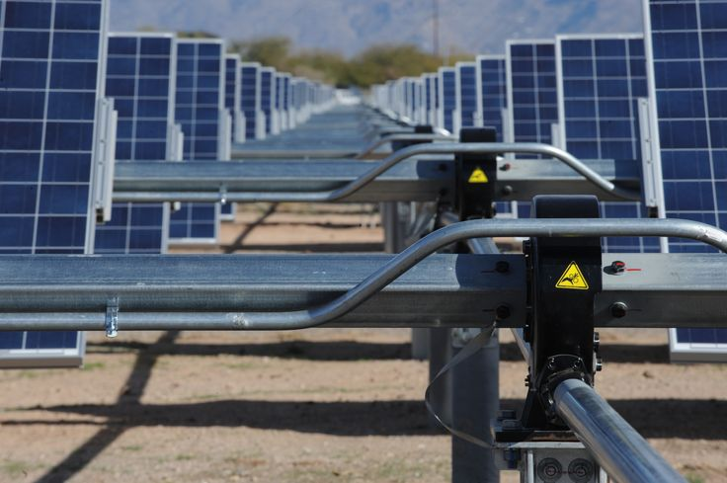
Notes:
Davis Monthan AFB

Slide 7
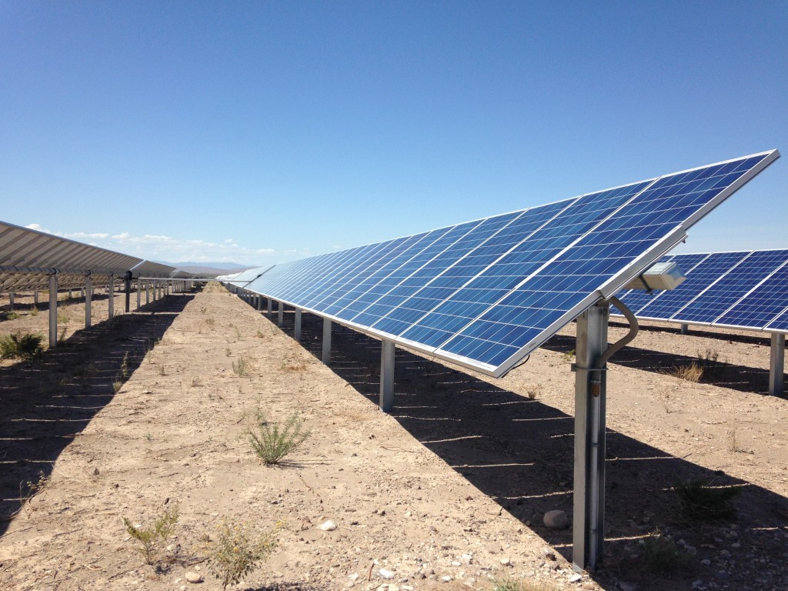
Notes:
Acacia Solar 16MWdc

Slide 8
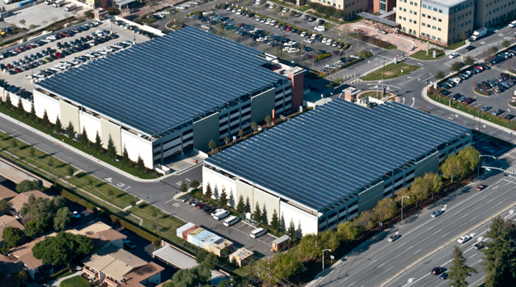
Notes:
Kaiser Medical Office Portfolio I-

Slide 9
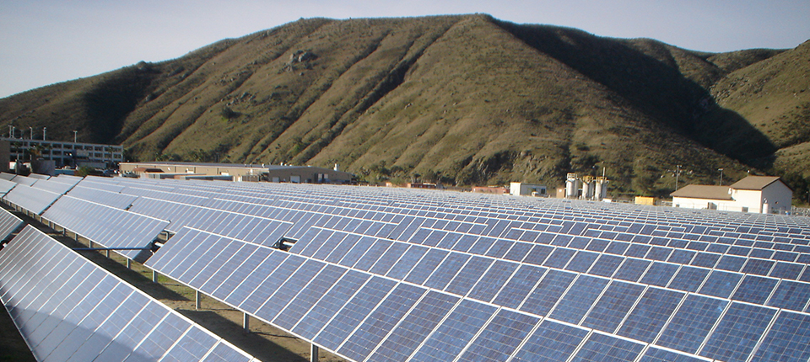
Notes:
Harrah’s Rincon Solar 1.25MW

