Slide 1
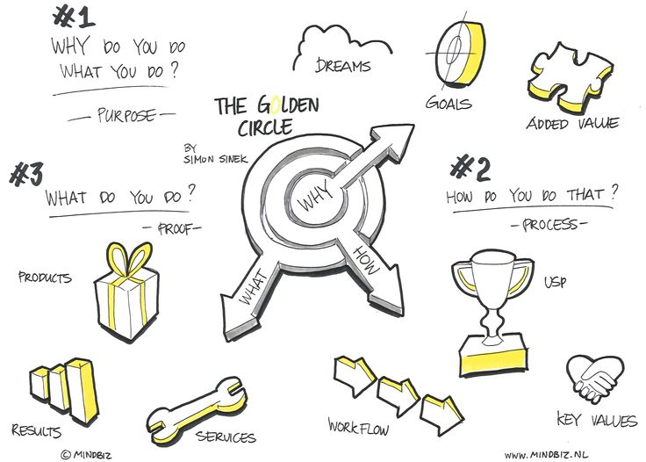
Notes:
This is very much the style guide – the yellow would be blue but otherwise this ‘style’ is exactly what I’m looking for

Slide 2

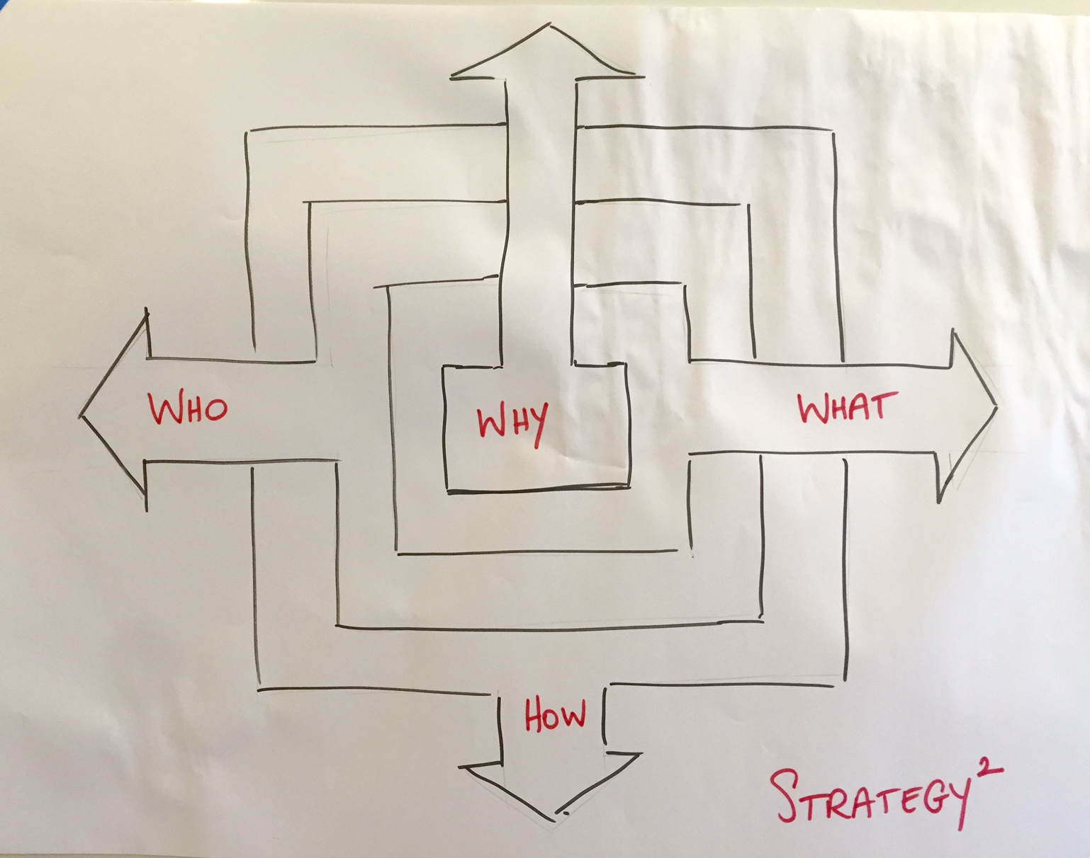
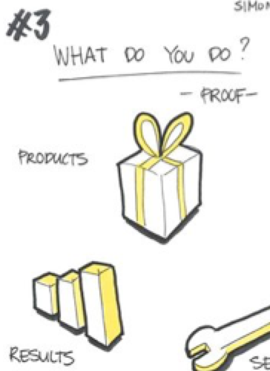



Destination [could b the icon from a SatNav]
‘Iconic figure’ icon [aspire]
Goals icon i.e. could literally be football goals
[goals]
#2
#3
To whom do you do it?
- People -
- Productise -
Services
icon
[services]
Geography icon
[globe?]
Target icon
#4
#4
How do you do it?
- Process -
Angels advocate icon
[mastery]
www icon
[marketing]
Dollar icon [monetise]
Notes:
So. This version is called ‘The Solution2’ by Mat Lock. The idea is that its represented in the same style as the Golden Circle but in this case, as it is square, there are 4 ‘segments’, each with three icons.
As you will see; the 4 segments are:
#1 Why you do what you do? – Purpose -
#2 What you do? – Productise – [please note: UK spelling ☺]
#3 Who do you do it to? – People –
#4 How do you do it? – Process -
I’ve tried to give examples of the icons for each – otherwise I have simply added a name/description

