Slide 1
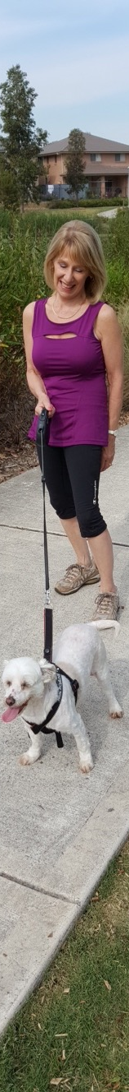
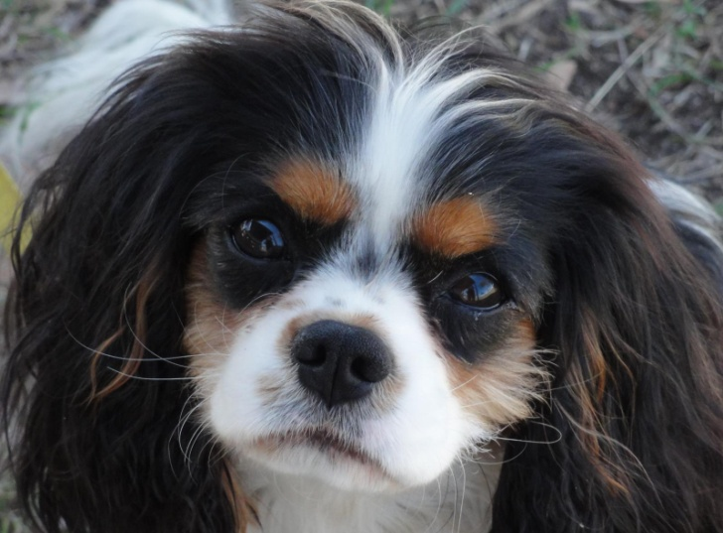

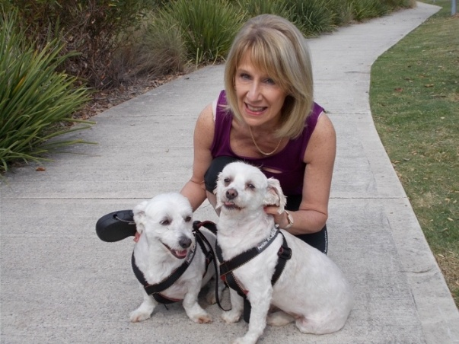

Personalised Service
Vicki’s
Pet Sitting
Home Care &
Dog Walking Service
Vicki’s Pet Sitting Home Care &
Dog Walking Service
Home care visit (up to two pets) $30
Includes 15-minute walk (dogs), feeding, clean water, picking up poop or cleaning litter tray, pats and stimulating play
Second visit (same day no walk) - $15
Extra services per visit if required FREE of charge:
> Meet and greet beforehand
> Pet brushing
> Administering pet medication
> Photo and update of your pet sent to you during each home visit or dog walk
> Mail & newspaper collection
> Bin collection
> Plant watering
30 minute dog walking service $20
Includes walk on a leash, drink of water and lots of pats!
Please note: $15 surcharge on public holidays
Let me treat your pets like
they are my own
Bookings & Enquiries:
0412 883 068
For a FAQ sheet or more information email:
petsittinghomecare@gmail.com
www.vickipetsitting.com.au
ABN: 94 338 056 026
Like me on Facebook:
facebook.com/vickispethomecare
> Pet Sitting
> Pet Home Care
> Dog Walking
Servicing Kellyville, North Kellyville, The Hills District and surrounding areas
Vicki McConnell
0412 883 068
petsittinghomecare@gmail.com
Fully insured & police checked

Slide 2
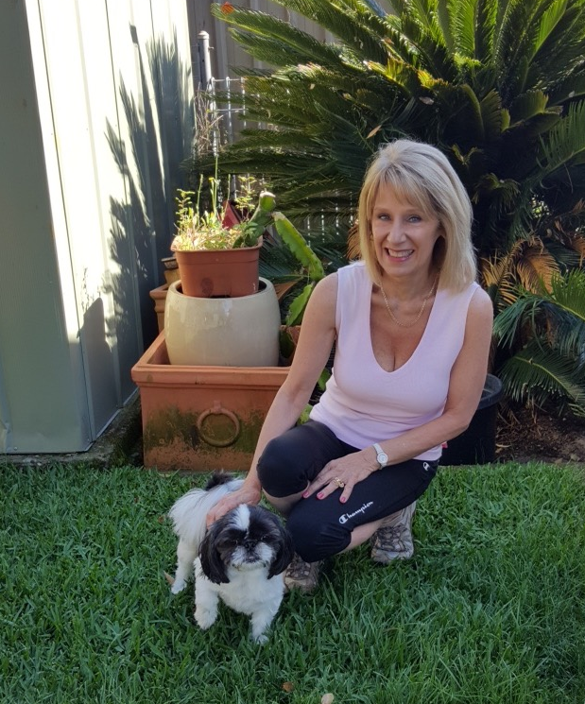
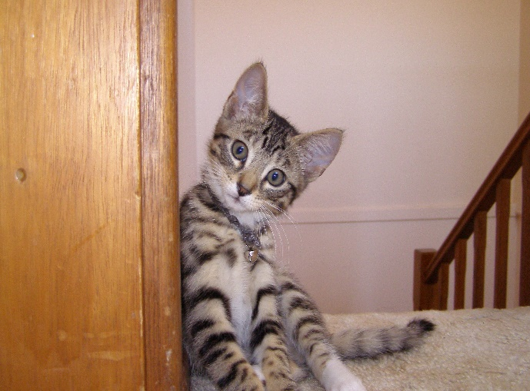
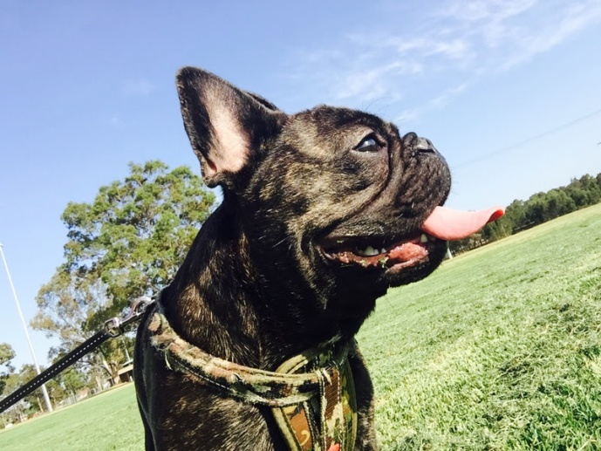
Testimonials from Clients
“If you are going away for a short break or well-deserved holiday, I understand sometimes you can’t take your pets with you. I can feed, play with and walk your pets until you get back.”
“I was recently called away from my home for several weeks and didn’t have anyone I could trust to take care of my two dogs Milly and Monty. Vicki walked and played with them and gave them daily cuddles, fresh water and food. More importantly, I had peace of mind that my babies were being looked after. I returned to two very happy dogs and would definitely recommend Vicki’s services.”
– Vicki Fowler, Waterside NSW
Vicki McConnell – Owner
Vicki’s Pet Sitting Home Care
& Dog Walking Service
Benefits of Pet Sitting
Pet sitting in your own home or hiring the services of a dog walker is a convenient option if you are:
> Going away for a short or extended period of time
> Time poor due to work, family or other commitments
> Physically unable to care for your pets the way you would like
I understand that your pets are part of your family and are used to their routines. It is my absolute pleasure to be able to look after your pets, either temporarily or on a regular basis.
I’ve always been a lover of animals ever since I was a little girl. After pursuing a long career in the corporate world, I am now enjoying a new phase in my life doing what I love - caring for your furry and feathered friends. Goodbye rat race, hello dog’s life!
“Vicki has looked after our Poppet and has thoroughly enjoyed her time with her. You can tell Vicki really loves animals and is a warm and genuine person. Vicki gives Poppet lots of cuddles and attention. I have no hesitation in recommending Vicki’s services to anyone needing a little extra care for their special pets.”
– Sharn and Margaret Spicer, Baulkham
Hills NSW
“Minding your pets in their own environment is the perfect solution for them and gives you peace of mind. I treat your pets like they are my own.”

