Slide 1



Business Partnership Review
January 21, 2016
Sound Technology Inc. , 401 Science Park Rd., State College, PA
Prepared for: Sound Technology Management Team
Brian Wilhelm -- Materials Manager
Ted Sutton – Comptroller
Kurt Ferster -- Facility Manager
Travis Orso -- Purchasing
Kelly Jo Sadley – Purchasing
To be determined -- Production Managers
Notes:
We appreciate you allowing the opportunity to present the information that follows.
If you have any questions do not hesitate to pose them at any time during the presentation

Slide 2
Agenda
Introductions
Brief Historical CE3S business review
Customer Testimonials and Conclusions
Value Perception
Point of use concepts and holding /storage areas
Cost Savings Initiative Quote Review
What’s in the future
Notes:
Harold Gentzel Outside Sales – Strategic VMI Development
Roy Hoffman Vice President
Don Smeltz President
Add short resumes for each of us

Slide 3

ce3s
Business & Relationship review
Founded in 1962
Installed our 1st VMI program 1994
Introduced VMI concept to Sound Technology February 2002
Customer Testimonials
Notes:
Cumberland Electronics Inc. was founded in 1962 in Carlisle Pennsylvania, USA. -- 53 years serving our customers
1st VMI --- 1994 C-Cor Electronics now Arris corporation supplied 4 Facilities state side 1 facility in Mexico
Ford Motor / Visteon Corp. -- Cumberland was chosen to be a model for there Commodity Management Program
Have been operating a VMI concept and bring cost savings to the Our VMI Customers for over 20 years
Have been operating a VMI concept and bring cost savings to the State College facility for over 17 years
Over the years we have always adjusted to and met the demands of the Sound Technology manufacturing requirements
Have invested over $1 million in IT infrastructure over the last 5 years to better manage and leverage the supply chain process
We have had to sell our capability to many over the years -- thru the changes of corporate ownership and management teams

Slide 4

ce3s
Notes:
CE3S President Donald Smeltz had been on the Board of Directors for Edge for over 10 years
Edge is a distributor-owned buying and marketing group with the strength, expertise, inventory and foot print equivalent to that of the larger national distributors.
We have strategic partnerships with top industry manufacturers and suppliers that have more than 300 product lines.
Distributor members have over 170 stocking locations, more than $90 million in inventory, and approximately $700 million in annual sales.

Slide 5
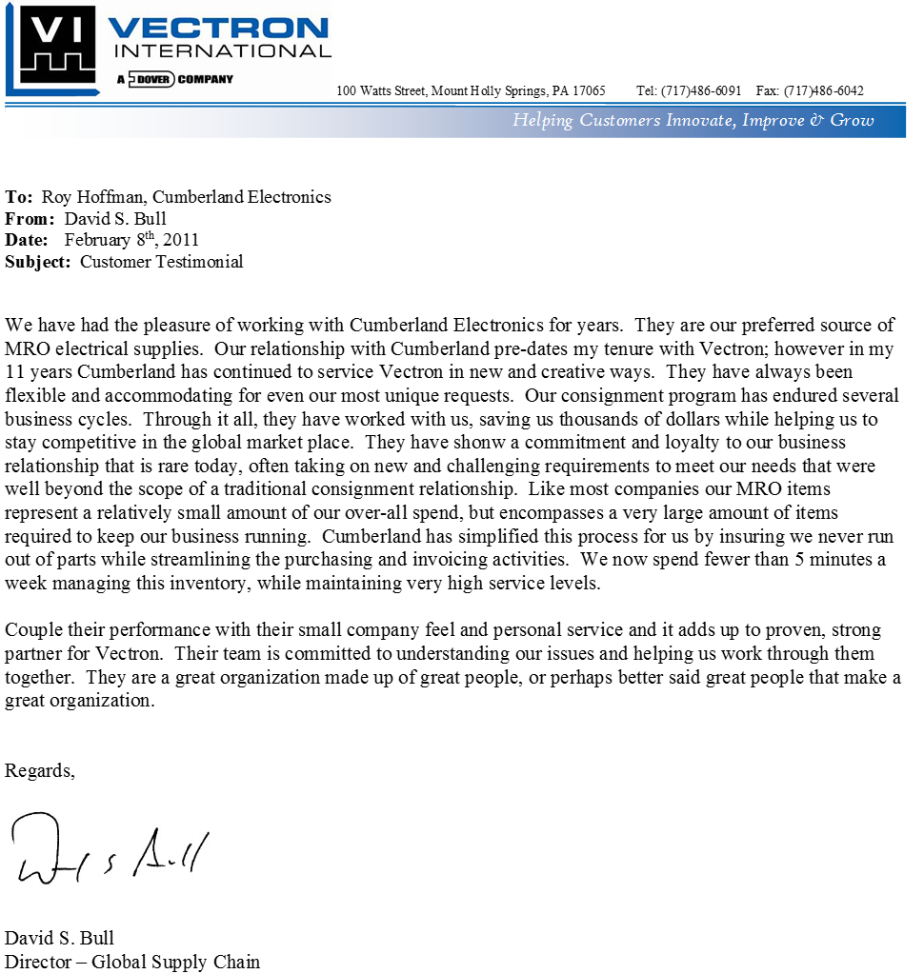
ce3s
What our customers have to say:
Notes:
Oak Industries, Piezo Electronics, McCoy Electronics --- VECTRON INTERNATIONAL LLC, --- Shanghai Apex Electronics Tech ---Pudong Shanghai China

Slide 6
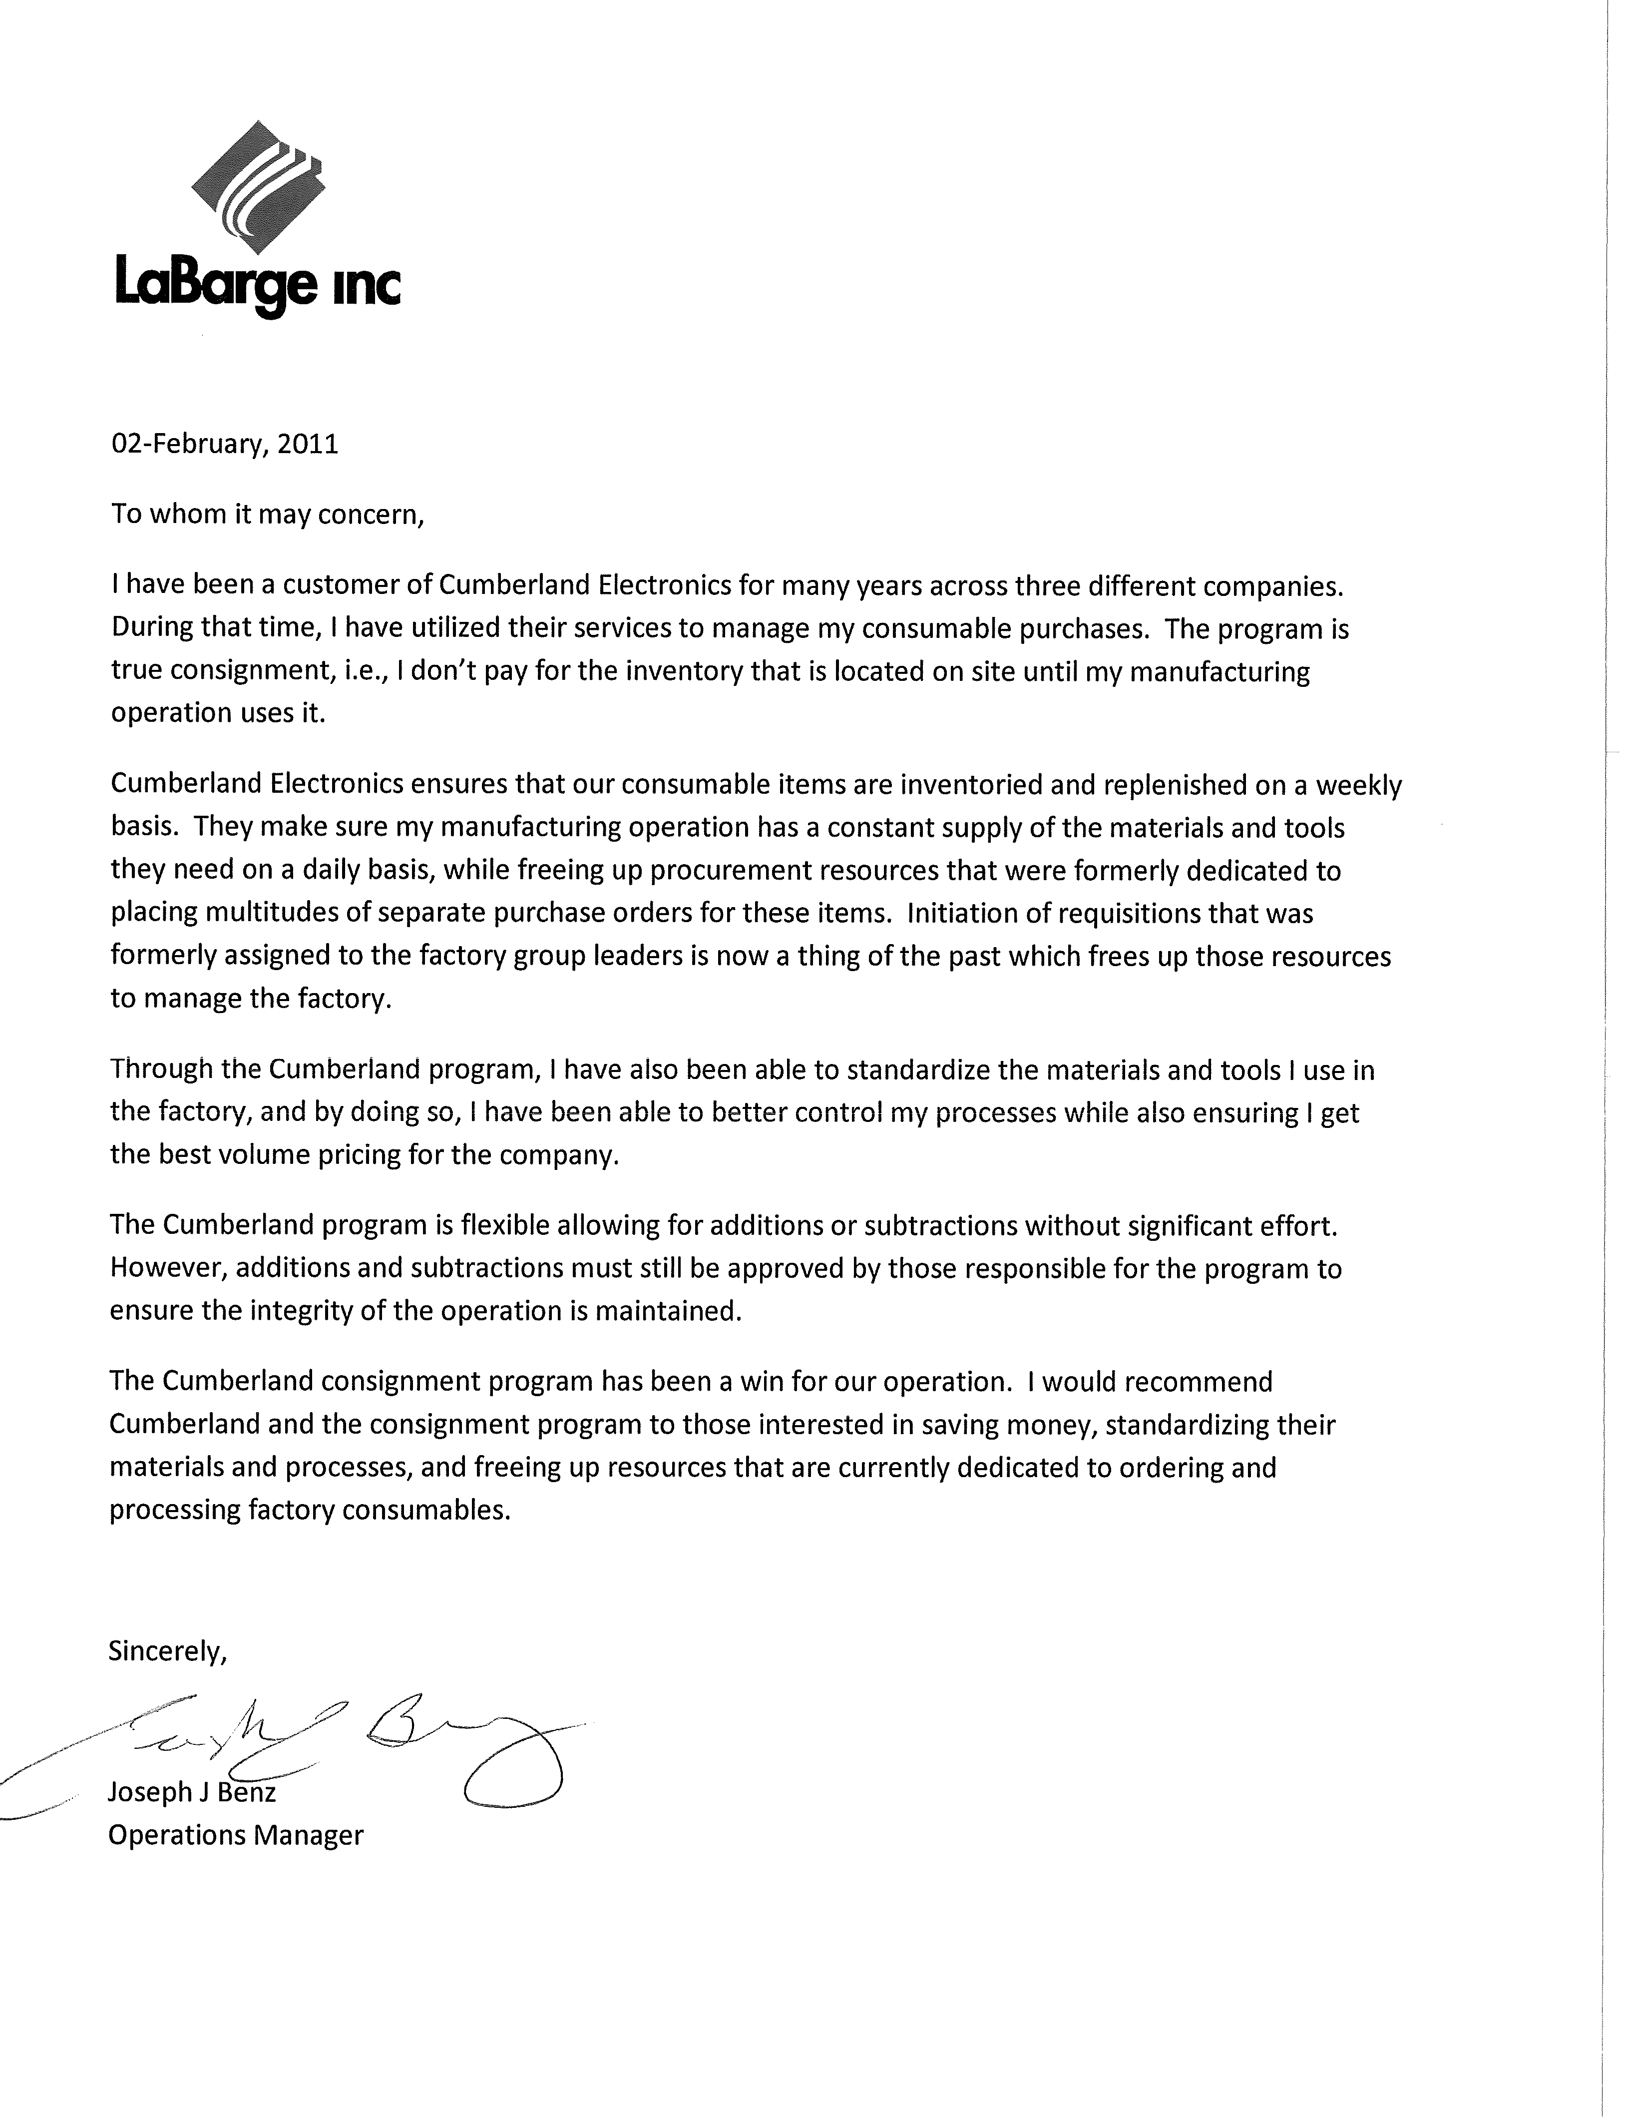
ce3s
Notes:
All of these companies were completely different in their end product offering

Slide 7
ce3s
VMI Value Perception
Notes:
LEAN Initiative
Manufacturers have always struggled to get better control of MRO costs and inventory management as part of LEAN programs.
CE3S has proactively brought these programs as a value-added service and function to help Sound Technology to help achieve the following goals:
Reduce MRO costs through improved usage and tracking data
Do more with less by leveraging technology and investing in state of the inventory management systems
Accommodated manufacturing plant redesign / remodeling ---- implemented changes on very short notice
Set-up and maintained in-plant POU areas in an effort to reduce waste and control cost for certain products and commodities
Replenish from main and satellite warehouse people in-plant 2-3 days a week 5 days a week to meet shift load
Improved POU stocking areas , reduced inventory to accommodate space constraints , ----- replenish more frequently
Compliance labeling and date code / shelf life management
Work directly with plant personnel / Supervision and Purchasing to facilitate their work effort

Slide 8
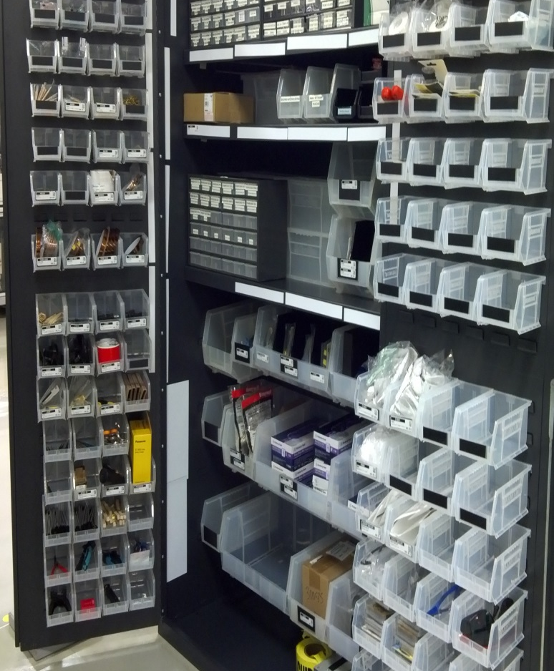
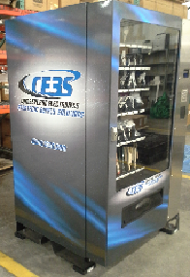
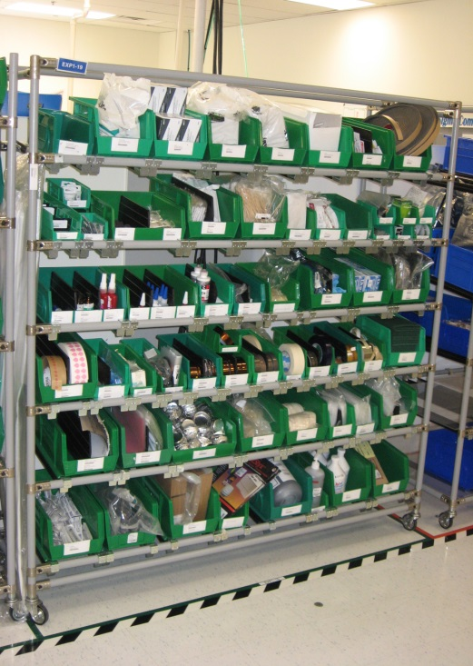
Point Of Use Storage Options
Stationary or Mobil Racks and Cabinets
Notes:
We have a variety of Point of use solution currently in use at other VMI facilities
We provide hybrid system which utilizes various concepts to improve worker productivity through best-practice point-of-work / use solutions
Our solutions provide higher density / lower cost solutions
Need to define and understand the cost of accountability -- don’t wrap $ around pennies
If need be can supply cabinets with higher levels of security / accountability --- mag-lock / prox card reader
Our supply process is fully auditable from our shelf to yours – pack line scan – license plate -- geo fencing
** Storage location / area
** Type of storage – cabinets , rack, regenerator
** Type of bins
implement of Microsoft Dynamics ERP system
Implementation of Web based inventory system
Customized reporting to capture usage trends, job costing, etc.

Slide 9
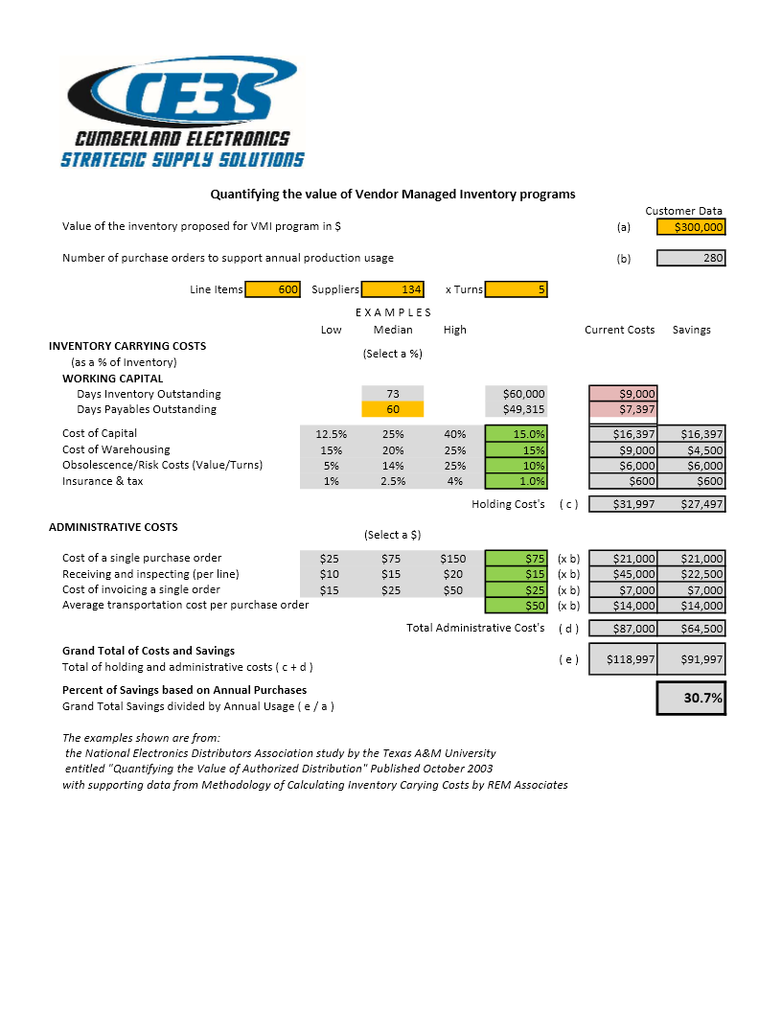
ce3s
Notes:
The figures used in this example are based on actual data
Our vendor managed solution is a true consigned product solution POU unlike POR
Our vendor managed solutions minimize exposure
Our vendor managed solutions minimize obsolescence
Our vendor managed systems collaborate

Slide 10
RFQ ITEMS

Slide 11
ce3s
Thank You for your time
We appreciate and respect the opportunity Sound Technology has afforded Ce3s to develop customized supply chain solutions for your organization and are looking forward to capturing new business opportunities. Thank you for your patience as we continue the development of our supply chain mechanics to better serve your organization. We are looking forward to working with all of your team members.
Best Regards,
ce3s VMI Sales Team

Slide 12
ce3s

