Slide 1
Spice Republic Logos and Images
January 2016

Slide 2
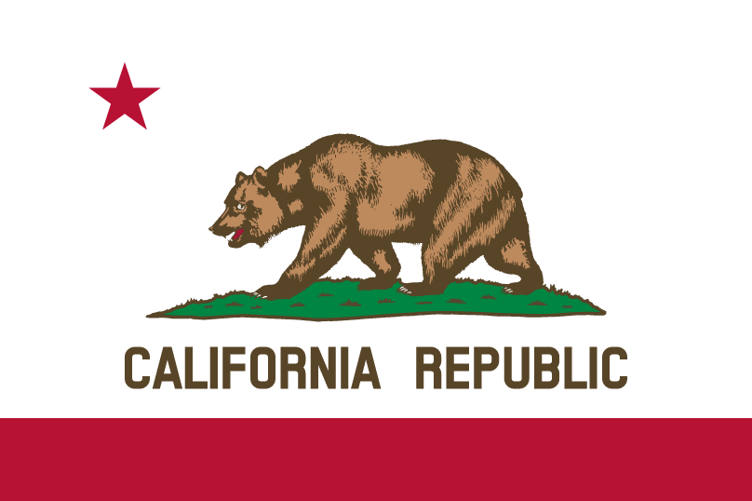
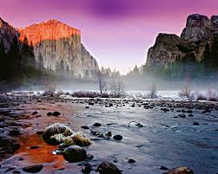
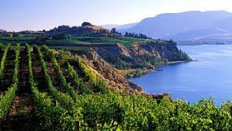
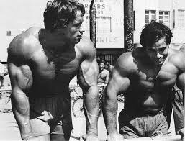
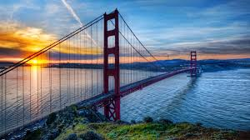
Brand Concept: California
California brand attributes
International symbol of cool
Strong food and gourmet associations
40M people who can instantly relate
City specific shout outs on social media could drive followers
Built in stock of geographic photos for Instagram
Easily authenticity – San Diego manufacturing
Easy “dog whistles” to target communities
  Venice Beach – fitness
  Wine Country – foodies
  Social Media – San Francisco
  Celebrities – Hollywood

Slide 3
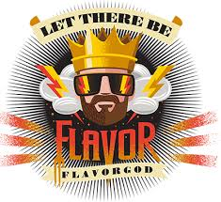
Branding Ideas
Competitor Name and Logo
Our Name and Logo
SPICE REPUBLIC

Slide 4
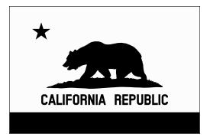
Other logo ideas: we are open to a playful riff on the California Bear – perhaps mixing it up with images of spices or replacing the star
Silhouette Version
Our Name and Logo
SPICE REPUBLIC

Slide 5
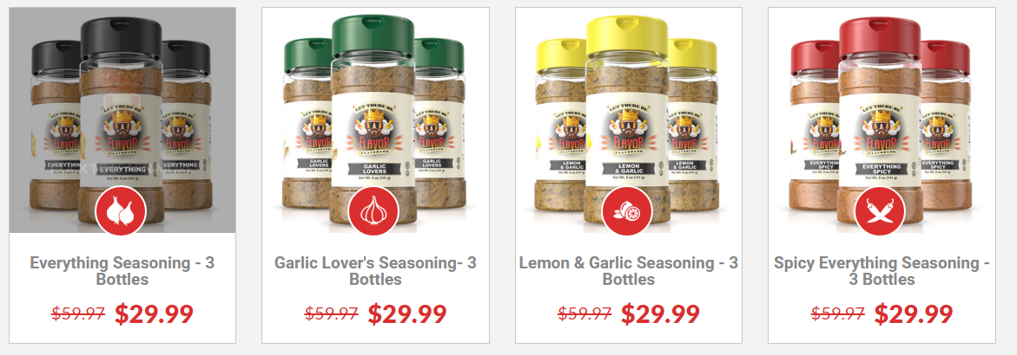
Our Bottle needs to stand out from the competition—we will also use a 5oz bottle like Flavor God

