Slide 1
Spice Republic Branding Brief
January 2016

Slide 2
Executive Summary
Spice Republic is a branded spice and seasoning company based in California
Our parent company has been making spices for high end restaurants in California for decades
We are targeting consumers who want to live a healthy lifestyle and enjoy great tasting home cooked meals
Our brand is California—the Bear Republic
We believe that California accurately captures our brand idea—healthy, fit, and fun
We want to create a beautiful, eye catching bottle without being too serious – we want people to fall in love not just with our how our product tastes, but with out product looks and feels

Slide 3
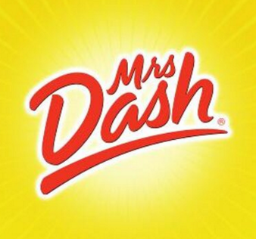
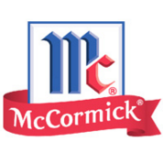
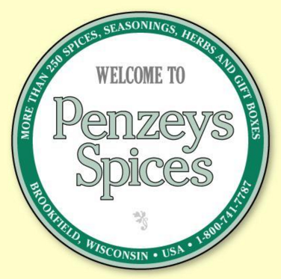
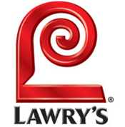
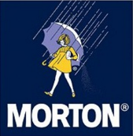
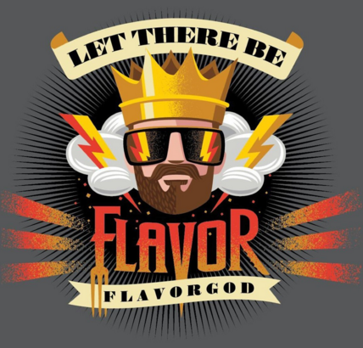
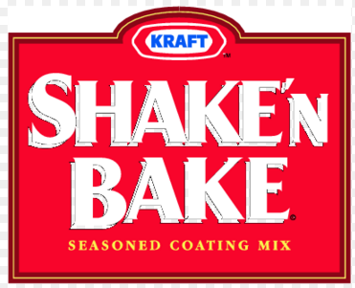


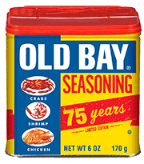
Our competitors are more literal – Flavor god is true peer competitor
Category | Description | Spice Industry
Proper Names | Names in which a proper name is the primary source of identity.
4. Direct Description | Names which convey functional information about an entity in direct descriptive language.
8. Foreign / Foreign-Like | Names which are in a language besides English or which are intended to sound non-English.
10. Geographic | Names which designate a geographic location, whether totally invented, man-made or natural.

Slide 4
Our Brand needs to have the following characteristics
Share Worthiness
Social media sharing will drive success: food, landscapes, and animals share best
Health and Flavor
A healthy, flavorful combination is our core value proposition. The name should reflect that
Unique
We need to stand out from the standard “gourmet” spice aisles

Slide 5
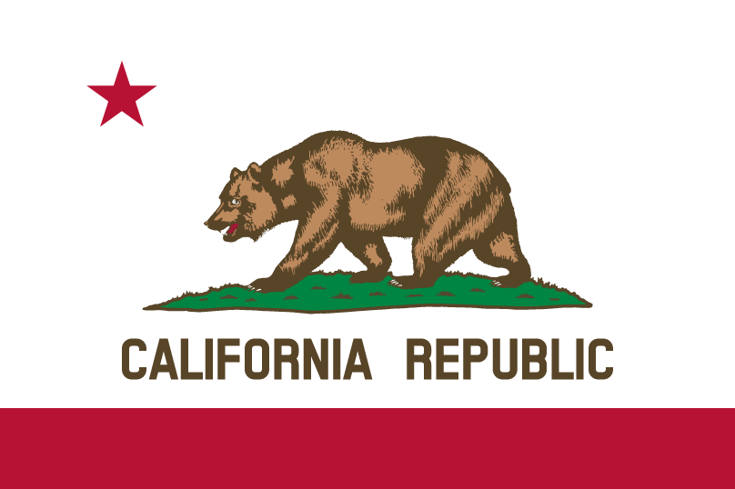
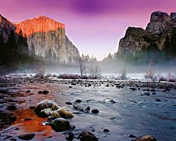
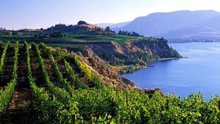
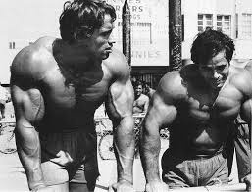
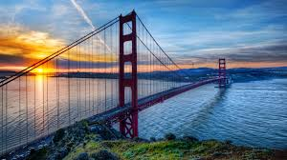
Brand Concept: California
California brand attributes
International symbol of cool
Strong food and gourmet associations
40M people who can instantly relate
City specific shout outs on social media could drive followers
Built in stock of geographic photos for Instagram
Easily authenticity – San Diego manufacturing
Easy “dog whistles” to target communities
Venice Beach – fitness
Wine Country – foodies
Social Media – San Francisco
Celebrities – Hollywood

Slide 6
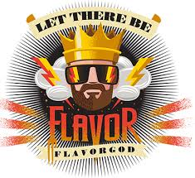
Branding Ideas
Competitor Name and Logo
Our Name and Logo
SPICE REPUBLIC

Slide 7
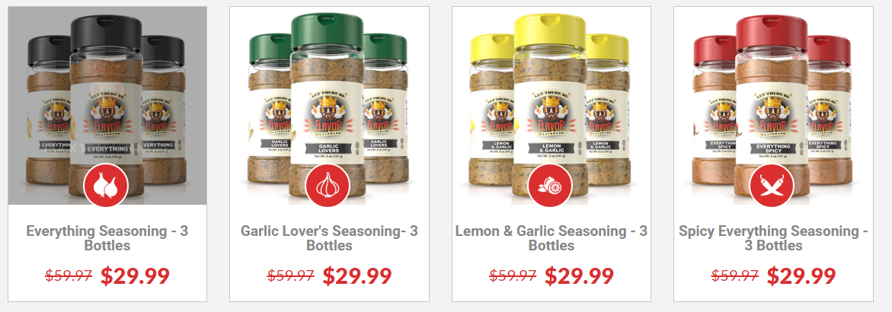
Our Bottle needs to stand out from the competition—we will also use a 5oz bottle like Flavor God

