Slide 1


ENDS 12/31/2015
www.DCF2016.com

Slide 2

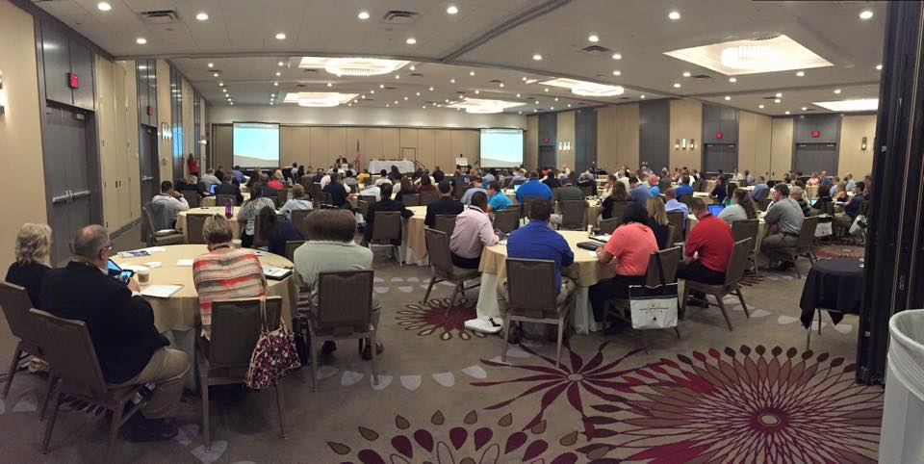
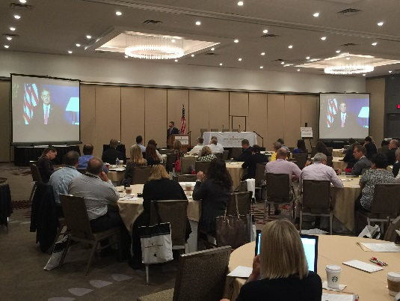
THE DEBT COLLECTION FORUM
A FORUM FOR DEBT COLLECTORS…BY DEBT COLLECTORS.
The Debt Collection Forum was created to provide quality content at a reasonable price-point to allow organizations to send multiple attendees and encourage active participation. This event is intended for debt collection professionals who are:
Senior Level Executives
Front Line Collection Managers
Compliance Professionals
Trainers
While there are many great conferences within our industry to choose from, most collection conferences just scratch the surface when attempting to provide real world solutions. The Debt Collection Forum was created to provide debt collection professionals with a foundation of direction, insight, and actionable solutions that can be applied regardless of the size of an organization. Join us at the inaugural Debt Collection Forum as we assemble an expert team of operations, compliance, and training professionals that will deep dive into real world solutions for today’s real world debt collection issues. Here is what you can expect:
Solution driven sessions, not sponsor driven sessions
Substance from "In The Trenches" experts who live it, breathe it, work it…every day
Learn operational, compliance, and training strategies that have proven results
Understand how to efficiently and effectively manage YOUR resources
Apply state of the art technology solutions

Slide 3
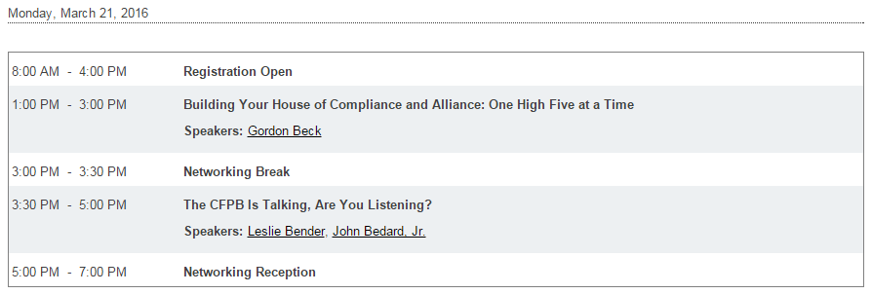
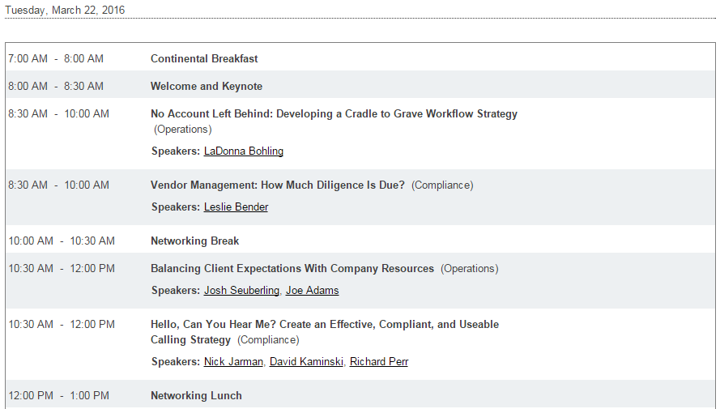
AGENDA

Slide 4
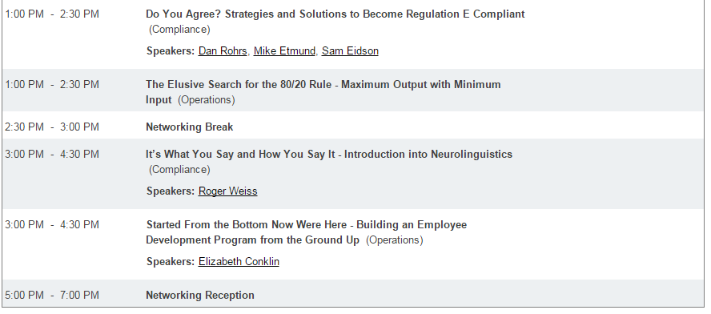
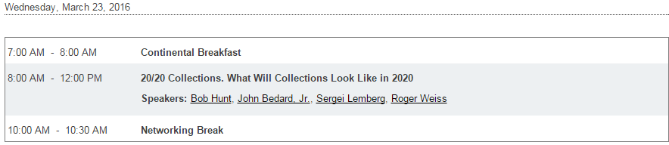

AGENDA cont.

Slide 5
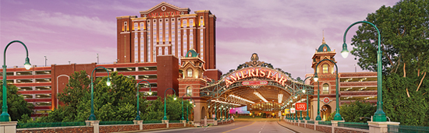
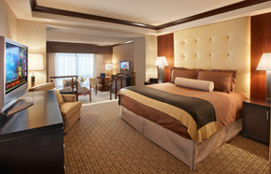
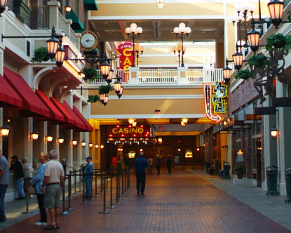
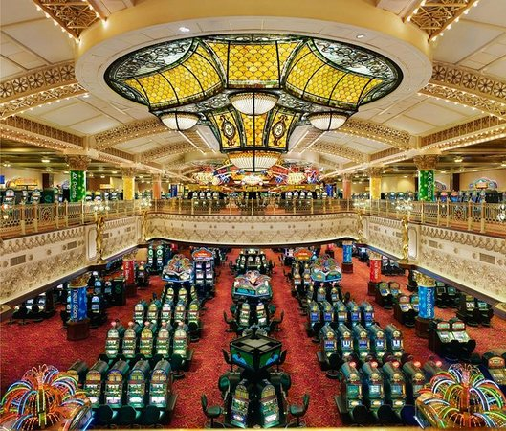
EVENT LOCATION
Ameristar St. Charles
1 Ameristar Blvd
St. Charles, MO 63301
(636) 949-7777
Special Room Rate: $139 per night
To make reservations attendees can go online and enter the Special Offer Code DOGC16A when prompted on the Hotel Reservations Page by following this link: http://www.ameristar.com/Hotel_Reservations.aspx
Or call the hotel reservations department at (636) 940-4301 to make their reservations. To receive the DCF group rates, the attendees should identify the group as Debt Collection Forum.
To qualify for the special room rate all reservations must be made by Friday March 4, 2016 or when the room block is sold out.

