Slide 1
AIRSYS-P-GE-GENERAL-E1506V1.5.PPT
Airsys Refrigeration Engineering Technology (Beijing) Co. Ltd.
AIRSYS
Expert in ICT Cooling
Notes:
9/16/2015
1

Slide 2

Topic
Business Strategies
About AIRSYS
Products and Solutions
Partners and Customers

Slide 3

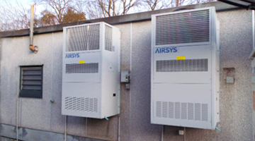
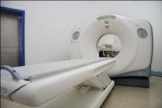
Business Strategies
Global leader in ICT and Medical Equipment Cooling
Data Center 40%
Telecom 30%
Medical 30%
Close Control A/C
Chillers
High Heat Density Product
Engineering, Consulting
BTS Shelter A/C, FCB
Cabinet Cooling
Energy Saving Solution
System Integration
Medical Chillers
Heat Exchangers
Integrated Cooling Solution
Core Competitiveness
State of the Art Technology: energy saving, intelligent control, high reliability.
Speed: R&D resource, concept to prototype <6weeks, vertical integrated manufacturing.
Best TCO: China-based Cost Advantage, best Opex saving. Highly Standardization on component selection.

Slide 4
Topic
Business Strategies
About AIRSYS
Products and Solutions
Partners and Customers

Slide 5
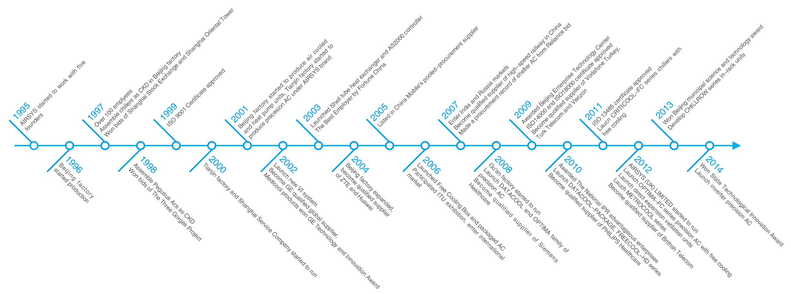
About AIRSYS — Milestones

Slide 6
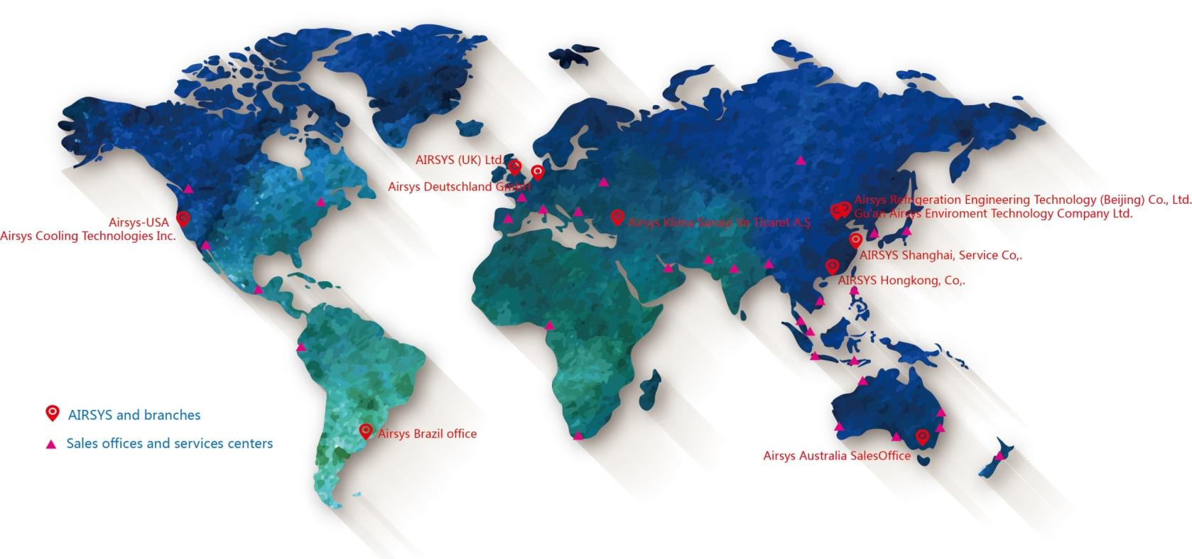
About AIRSYS — Footprint

Slide 7
About AIRSYS —Culture and Core Value
Reliability means supplying reliable products and services and winning trusts from happy customers in order to win the market;
Reliability
Efficiency means optimizing resource distribution to ensure sustainable business development and maximizing profit margins;
Efficiency
Responsibility
Responsibility means being responsible to shareholders, customers, employees, suppliers, and the society in large;
Respect
Respect means respecting to shareholders, customers, employees, suppliers, partners and competitors.

Slide 8
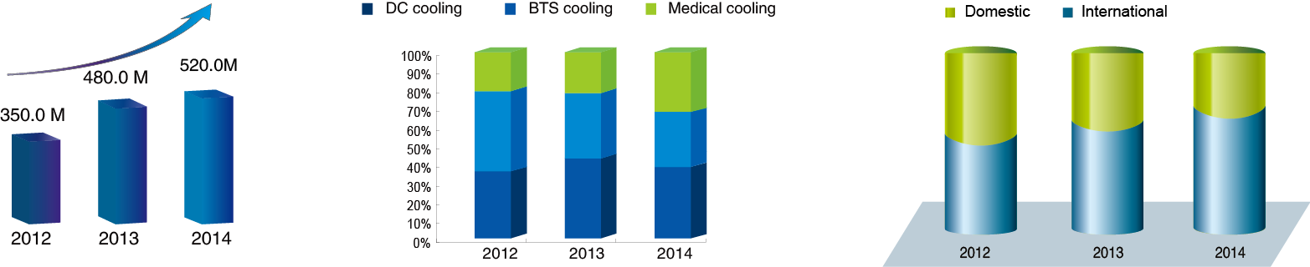
Revenue Growth and Distribution
About AIRSYS — Culture and Core Value
Total Sales
Sales for different product
Domestic/ International Sales
Notes:
9/16/2015
8

Slide 9
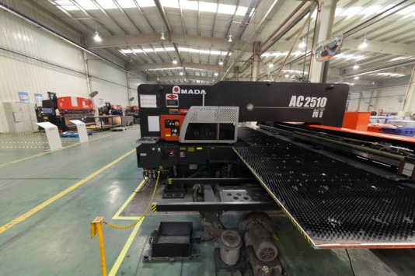
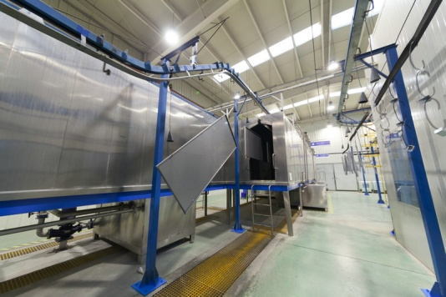
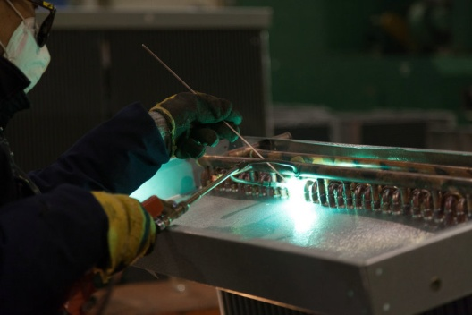
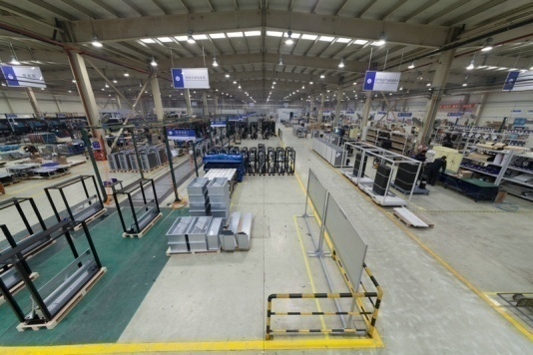
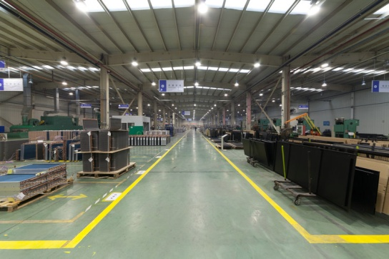
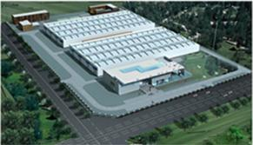
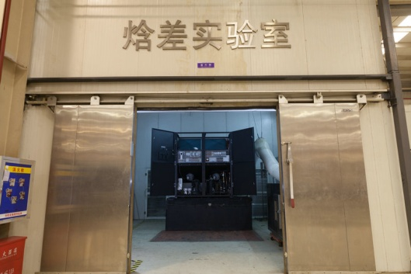
Manufacturing Facilities
About AIRSYS — Manufacturing Facilities
Sheet Metal
Powder Coating
Welding
Assembling
Heat exchanger
Laboratory
Gu’an Manufacturing base: 35,000 ㎡; Beijing Manufacture base: 12,000 ㎡;

Slide 10
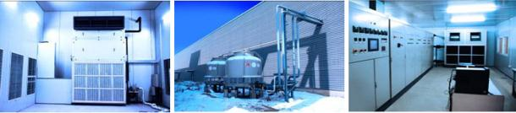



About AIRSYS — R&D and Technology
Lab and Equipments
Enthalpy & AC performance lab
Chiller performance lab.
Climate Room
Water tight test chamber
Salty fog & anti-corrosion lab
International R&D Team
R & D Tools
Product Lifecycle Management Sys.
SOLIDWORKS 3D design
Performance simulation
CFD simulation
Bachelor
35
PHD 3
Master 10
Total Patents：75
Invention Patents：39
R&D Team:48 people
Notes:
9/16/2015
10
技术水平处于国际领先地位，申请专利超过65件。
先进的研发试验设备
具有为大型国际客户订制产品的能力

Slide 11




QA Management
About AIRSYS — QA Management
Quality：ISO9001 Environment： ISO14001,
Healthy and Safety： OHSAS18001 Medical：ISO13485
Annual Factory audit by: GE, Siemens, Philips, Vodafone, Eltek, Delta, etc.
Notes:
9/16/2015
11

Slide 12

QA Management
About AIRSYS — Honor
AIRSYS Awarded 2015 Product Line Strategy Leadership in the Global Cooling Solution Space.
A full, comprehensive product line that addresses numerous customer needs and preferences is therefore a critical ingredient to any company’s long-term retention efforts. To achieve these dual goals (customer value and product line strength), an organization must be best-in-class in three key areas: understanding demand, nurturing the brand, and differentiating from the competition.
----Frost &Sullivan
Notes:
9/16/2015
12

Slide 13
Topic
Business Strategies
About AIRSYS
Products and Solutions
Partners and Customers

Slide 14
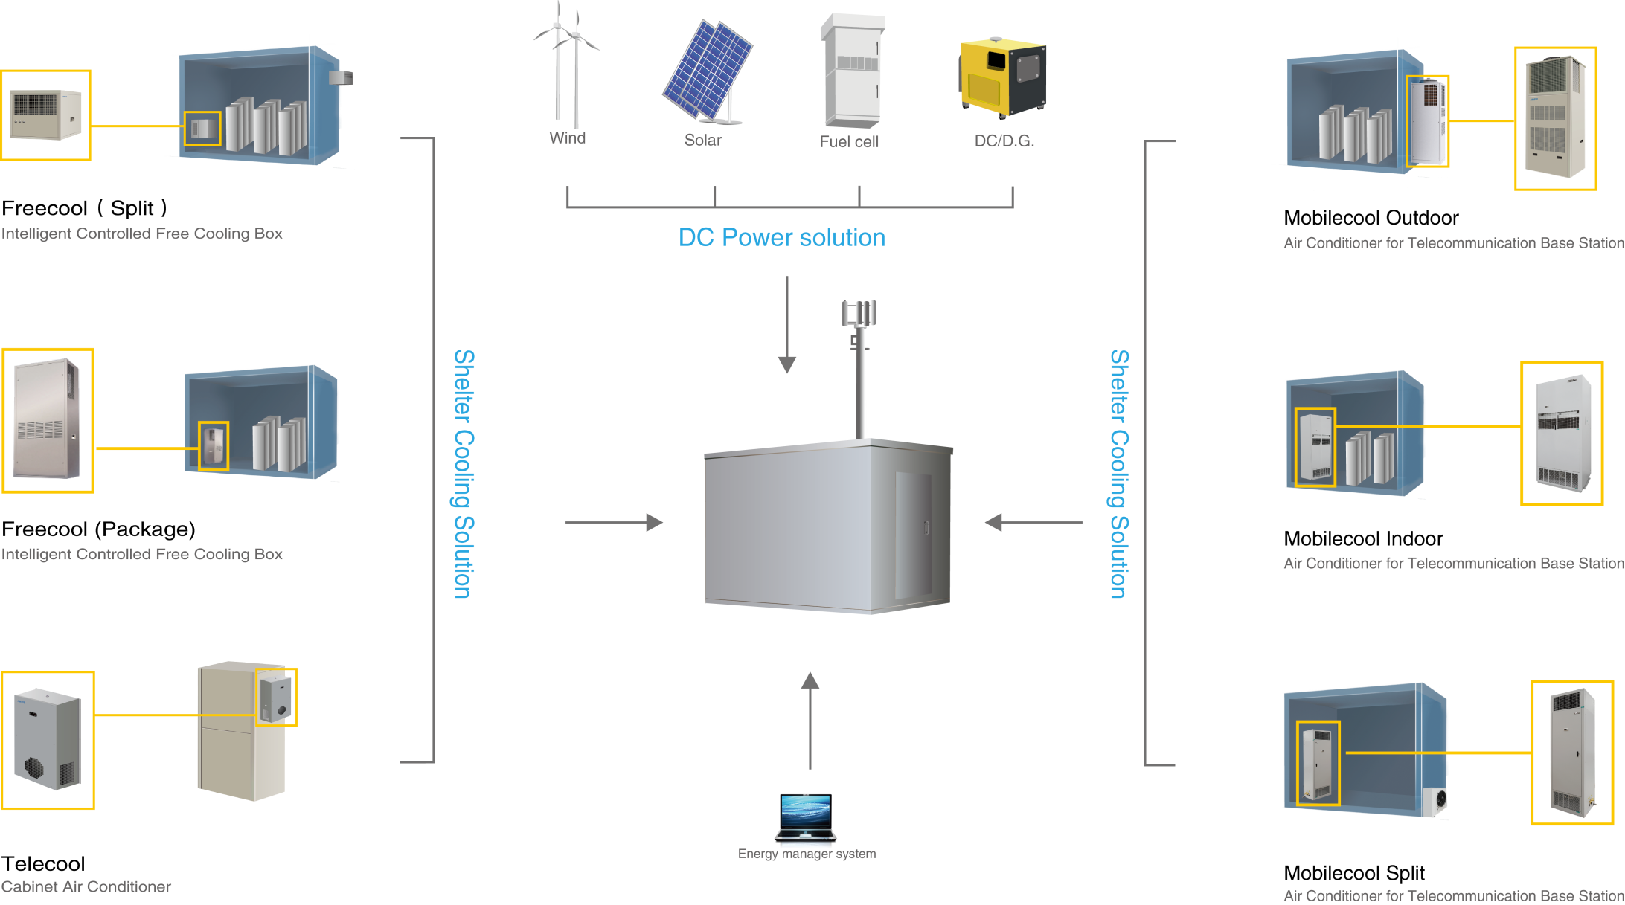
BTS Shelter Solution
BTS Shelter Solution

Slide 15
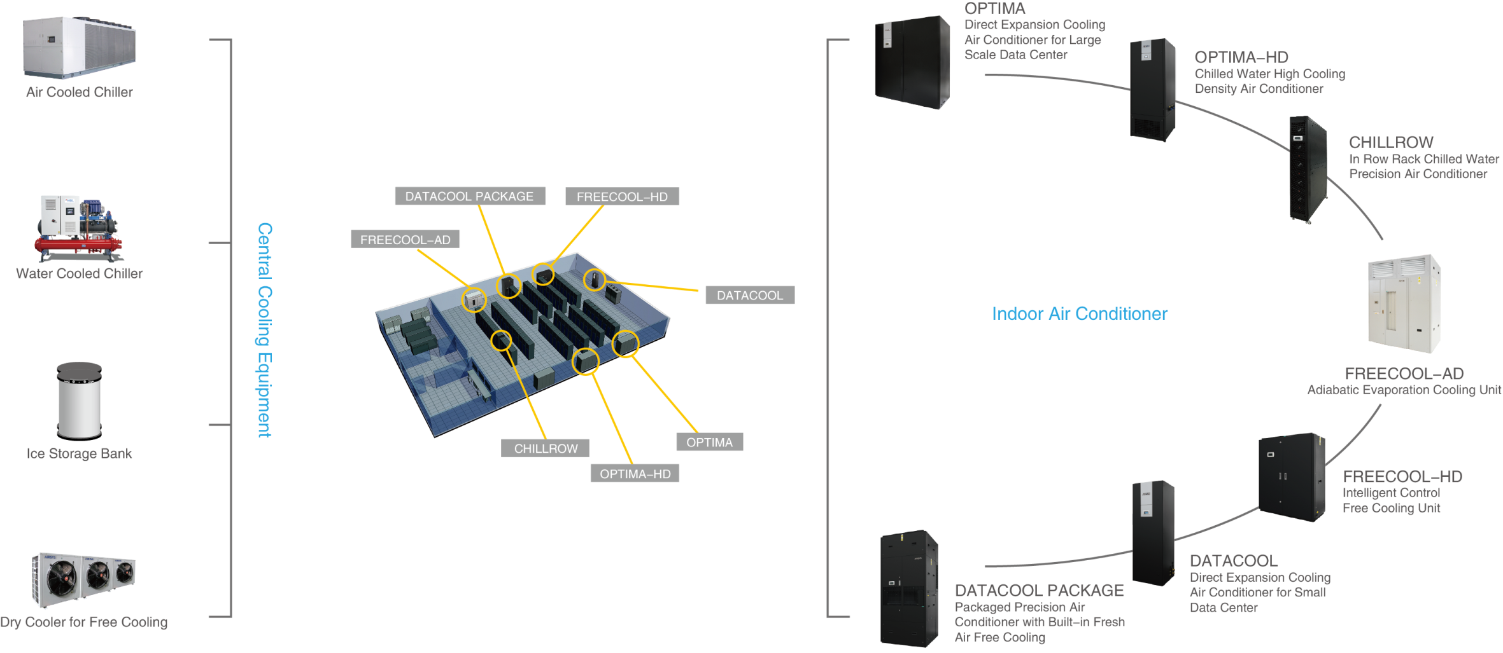
Data Center Solution
Data Center Solution
Data Center Solution

Slide 16





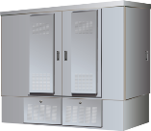







Cabinet Solution
Cabinet Solution
Cabinets
Integration
Cooling
Fan Cooling
Battery Cabinets
Top Mounted A/C
HEX
Battery cabinets
Door Mounted A/C
FTTX Cabinets
Battery A/C

Slide 17

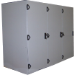




Medical Solution
Fully integration, High energy saving, Standard production
Cabinet & cooling unit integration
MRI related equipments integration
Product map
Products
Customers
Medical cooling and HX units
Total integration
A/C
HEX
Chillers
Cabinet
GE
SIEMENS
PHILIPS
Product and System Integration：Cooling + HEX + Cabinet + Control

Slide 18

Core Technology
Latest Cooling Technology
Energy Saving
High Reliability
Controlling
Free Cooling
Performance Simulation
Controlling logic
System Design
Testing Technology
Manufacture and QA Management
Automatic control
Automatic Analysis
Remote Control
Energy Management
EER: ＞ 3.2
MTBF>20,000H
Energy Saving:10~80%
Pay back time < 3 Years

Slide 19
Topic
Business Strategies
About AIRSYS
Products and Solutions
Partners and Customers

Slide 20
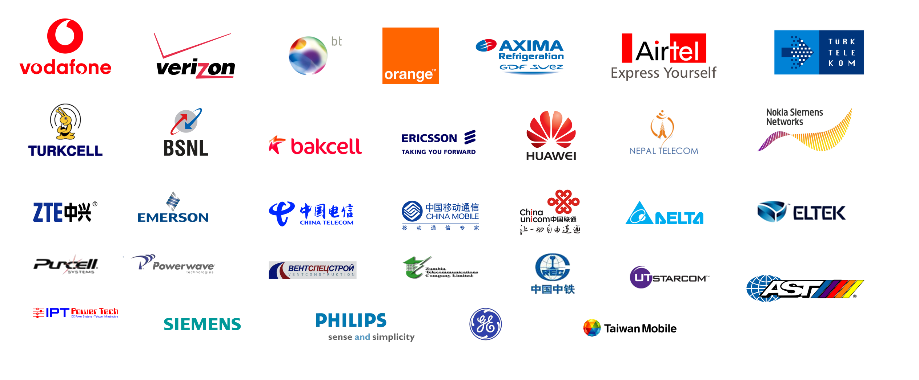

Customers
Customers

Slide 21
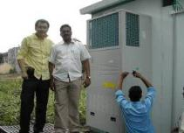

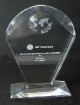
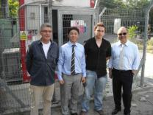
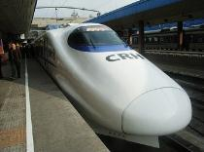

Successful Cases
Successful Cases
Reliance Project：
GE Healthcare：
Vodafone：
Railway Project：
Passed all the testing in 2 Month;
Deliver 30,000pcs PAC in a year;
40% cost down.
Qualified Supplier;
10 years cooperation;
Technology or Innovation Award;
International Standard.
Global Qualified Supplier;
FCB and PAC orders from different countries.
More than 90% market share in China High ;
Speed Railway project.

Slide 22



Successful Cases
Successful Cases
China Mobile
BT
Mingqitong DC
ELTEK
Qualified Supplier;
“Green & Saving” Partner; More than 3000pcs product installation reference.
Free cooling solution for Datacenter & switch room
High energy-saving
Easy Maintenance
High density DC
Complete system integration and installation
Free cooling water chiller
Multi energy saving solutions
Long term partnership
Customized cooling solution
Cabinet solution

Slide 23


Thank You
北京市石景山区鲁谷东街28号 邮编：100040 T:+86 10 68656161 F: +86 10 68682453 www.air-sys.com
Notes:
9/16/2015
23

