Slide 1
AIRSYS-P-GE-GENERAL-E1303V02.PPT
AIRSYS Refrigeration Engineering Technology ( Beijing ) Co., Ltd.
AIRSYS
Expert in ICT Cooling
Notes:
12/14/2014
1

Slide 2
培训日程
2014年12月15日
序号 | 时间 | 培训内容
1 | 9:00~9:30 | 阿尔西公司简介
2 | 9:30~10:20 | 机房空调简介
3 | 10:20~10:40 | 休息
4 | 10:40~12:00 | OPTIMA产品介绍
5 | 1:00~3:30 | OPTIMA产品介绍
6 | 3::30~3:50 | 休息
7 | 3:50~5:00 | OPTIMA-FC节能分析及案例介绍
8 | 5:00~5:30 | 讨论
2014年12月16日
序号 | 时间 | 培训内容
1 | 9:00~10:30 | DATACOOL产品介绍
2 | 10:30~10:50 | 休息
3 | 10:50~12:00 | MOBILECOOL-OUTDOOR产品简介及案例分析
4 | 1:00~2:30 | FCB产品简介及案例分析
5 | 2:30~2:50 | 休息
6 | 2:50~5:00 | 全部样本介绍
7 | 5:00~5:30 | 讨论

Slide 3


Topic
业务&战略
Business & strategy
基本情况
Base situation
产品与解决方案
Product and solution
重点客户
Key account

Slide 4

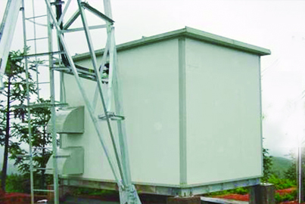
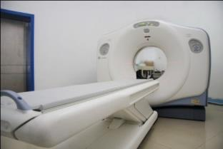
Business Strategies
Global leader in ICT and Medical Equipment Cooling
Data Center 40%
Telecom 30%
Medical 30%
Close Control A/C
Chillers
High Heat Density Product
Engineering, Consulting
BTS Shelter A/C, FCB
Cabinet Cooling
Energy Saving Solution
System Integration
Medical Chillers
Heat Exchangers
Integrated Cooling Solution
Core Competitiveness
State of the Art Technology: energy saving, intelligent control, high reliability.
Speed: R&D resource, concept to prototype <6weeks, vertical integrated manufacturing.
Best TCO: China-based Cost Advantage, best Opex saving. Highly Standardization on component selection.

Slide 5
Topic
Business & strategy
Base situation
产品与解决方案
Product and solution
重点客户
Key account

Slide 6
About AIRSYS — Milestones
1995
AIRSYS
Founded
1998
Set up 1st factory
Set up R&D team
Launched AIRSYS brand chillers and Close Control A/C
2001
ISO9001 certified. Complete product lines: chiller , Heat Pumps & Close Control A/C.
2003
GE Qualified Global Supplier,
Technology and Innovation Award from GEHC.
The Best Employer by the Fortune Magazine-China
2005
Beijing Factory Expansion Project Completed
Became main supplier for China mobile, China Telecom, China Unicom.
2006
Started international marketing as an expert in ICT cooling
2007
Broke through Indian Telecom market awarded with record-breaking BTS shelter A/C order
Established partnership with multiple global Telecom operators.
2008
Completed a new manufacturing facility of 35,000 sqm in GuAn China, the largest ICT cooling production base in Asia.
2009
Became Vodafone Global Qualified Supplier..
Completed Total solutions for Shelter cooling, Datacenter cooling, Cabinet cooling.
2010
Passed Verizon Wireless & French Telecom Technical qualification, energy saving tests and field trials
2011
Became Philips Healthcare,British Telecom Global supplier.

Slide 7



About AIRSYS — Footprint
AIRSYS HQ & Beijing factory
AIRSYS GU’AN factory
AIRSYS Shanghai, Service Co,.
Sales & Distribution:
Asia Pacific: India, Pakistan, Nepal, Australia, New Zealand, Indonesia, Malaysia, Vietnam, Philippine
EMEA: Russia, France, UK, Spain, Romania, Czech, Italy, Turkey; South Africa, Nigeria, etc.
Americas: U.S.A, Canada, Mexico, Brazil,
Tech Support & Logistic Center:
EU – CIS - India
North America
Middle East & Africa

Slide 8

Culture and Core Value
Reliability
Reliability means supplying reliable products and services and winning trusts from happy customers in order to win the market;
Efficiency
Efficiency means optimizing resource distribution to ensure sustainable business development and maximizing profit margins;
Responsibility
Responsibility means being responsible to shareholders, customers, employees, suppliers, and the society in large;
Respect
Respect means respecting to shareholders, customers, employees, suppliers and partners.

Slide 9
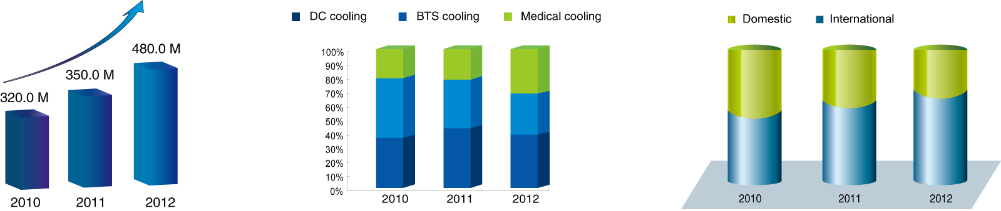
Revenue Growth and Distribution
About AIRSYS — Culture and Core Value
Total Sales
Sales for different product
Domestic/ International Sales
Notes:
12/14/2014
9

Slide 10
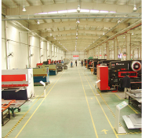
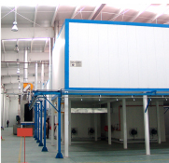
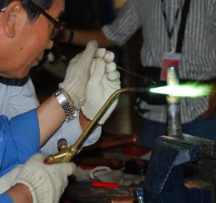
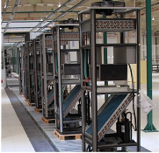
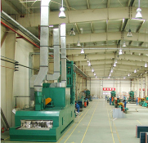
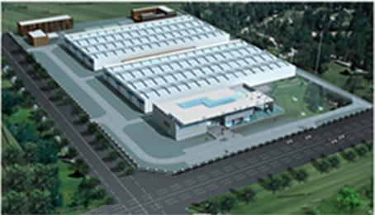
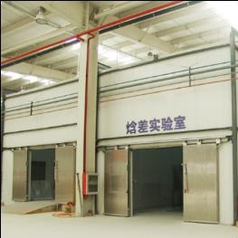
Manufacturing Facilities
About AIRSYS — Manufacturing Facilities
Sheet Metal
Powder Coating
Welding
Assembling
Heat exchanger
Laboratory
Gu’an Manufacturing base: 35,000 ㎡; Beijing Manufacture base: 12,000 ㎡;

Slide 11
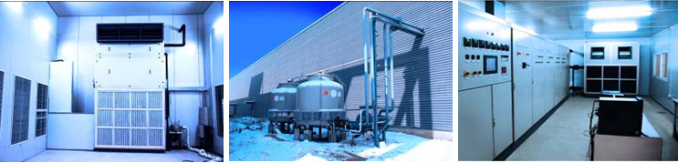




R&D and Technology
About AIRSYS — R&D and Technology
Lab and Equipments
Enthalpy & AC performance lab
Chiller performance lab.
Climate Room
Water tight test chamber
Salty fog & anti-corrosion lab
International R&D Team
R & D Tools
Product Lifecycle Management Sys.
SOLIDWORKS 3D design
Performance simulation
CFD simulation
Bachelor
55
PHD 3
Master 10
Total Patents：75
Invention Patents：39
R&D Team:68 people
Notes:
12/14/2014
11
技术水平处于国际领先地位，申请专利超过65件。
先进的研发试验设备
具有为大型国际客户订制产品的能力

Slide 12




QA Management
About AIRSYS — QA Management
Quality：ISO9001 Environment： ISO14001,
Healthy and Safety： OHSAS18001 Medical：ISO13485
Annual Factory audit by: GE, Siemens, Philips, Vodafone, Eltek Valere, etc.
Notes:
12/14/2014
12

Slide 13
Topic
Business & strategy
Base situation
产品与解决方案
Product and solution
重点客户
Key account

Slide 14
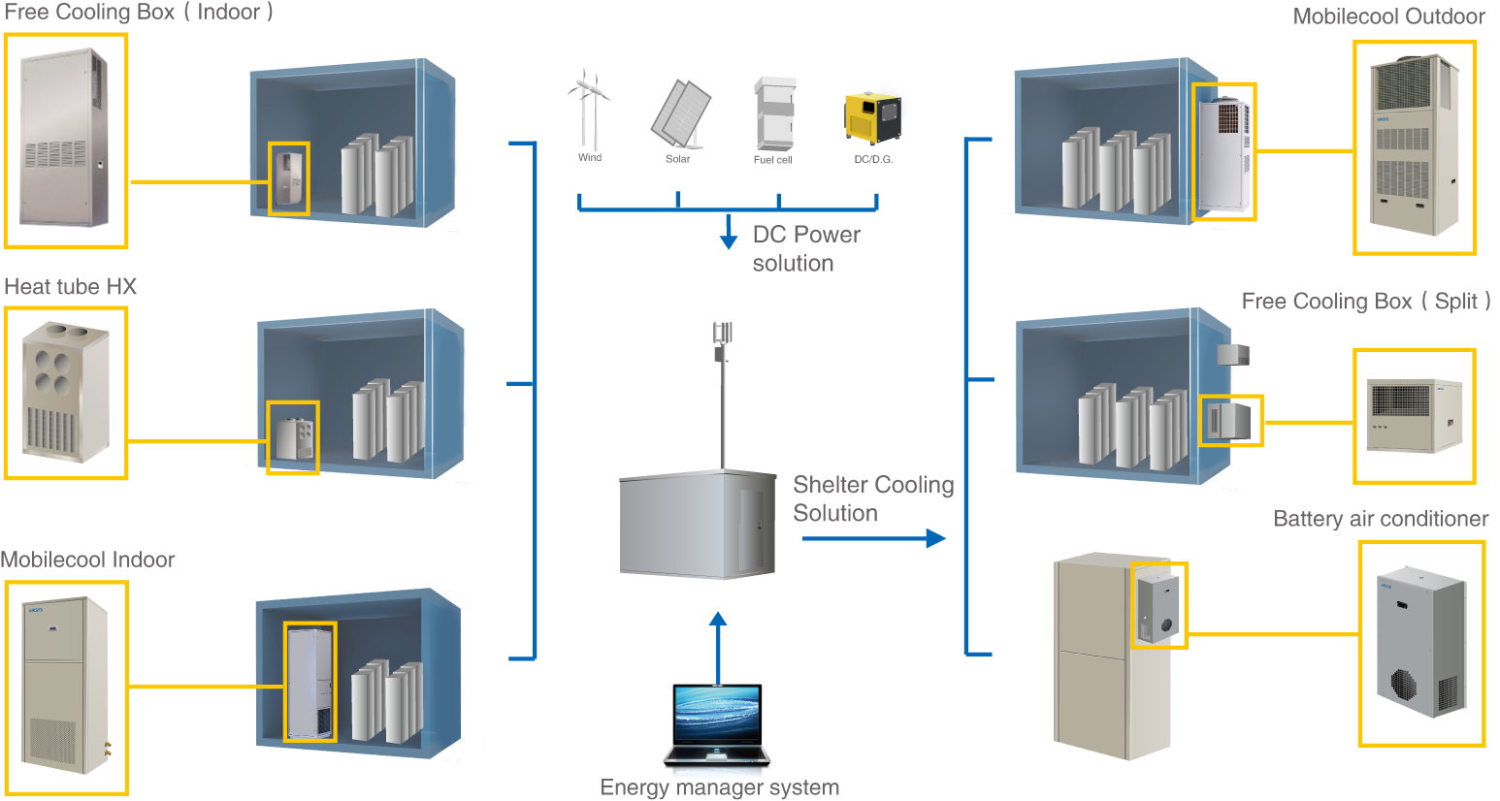
BTS Shelter Solution
BTS Shelter Solution

Slide 15
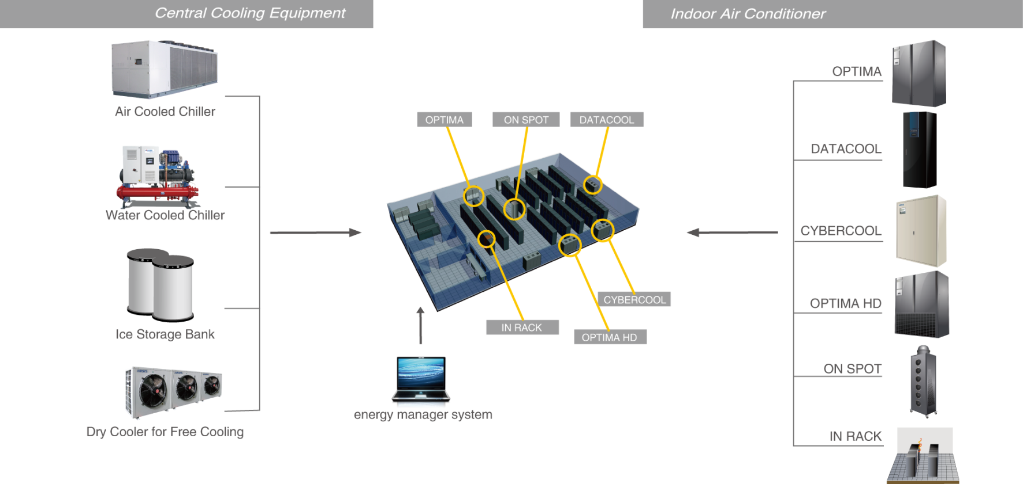
Data Center Solution
Data Center Solution

Slide 16


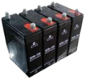


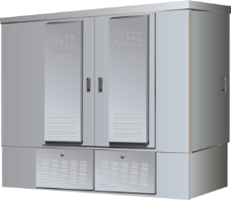



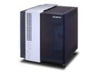
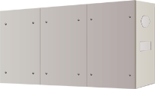

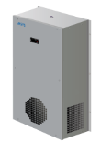
Cabinet Solution
Cabinet Solution
Cabinets
Integration
Cooling
Fan Cooling
Battery Cabinets
Top Mounted A/C
HEX
Battery cabinets
Door Mounted A/C
FTTX Cabinets
Battery A/C

Slide 17

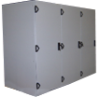




Medical Solution
Fully integration, High energy saving, Standard production
Cabinet & cooling unit integration
MRI related equipments integration
Product map
Products
Customers
Medical cooling and HX units
Total integration
A/C
HEX
Chillers
Cabinet
GE
SIEMENS
PHILIPS
Product and System Integration：Cooling + HEX + Cabinet + Control

Slide 18

Core Technology
Latest Cooling Technology
Energy Saving
High Reliability
Controlling
Free Cooling
Performance Simulation
Controlling logic
System Design
Testing Technology
Manufacture and QA Management
Automatic control
Automatic Analysis
Remote Control
Energy Management
EER: ＞ 3.2
MTBF>20,000H
Energy Saving:10~80%
Pay back time < 3 Years

Slide 19
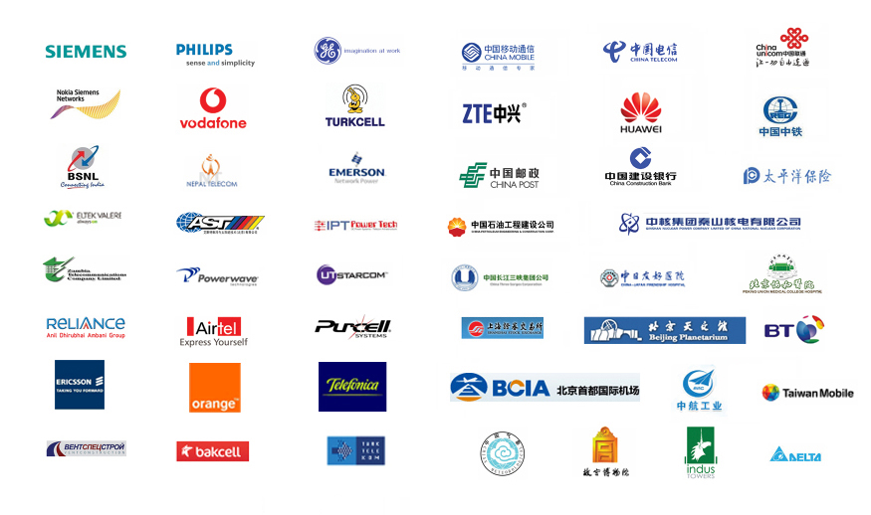
Customers
Customers

Slide 20
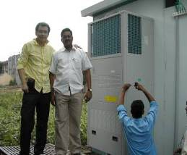

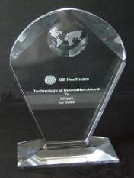
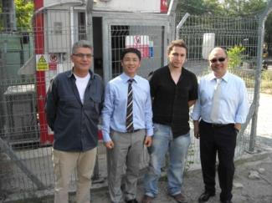
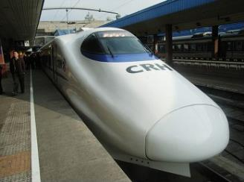

Successful Cases
Successful Cases
Reliance Project：
GE Healthcare：
Vodafone：
Railway Project：
Passed all the testing in 2 Month;
Deliver 30,000pcs PAC in a year;
40% cost down;
Qualified Supplier;
7 years cooperation;
Technology or Innovation Award;
International Standard
Global Qualified Supplier;
FCB and PAC orders from different countries.
More than 90% market share in China High Speed Railway project

Slide 21
Topic
Business & strategy
Base situation
产品与解决方案
Product and solution
重点客户
Key account

Slide 22




Successful Cases
Successful Cases
China Mobile
BT
Mingqitong DC
ELTEK
Qualified Supplier;
“Green & Saving” Partner;
More than 3000pcs product installation reference.
Free cooling solution for Datacenter & switch room
High energy-saving
Easy Maintenance
High density DC
Complete system integration and installation
Free cooling water chiller
Multi energy saving solutions
Long term partnership
Customized cooling solution
Cabinet solution

Slide 23

THANK YOU
Contact Us
28, Lugu East Street , Shijingshan District, Beijing, China,100040
P. +86 10 68656161 /F: +86 10 68682453 www.air-sys.com
Notes:
12/14/2014
23

