Slide 1
AIRSYS-P-GE-GENERAL-E1506V1.5.PPT
Airsys Refrigeration Engineering Technology (Beijing) Co. Ltd.
AIRSYS
Expert in ICT Cooling
Notes:
12/29/2015
1

Slide 2
Topic
Business Strategies
About AIRSYS
Products and Solutions
Partners and Customers

Slide 3

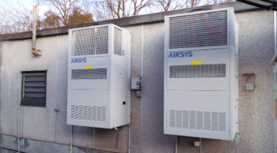
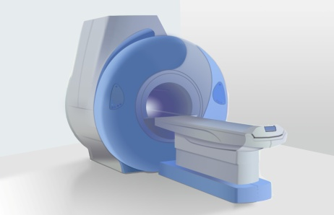
Business Strategies
Global leader in ICT and Medical Equipment Cooling
Data Center 40%
Telecom 30%
Medical 30%
Close Control A/C
Chillers
High Heat Density Product
Engineering, Consulting
BTS Shelter A/C, FCB
Cabinet Cooling
Energy Saving Solution
System Integration
Medical Chillers
Heat Exchangers
Integrated Cooling Solution
Core Competitiveness
State of the Art Technology: energy saving, intelligent control, high reliability.
Speed: R&D resource, concept to prototype <6weeks, vertical integrated manufacturing.
Best TCO: China-based Cost Advantage, best Opex saving. Highly Standardization on component selection.

Slide 4
Topic
Business Strategies
About AIRSYS
Products and Solutions
Partners and Customers

Slide 5
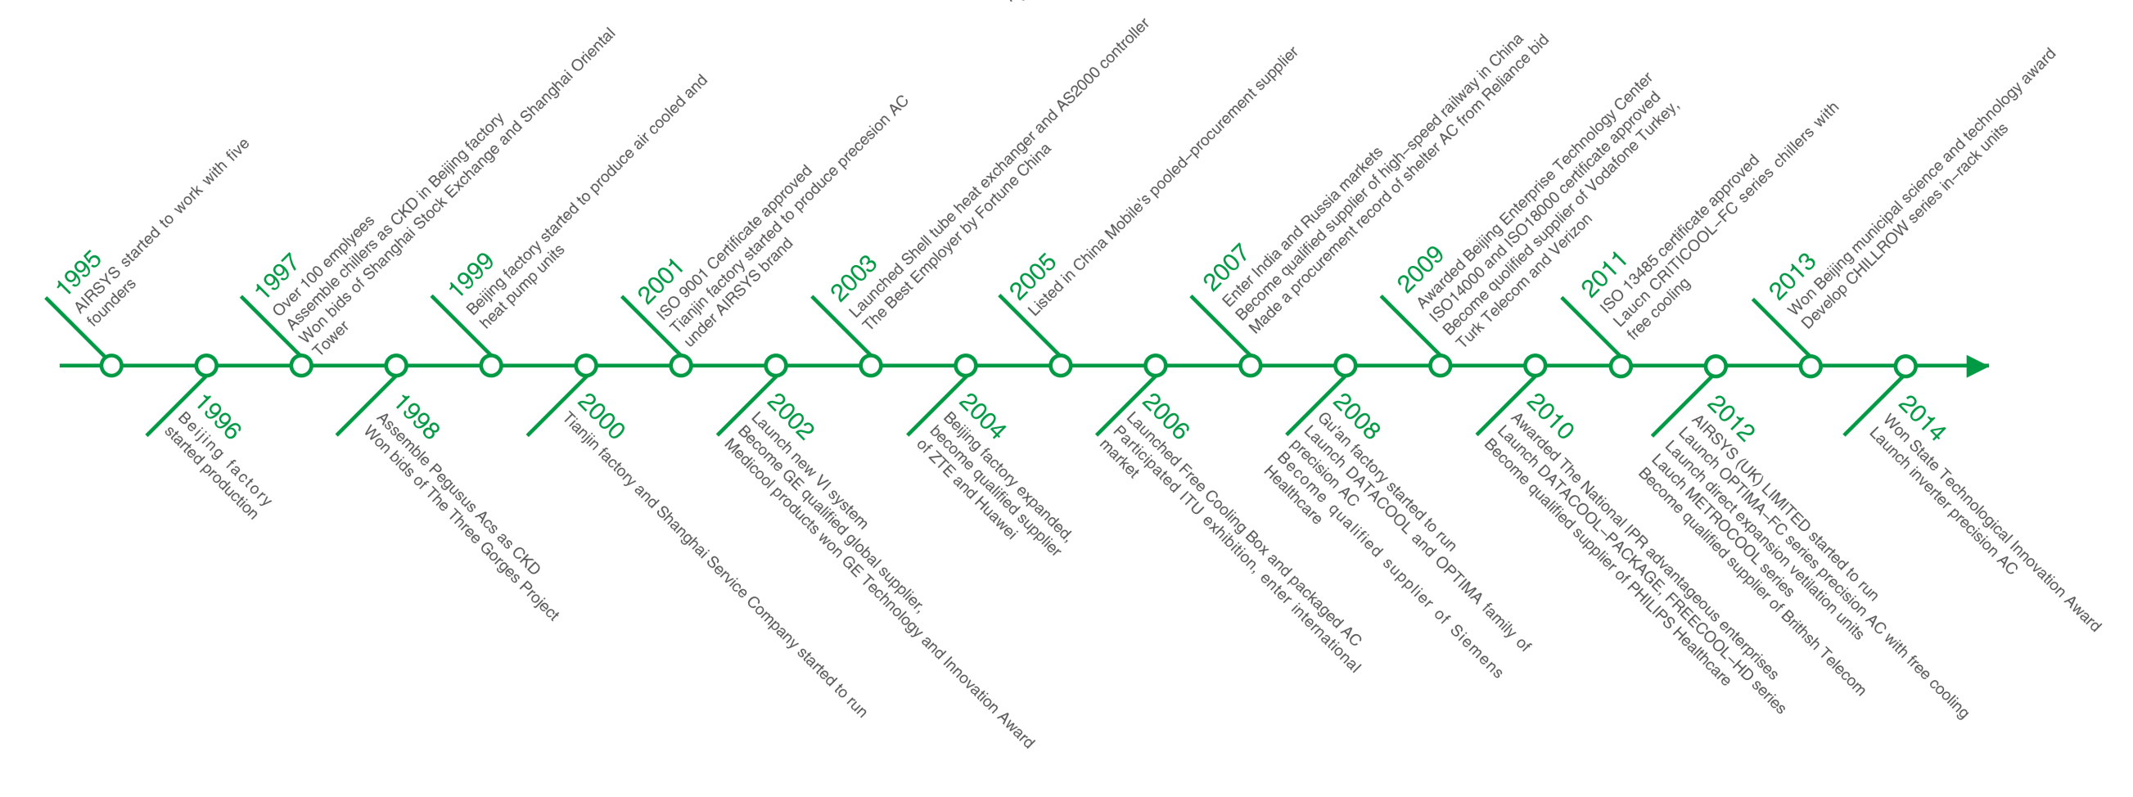
About AIRSYS — Milestones

Slide 6
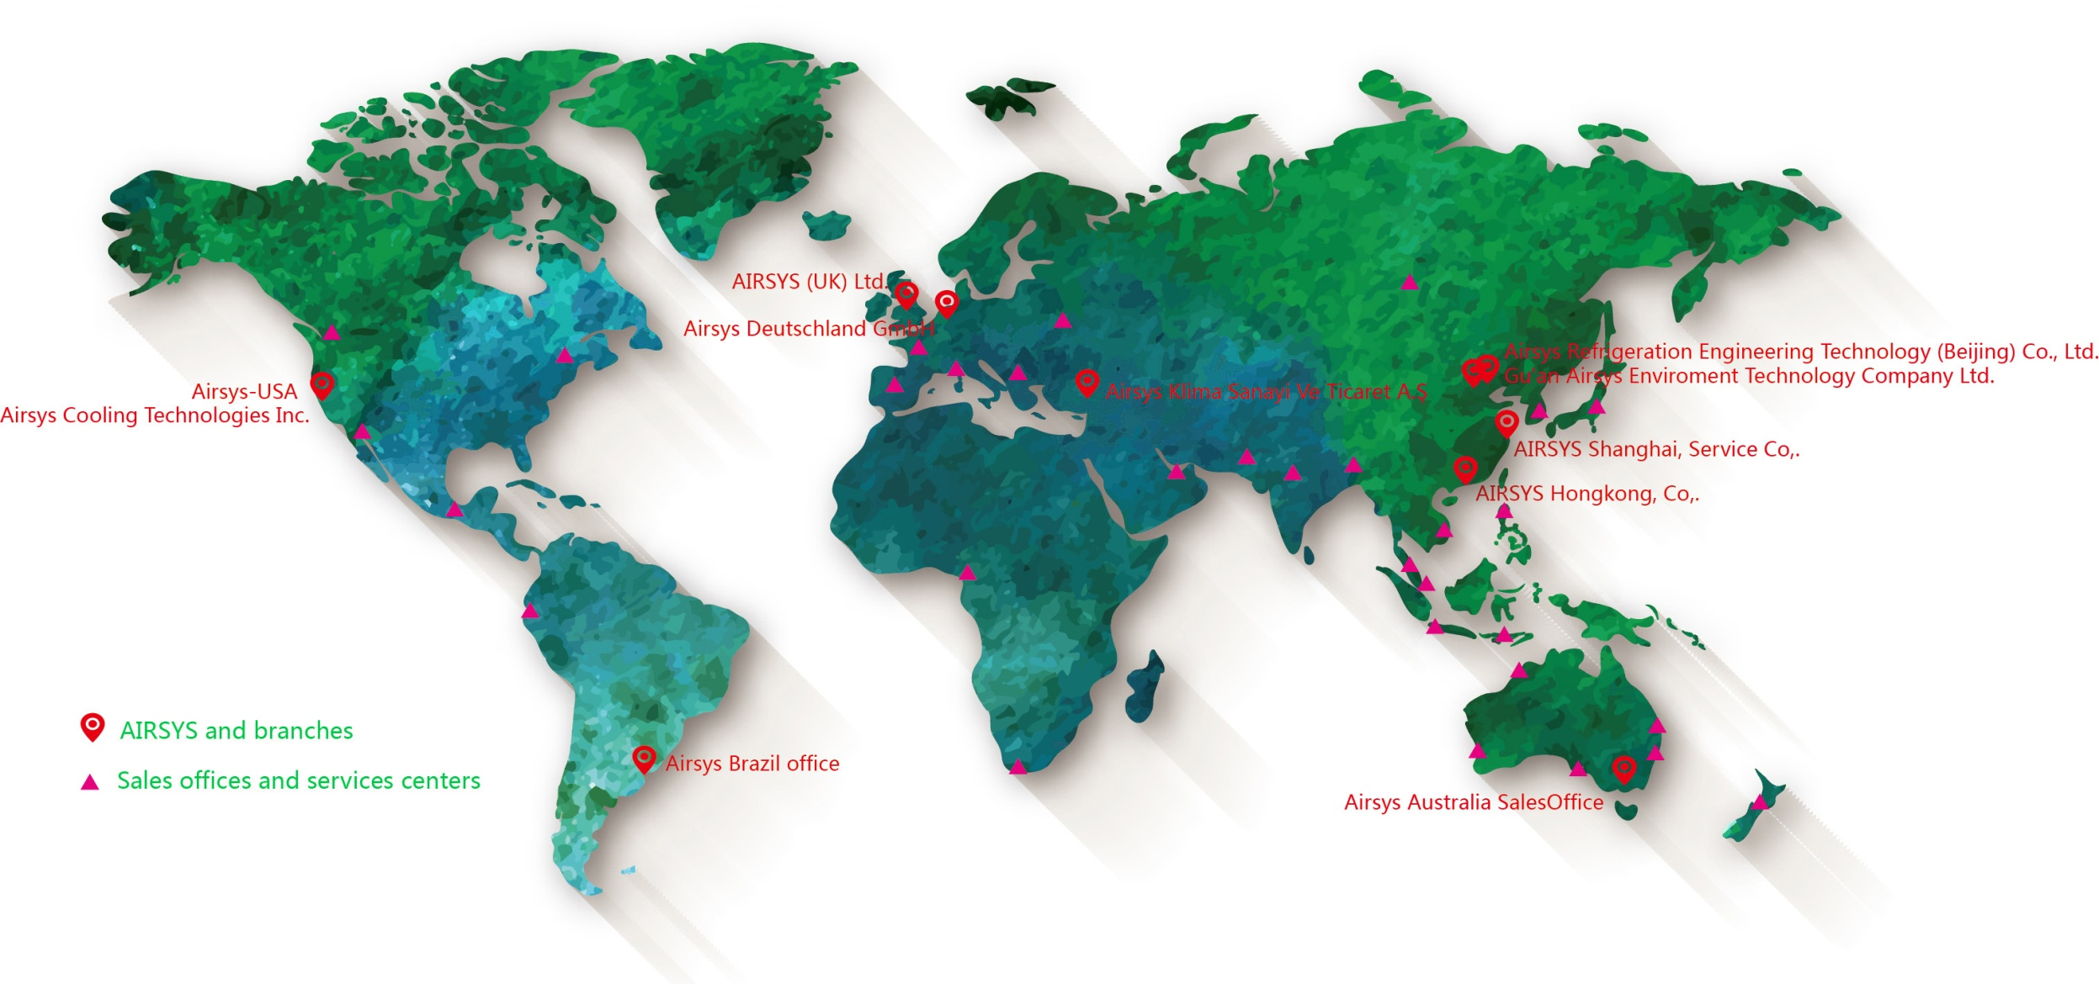
About AIRSYS — Footprint

Slide 7
Culture and Core Value
Reliability means supplying reliable products and services and winning trusts from happy customers in order to win the market;
Reliability
Efficiency means optimizing resource distribution to ensure sustainable business development and maximizing profit margins;
Efficiency
Responsibility
Responsibility means being responsible to shareholders, customers, employees, suppliers, and the society in large;
Respect
Respect means respecting to shareholders, customers, employees, suppliers, partners and competitors.

Slide 8
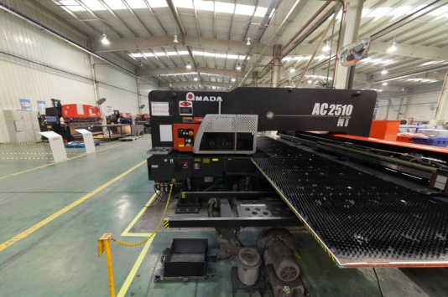
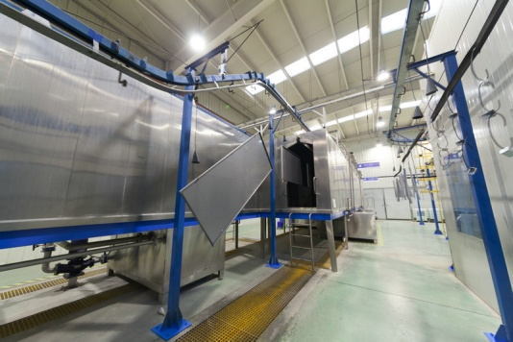
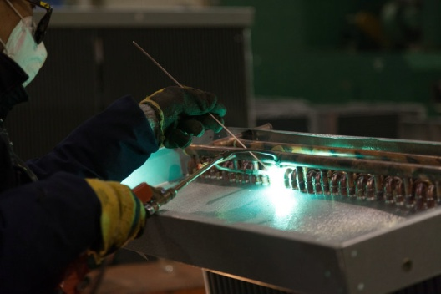
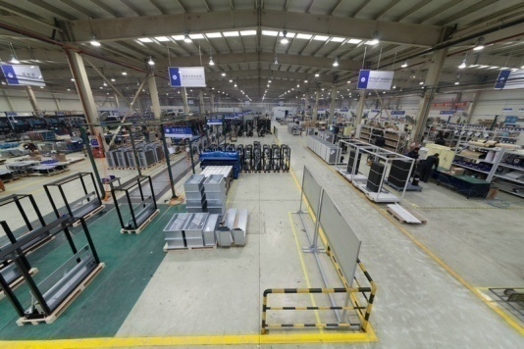
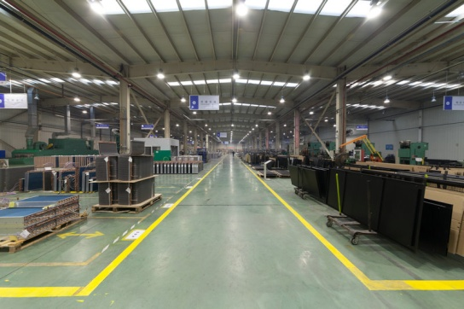
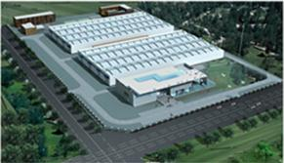
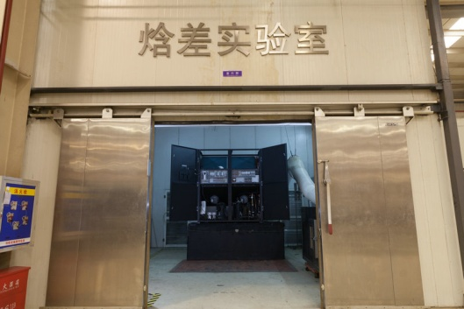
About AIRSYS — Manufacturing Facilities
Sheet Metal
Powder Coating
Welding
Assembling
Heat exchanger
Laboratory
Gu’an Manufacturing base: 35,000 ㎡; Beijing Manufacture base: 12,000 ㎡;

Slide 9
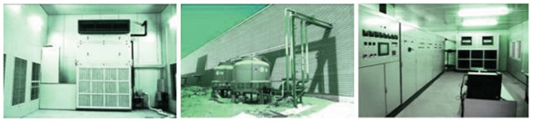

About AIRSYS — R&D and Technology
Lab and Equipments
Enthalpy & AC performance lab
Chiller performance lab.
Climate Room
Water tight test chamber
Salty fog & anti-corrosion lab
R&D Tools
  Product Lifecycle Management Sys.
  SOLIDWORKS 3D design
  Performance simulation
  CFD simulation
  International R&D Team
Bachelor
35
PHD 3
Master 10
R&D Team:48 people
Total Patents：75
Invention Patents：39
Notes:
12/29/2015
9
技术水平处于国际领先地位，申请专利超过65件。
先进的研发试验设备
具有为大型国际客户订制产品的能力

Slide 10




QA Management
About AIRSYS — QA Management
Quality：ISO9001 Environment： ISO14001,
Healthy and Safety： OHSAS18001 Medical：ISO13485
Annual Factory audit by: GE, Siemens, Philips, Vodafone, Eltek, Delta, etc.
Notes:
12/29/2015
10

Slide 11
Topic
Business Strategies
About AIRSYS
Products and Solutions
Partners and Customers

Slide 12
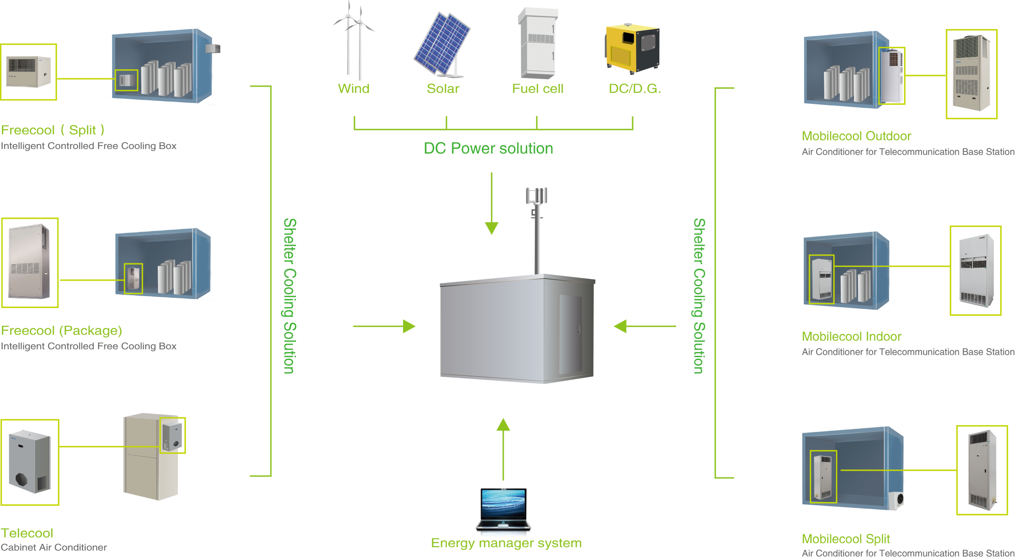
BTS Shelter Solution
BTS Shelter Solution

Slide 13
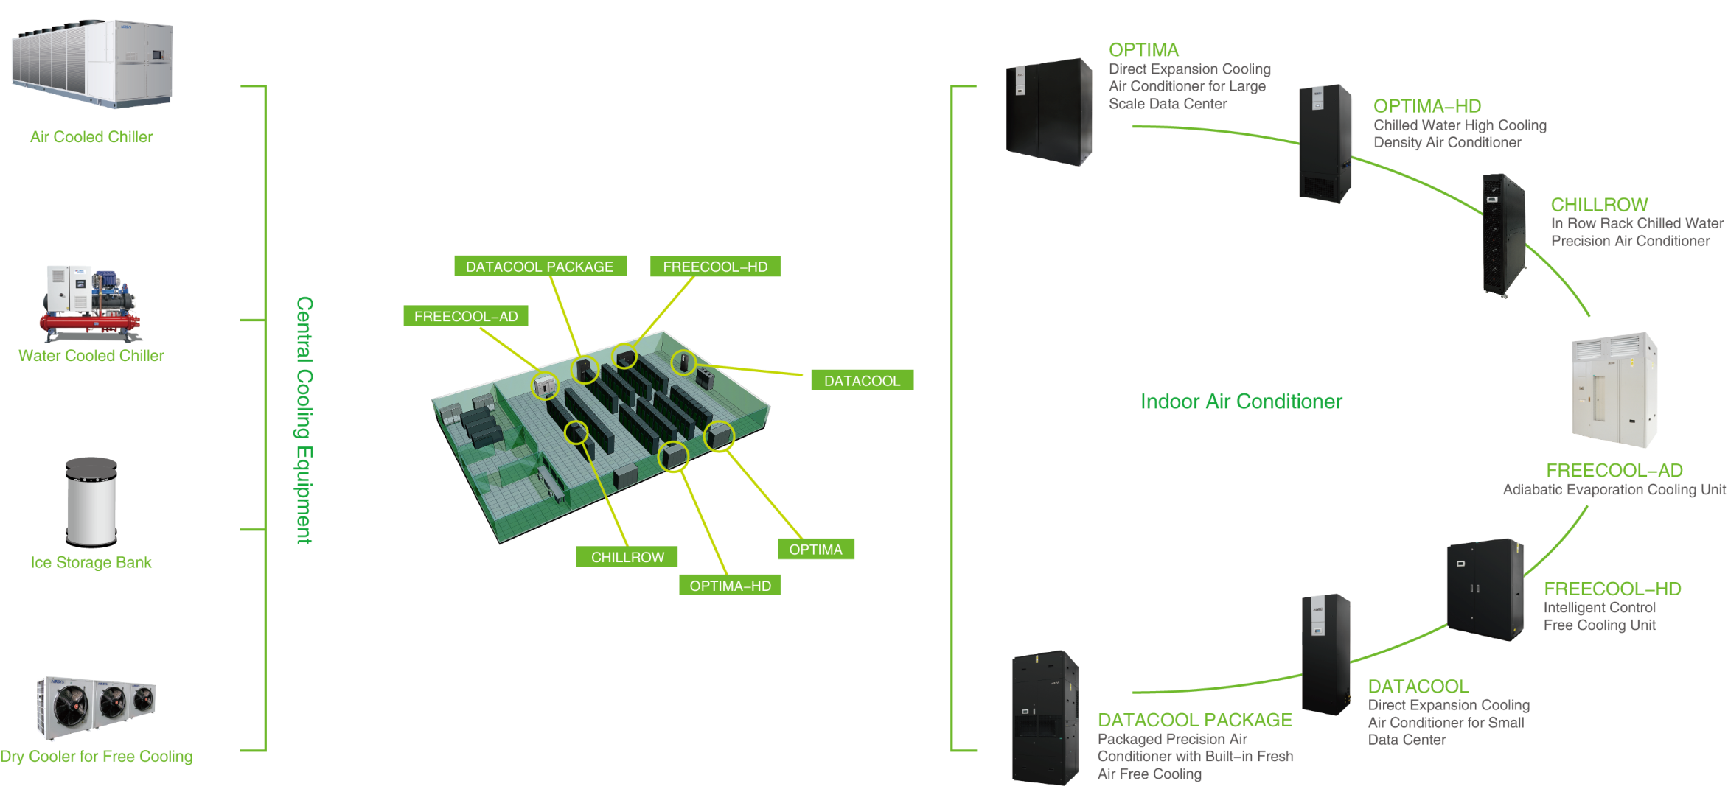
Data Center Solution
Data Center Solution
Data Center Solution

Slide 14





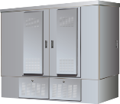







Cabinet Solution
Cabinet Solution
Cabinets
Integration
Cooling
Fan Cooling
Battery Cabinets
Top Mounted A/C
HEX
Battery cabinets
Door Mounted A/C
FTTX Cabinets
Battery A/C

Slide 15

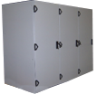




Medical Solution
Fully integration, High energy saving, Standard production
Cabinet & cooling unit integration
MRI related equipments integration
Product map
Products
Customers
Medical cooling and HX units
Total integration
A/C
HEX
Chillers
Cabinet
GE
SIEMENS
PHILIPS
Product and System Integration：Cooling + HEX + Cabinet + Control

Slide 16

Core Technology
Latest Cooling Technology
Energy Saving
High Reliability
Controlling
Free Cooling
Performance Simulation
Controlling logic
System Design
Testing Technology
Manufacture and QA Management
  Automatic control
  Automatic Analysis
  Remote Control
  Energy Management
  EER: ＞ 3.2
  MTBF>20,000H
Energy Saving:10~80%
Pay back time < 3 Years

Slide 17
Topic
Business Strategies
About AIRSYS
Products and Solutions
Partners and Customers

Slide 18
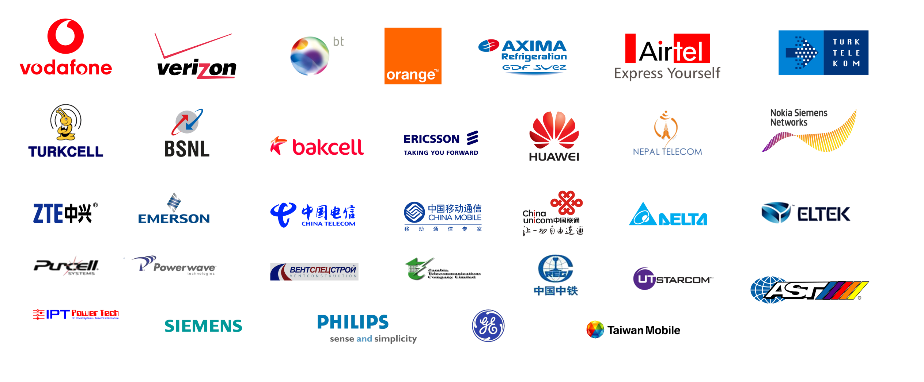

Customers
Customers

Slide 19
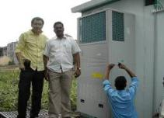

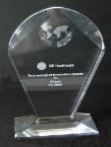
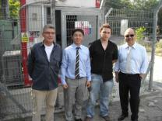
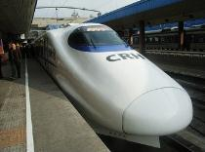

Successful Cases
Successful Cases
Reliance Project：
GE Healthcare：
Vodafone：
Railway Project：
  Passed all the testing in 2 Month;
  Deliver 30,000pcs PAC in a year;
  40% cost down.
  Qualified Supplier;
  10 years cooperation;
  Technology or Innovation Award;
  International Standard.
  Global Qualified Supplier;
  FCB and PAC orders from different countries.
  More than 90% market share in China High ;
  Speed Railway project.

Slide 20



Successful Cases
Successful Cases
China Mobile
BT
Mingqitong DC
ELTEK
Qualified Supplier;
“Green & Saving” Partner; More than 3000pcs product installation reference.
Free cooling solution for Datacenter & switch room
High energy-saving
Easy Maintenance
High density DC
Complete system integration and installation
Free cooling water chiller
Multi energy saving solutions
Long term partnership
Customized cooling solution
Cabinet solution

Slide 21


THANK YOU
28,Lugu East Street,Shijingshan District, Beijing, China 100040
Tel:+86 10 68656161 Fax: +86 10 68682453
www.air-sys.com
Notes:
12/29/2015
21

