Slide 1

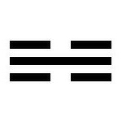
I am open to not starting Petrock with a capital letter. The inverted triangle is the alchemical symbol for water. The triangle is also used to denote the water table level in say a diagram or cross-section.
petroc
I thought of a jigsaw piece as I am adding the groundwater/hydrogeology missing bit of a larger puzzle. I also thought the interlocking rounded parts could look like water drops.
This is the trigram symbol for water in Taoist philosophy, I-Ching etc. It also looks a bit like a section through geological layers, with the middle line perhaps being groundwater. It might look more interesting in 3-d.

Slide 2
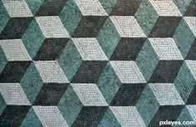
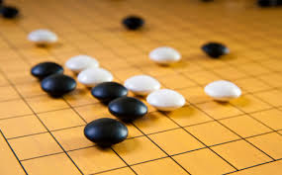
This geometric design is from a Roman mosaic and I find it very appealing.
I like to play Go and enjoy the aesthetic of the interlocking grid where stones are placed. I also enjoy the metaphor of the game to life: success through sharing and being mindful of the bigger picture while focussing on the immediate.
The above are just my early thoughts. I am open to other completely different ideas.

