Slide 1
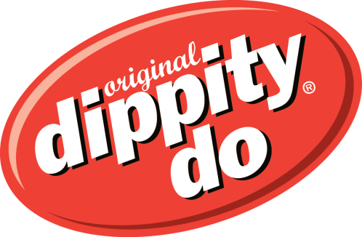
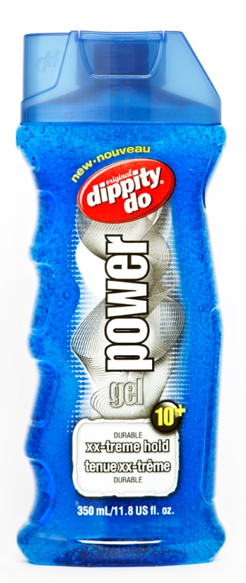
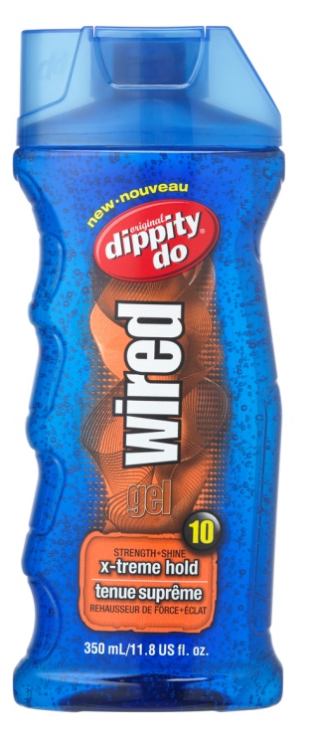
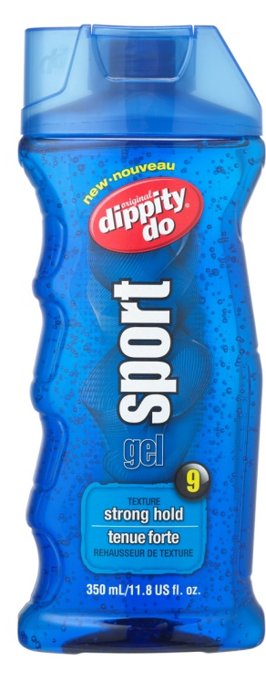
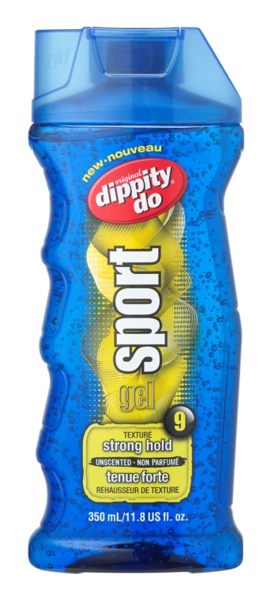
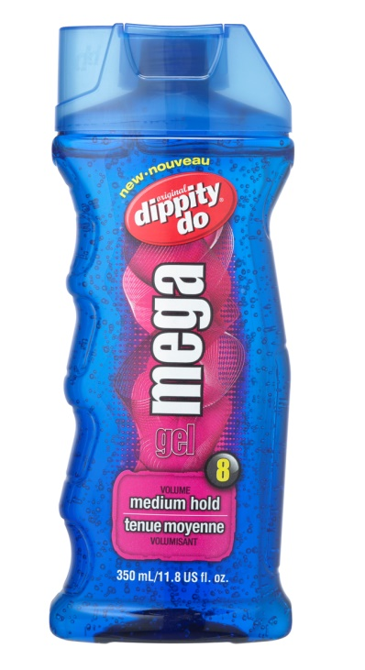
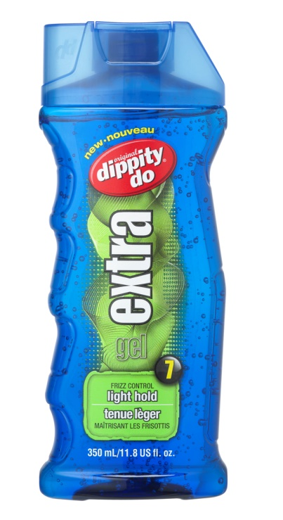
dippity-do Brand Brief
For : Design Crowd

Slide 2
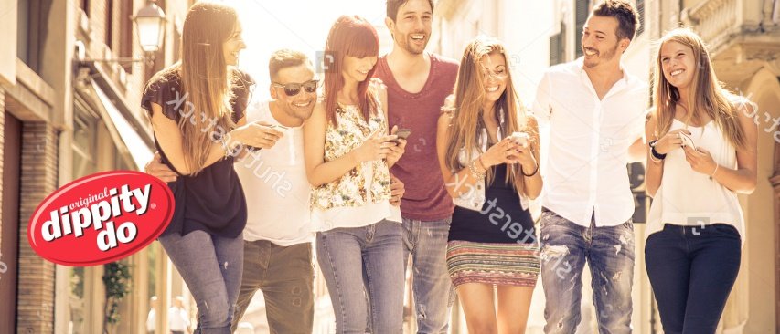
Insights
While hair gel is a staple of the styling category, dippity-do is the only brand that focuses here
The hair styling category is fragmented and noisy – multiple players with strong marketing budgets
dippity-do is a “heritage” brand – the #1 gel in Canada with a strong latent awareness amongst 35+ consumers
The usage is BROAD and diverse
HH 3+ account for almost 50% of purchase, and in fact 2 person HH make up ¼ of purchasers as well
Despite it’s value proposition, DD is found in HH across the economic scale (45% of user HH are +$70K)
35-44 represents almost 50% of purchases, but under 35 is 18%

Slide 3

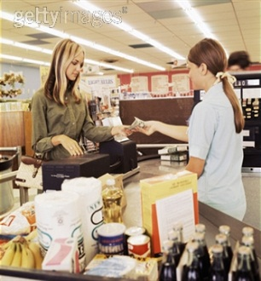

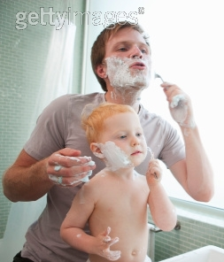
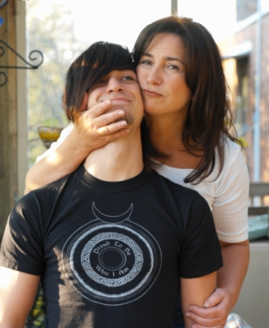
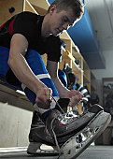
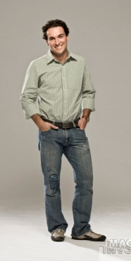
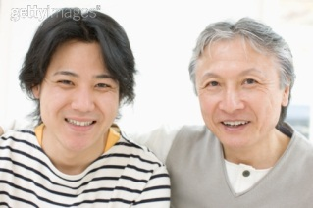
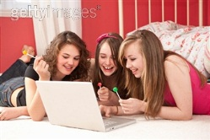
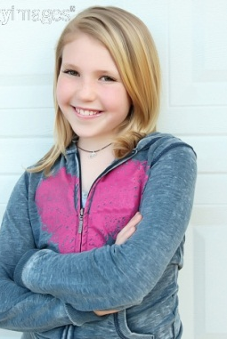
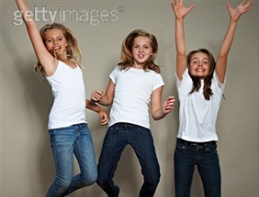
Consumer Target Insights
#1 – Mom
Principle grocery shopper/Gatekeeper
Grew up with dippity-do, was likely her first haircare product, watched her mom use it
VERY Value conscious but is motivated to please her family
Believes her family is a reflection of herself
#2 – The “Men” in her life
Dad as a “guy’s guy”, doesn’t fuss too much with his hair but does use some product to keep it in place
Older teenage boys at home – very image conscious and care about their looks and the products they use
#3 – Her teens/tweens
Female skewed, like to try new things with their hair, driven by innovation and what celebrities are doing

Slide 4
Base Positioning
Every style imaginable, Everyday
Reliable, Genuine, Approachable, Fun
Pride – you chose a brand everyone will use, Assured – you know it works, it’s tried, tested, true
Hold for every style and hair type
Broad range, #1 gel brand, heritage, alcohol and residue free, vitamin enhanced, VALUE
Icons:
Red DD logo
Bright coloured product
Historic advertising
Essence
Personality
Emotional Rewards
Functional Benefits
Attributes
Positioning: For Mom’s who want value and versatility, dippity-do is her first choice in styling products because she trusts it and it has something for everyone.

