Slide 1

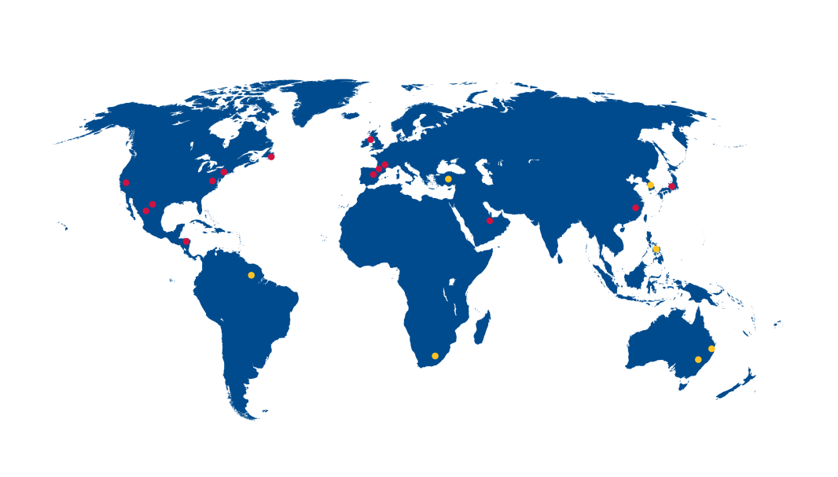
Williamson-Dickie Holding Co.
2016 Budget Presentation
Meeting
December 11, 2015
Williamson-Dickie Co. Proprietary & Confidential

