Slide 1
About the company/products
We are an online retailer of food products made in Italy
Our products are artisanal, produced in small batches and high end. They include Coffee, Liquor, Olive Oil
Our brand name is “for my friends” and our positioning is luxury

Slide 2
Label Design instructions
We need to produce a series of labels for our growing family of products. The labels need to show clearly the products constitute are part of the same collection of products. They will vary whilst but are to be based on the same template, as the range expands we will use the same template for new products
We require labels for boxes (3 box labels) that contain our product range AND a labels for a liquor bottle and for and an olive oil bottle (2 bottle labels).
Each box label will be constructed with four design elements:
The Company Logo – the Logo is the same across all labels
A graphic pattern – the pattern varies for each product
The product name – Each product name is made of a first name followed by a generic name (Espresso, Olive Oil….)
The product description – each product description varies
An empty space for personalisation
Each bottles label will include, Logo, Pattern, Product Name, Product description
We require executable files that can be used by the printer
The size of the box labels are 27cm in length x 10cm and in height. It wraps in part the box that is to be used to contain the products. The size of bottle labels are 7cm in length and 10cm in height
27cm
10cm
10cm
7 cm

Slide 3
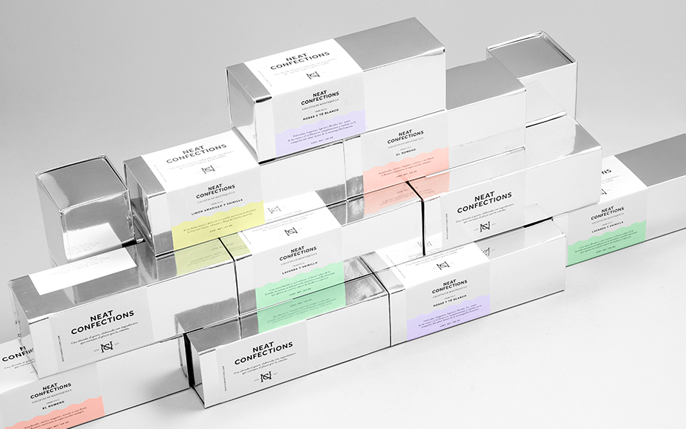
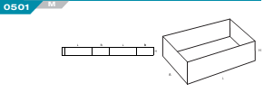
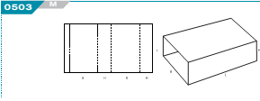
Box Description
The technical description of the box serves to give a clear indication of the box that the label shall be used for
The box is made of two components. A base and a sleeve FEFCO reference number 501 and 503
Example of similar box
Info
Size | 9x9x30 cm
Material | Cardboard 300g
Colour | Crome
Type of paint | Base Neutral and Sleeve covered wwith a silver polyester sheeet

Slide 4
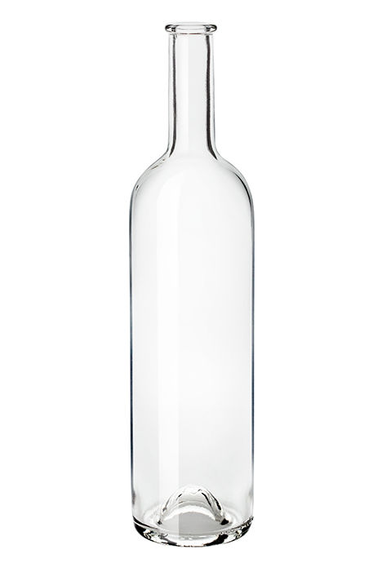
Bottle Description
The technical description of the bottle serves to give a clear indication of what the box label shall be set on against.
Exact Bottle 500ml/ 350ml bottle that will be used
Info | 500ml | 350ml
Height | 282mm | 244 mm
Diameter | 637mm | 600mm
Colour | Clear | Clear

Slide 5


Logo Design
Current Logo
Instructions for new Logo
We aim to modify the current logo to be more consonant with the brand identity
Font should be very graphic to eliminate the need of further graphic elements. The logo needs to be balanced with the other elements of the label: the pattern the product name fonts, the product descriptions etc…
Example for inspiration below. Also check out typfaces for luxury and others such as Schepps Dairy: http://bpando.org/2011/08/02/packaging-schepps-dairy/ and White Pike Whiskey: http://whitepike.com/

Slide 6
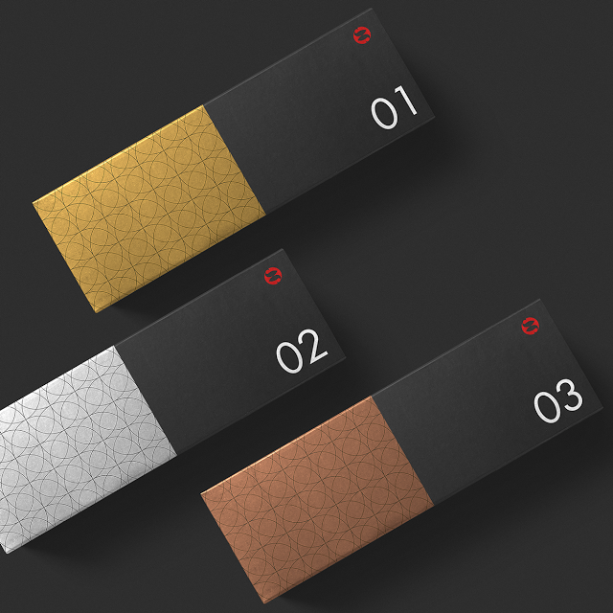
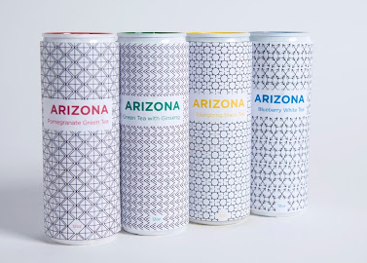
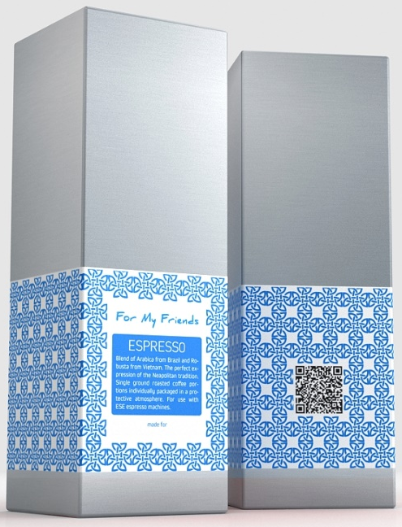
Graphic pattern
Each label will have a different pattern. Each pattern should be a translation of one of the symbols taken from the drawing below. Each Pattern will be set against a white paper label. The colour of the patterns should be the same. We have a preference for silver.
The Graphic pattern covers most of the label. Below are some examples.

Slide 7
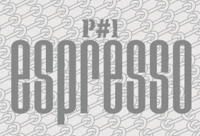
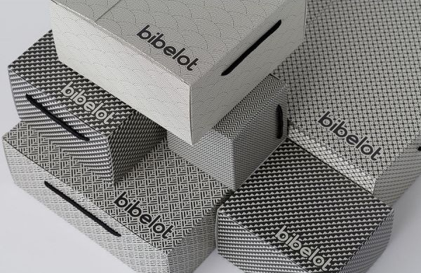
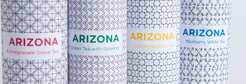
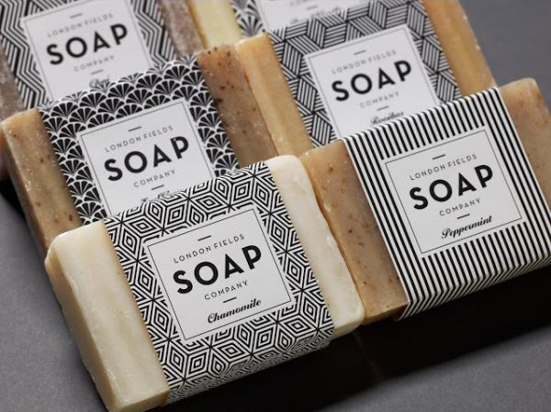
Product 1 – Product Name Instructions
The instructions are for the design of the product name within the box label
Product Name: Luca Espresso
The name “Luca” should be emphasized whilst “Espresso” should be de-emphasized.
We like two strategies where the font is sufficiently strong and graphic to be set directly against the patterns like for the bibelot or p#1 espresso OR where the product name is set in a clear space that complements the symmetry of the pattern like for the Arizona or Soap product.
Examples of product names set against a pattern
Examples of product name set in a space that complement the symmetry of pattern

Slide 8
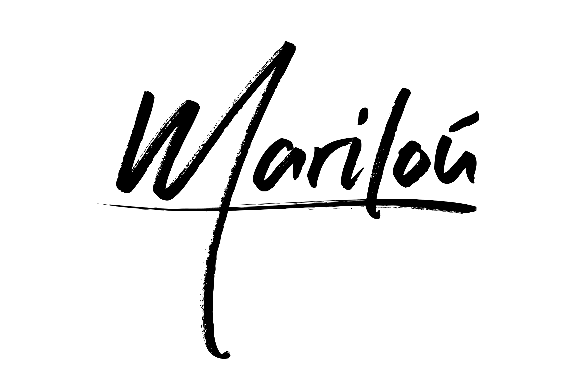
Product 2 - Product Name Instructions
The instructions are for the design of the product name within the box label
Product Name: Marilou Amaro Elixir
The name Marilou should be emphasized whilst “Amaro Elixir” should be de-emphasized.
We like two strategies where the font is sufficiently strong and graphic to be set directly against the patterns OR where the product name is set in a clear space that complements the symmetry of the pattern
This exact font should be used for the Marilou product name. We have the source file to be used

Slide 9
Product 3 – Product Name Instructions
The instructions are for the design of the product name within the box label
Product Name: Oro Extra Virgin Olive Oil
The name “Oro” should be emphasized whilst “Extra Virgin Olive Oil” should be de-emphasized.
We like two strategies where the font is sufficiently strong and graphic to be set directly against the patterns OR where the product name is set in a clear space that complements the symmetry of the pattern
The type font to be used for the name of Extra Virgin Olive Oil is not defined

Slide 10
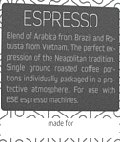
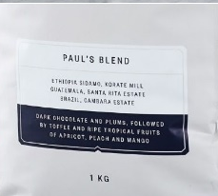
Product 1 – Product Description
The instructions are for the design of the product description within the box label
TEXT: “A Blend of Arabica and Robusta, Luca is the perfect expression of the Neapolitan Espresso tradition in single roasted coffee portions individually packaged for perfect delivery for use with ESE espresso machines.”
Personalisation – Below the Product description a space is left to write by hand to personalise the product. The caption for the personalisation space says “Made in Italy for”
Examples of product description strategy

Slide 11
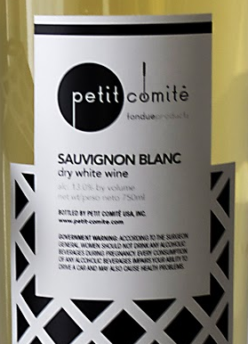
Product 2 – Product Description
The instructions are for the design of the product description within the box label
Product Description – Together with the product name, the space for handwritten personalization they constitute the product identity.
TEXT: “A rich and powerful Amaro inspired by an ancient Tuscan recipe. An elixir made from infusion of herbs, caramel, orange and magic. 35 CL ℮ / 38% Vol.”
Personalisation – Below the Product description a space is left to write by hand to personalise the product. . The Caption for the personalisation space says “Made in Italy for”
Examples of product description Strategy

Slide 12
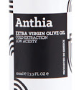
Product 3 – Product Description
The instructions are for the design of the product name within the box label
Product Description – Together with the product name, the space for handwritten personalization they constitute the product identity.
TEXT: “Cold Extracted oil from organically farmed olives so lush you can drink” 35 CL ℮ ”
Personalisation – Below the Product description a space is left to write by hand to personalise the product. The Caption for the personalisation space says “Made in Italy for”
Examples of product description Strategy

Slide 13
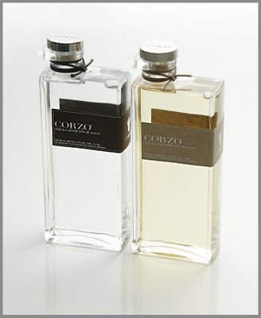
Product 2 Bottle Label
The instructions are for the design of the product description within the bottle label
Product 2 will also have an additional label that will be blued onto the bottle
There will be only 1 label for the bottle. The Label will include the brand information and legal mentions and the same graphic pattern as for the box of the product
The product name Marilou Amaro Elixir should be emphasized.
Product Content Description – Following content should be included on the label:
alcool, zucchero, aromi naturali, acqua
35 CL ℮ / 38% Vol
Codice Ditta: GRX00001R
L’ESPRESSO SRLS
Product Label Example

Slide 14
Product 3 Bottle Label
The instructions are for the design of the product description within the bottle label
Product 3 will also have an additional label that will be glued onto the bottle
There will be only 1 label for the bottle. The Label will include the brand information and legal mentions and the same graphic pattern as for the box of the product
The product name Oro Extra Virgin Olive Oil should be emphasized.
Product Content Description – Following content should be included on the label: 35 CL ℮

