Slide 1


IQ Company Overview
Welcome to
the Future where
Food is the
Best Medicine

Slide 2
Safe Harbor Statement
This business proposition contains forward-looking statements (within the meaning of Section 27A of the Securities Act of 1933 and Section 21 of the Securities Exchange Act of 1934, both as amended) that are based on management’s beliefs, assumptions and expectations and on information currently available to management. All statements that address operating performance, events or developments that we expect or anticipate will occur in the future are forward-looking statements, including without limitation or expectations with respect to the timing and progress of, and presentation of data related to, clinical trials, expected timing of regulatory filings and approvals, research and development activities and change in executive management. Management believes that these forward-looking statements are reasonable as and when made. However, you should not place undue reliance on forward-looking statements because they speak only as of the date when made. Culinary Health Innovations, Inc. does not assume any obligation to publicly update or revise any forward-looking statements, whether as a result of new information, future events or otherwise. Culinary Health Innovations, Inc. may not actually achieve the plans, projections or expectations disclosed in forward-looking statements, and actual results, developments or events could differ materially from those disclosed in the forward-looking statements. Forward-looking statements are subject to a number of risks and uncertainties including without limitation, the possibility the regulatory bodies do not accept our applications or approve the marketing of our products.
The information contained in this presentation is being furnished to you and a limited number of sophisticated investors on a “one-on-one” confidential basis for the purpose of providing certain information about a potential investment opportunity in Culinary Health Innovations, Inc., a Delaware corporation.

Slide 3

Company Overview
“The doctor of the future will no longer treat the human frame with drugs, but rather will cure and prevent disease with nutrition” Thomas Edison, 1908
“A Seismic Shift
In the Way People Eat”
New York Times, 11/15
“The Future of
Medicine Is Food”
Tulane University, 11/15

Slide 4
IQ Key Investment Summary
IQ is a rare opportunity to invest alongside $100mm of IP; product and sales channel development; and ground-breaking clinical trials in the fastest growing, highest valuation sector of the food industry – all at a time when food is becoming a pharmaceutical replacement in the healthcare industry.
Series B Accredited Investor Round $5mm
Use of Proceeds for Inventory Build, Sales channel support
$5mm = 15% ownership; $30mm pre-money valuation
$50,000 minimum investment; first closing 12/15/15

Slide 5
IQ Key Investment Summary
Potential to earn VC-type returns (10X-50X+) built on the foundation of a Fortune 100 lineage, 20 years of work, and over $100mm of investment.
Patented IP and defensible clinical claims as a key competitive advantage.
A tsunami of market dynamics: demographic, socio-graphic, regulatory have resulted in a huge commercial opportunity.
The only Deliver-to-Home wellness product that delivers measurable health benefits with 4 major clinical trials proving effectiveness.
A programmatic business model which becomes very large, very quickly with a relatively small number of customers.
Demonstrated demand by institutional customers in each of our target distribution channels.
A world class management team with experience growing and running a variety of public and private companies, and a track record of creating returns for investors.
An investment environment with lofty valuations on wellness/food/deliver to home companies in both the private and public markets

Slide 6
Executive Summary: History
IQ was developed by Campbell’s Soup Company in the 1990s as a competitive response to Healthy Choice. Campbell's Swanson HungryMan meals lost substantial share to the new “frozen diet meals”. Rather than introduce diet versions of their products, Campbell’s introduced Intelligent Quisine – a new benchmark healthy food program that was well ahead of its time. Despite a successful launch, IQ was shelved when Campbell’s reorganized and sold its frozen food division.
.

Slide 7

Executive Summary: History
Campbell’s spent over $100mm developing and performing pharma-type clinical studies - - 1200 consumers, over 10 leading research universities, and written up in 14 leading medical journals. The physiological metric improvements were amazing and are a major differentiator for IQ today.
In 2013, members of the original product development team (food scientists, medical advisors, and marketing professionals) came together and negotiated a license agreement to finally commercialize the IQ program.
.

Slide 8
Market Aligned with IQ
IQ was ahead of its time, but recent disruptive market factors have now aligned perfectly with IQ’s benefits and purpose:
Disruptive Condition #1: Medical costs forcing consumer shift to “wellness strategy” spending, at home health care solutions
Disruptive Condition #2: Healthy food mentality replacing ConAgra, McDonalds, Walmart buying habits - causing high growth, extreme valuations in entreprenurial health food space.
Disruptive Condition #3: Healthy, Delivered to Home, & Convenience are the fastest growth sectors of food market
Disruptive Condition #4: Food as Pharma is “new” market disruptor
Disruptive Condition #5: Millennials distrust Big Companies - they support new, renegade market changers (Blue Apron)

Slide 9
Differentiation
IQ is singularly unique:
In the new world of fresh, healthy, delivered–to-home meals and food-based wellness strategies, Intelligent Quisine is the only healthy, comprehensive, 100% nutritionally complete, patented, fresh, delivered-to-home meal program clinically proven to improve your health metrics.

Slide 10
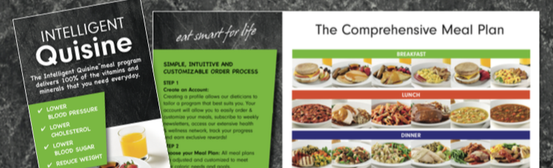
The IQ Product Line Details
Comprehensive menu of 33 complete meals with sides, dessert, 14 snacks
100% of recommended nutrients: filling and satisfying
$690 per month for 3 meals/day + 2 snacks
Average price $6.50/meal, $23/day including snacks
No other food required unlike other plans or entrees
Master Chef Designed, Restaurant Quality and Taste
Flash-freezing process preserves freshness and nutrients
Shipped to your door in 1-2 days

Slide 11
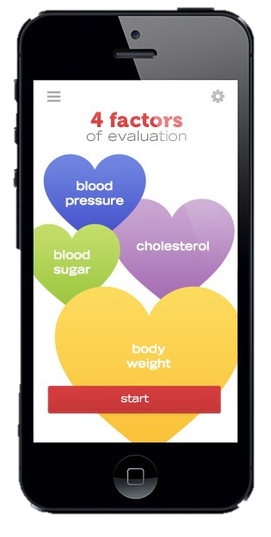
No food program or drug can match Intelligent Quisine’s efficacy and Clinical Trials
“...To our knowledge, there is no single pharmaceutical intervention capable of inducing similar, simultaneous improvements in these cardiovascular risk factors [as seen with Intelligent Quisine]” **
**Dr. McCarron et al, Archives of Internal Medicine
In Just 12 Weeks…
73% of participants reduced blood cholesterol
75% of participants reduced blood pressure
62% of participants reduced blood sugar
80% of participants reduced excessive body weight

Slide 12
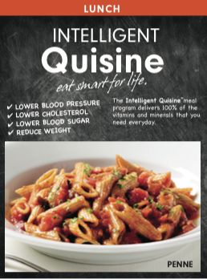

IQ Changes the Frozen/Convenience Paradigm with Restaurant Quality Ingredients and Taste
Food people want to eat that
Tastes good – Over 70% rated
food as better than expected¹
Variety of foods – 33 current
meals expanding to over 100
Master Chef reformulated
recipes as of 4Q 2015
Satiating – Larger portion
size than typical frozen meals
(15 oz vs. 10 -12 oz)
1. IQ Product Satisfaction Survey, August 2009

Slide 13
IQ sets the Nutritional Gold Standard by meeting recommendations of all 6 leading health industry organizations
 | American Heart Association | American Cancer Society | American Diabetes Association | Adult Treatment Panel III Guidelines | Dietary Guidelines 2010 | Academy Of Nutrition & Dietetics
Carbohydrates | * | ✓ | ✓ | ✓ |  | ✓
Fiber | ✓ | ✓ | ✓ | ✓ | ✓ | ✓
Protein | ✓ | ✓ | ✓ | ✓ | ✓ | ✓
Total fat | ✓ | ✓ | * | ✓ | ✓ | ✓
Saturated fat | ✓ | ✓ | ✓ | ✓ | ✓ | ✓
Sodium | NEW REQUIREMENT | ✓ | ✓ | ✓ | ✓ | ✓
Cholesterol | ✓ | * | ✓ | ✓ | * | *
Patented micro-nutrient fortification technology enables IQ to be the only company to meet the nutritional recommendations of all 6 leading health organizations.

Slide 14












Intelligent Quisine is the Only Meal Plan that is Both Clinically Proven and Nutritionally Complete
High
Scientific
Basis
Low
Low Nutritional Completeness High

Slide 15
Target Customers Demographics
First Target Market Sector: Healthcare Providers
Diabetics: 35mm in US
Pre-Diabetics: 105mm in US
Cardiac Care Deaths: 1 in 4 in US
High Cholesterol: 31.7% in US
Overweight/Obese: 67%/36%
Health/Fitness: Only 16% are “fit”

Slide 16
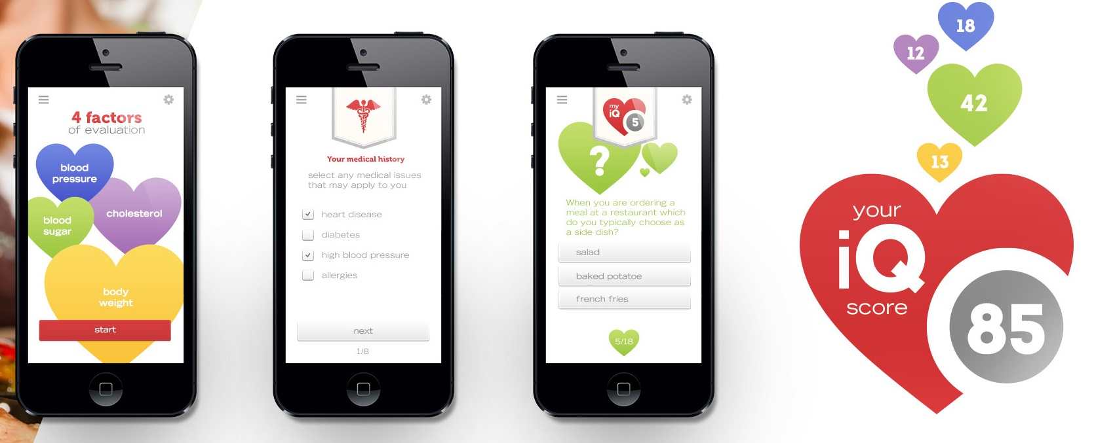
IQ Sales Plan and Status
1. Doctor Channels: Clinics treating Diabetic/Heart Patients
2. Healthcare Organizations: Humana, etc.: Reduce cost of medical care
3. Fitness Programs: Gold’s Gym, LifeTime Fitness: Achieve and Maintain Wellness
4. Hospital Groups: Replace Meals on Wheels, In and Out-Patient care, “Prescribe” meal plan
5. Retail Grocery: Publix, Albertsons, Kroger: Improve Health parameters of freezer offerings and fight Whole Foods, etc.
6. Online Sales: GNC, Vitamin Shoppe, Walgreens, etc.: Food as Pharma play
Internet Sales to Individuals: Weight,
fitness, convenience, wellness

Slide 17
IQ Sales Projections
Average number of customers ordering weekly and continuously during each month
2016
I
2017

Slide 18
IQ Profit Projections
Profitability reached during Q4 2016 with less than 4000 customers on program

Slide 19
Intelligent Quisine: Led by an Experienced Management Team
IQ is an “execution-stage” company well served by a veteran management team that has generated several billion dollars in start-up revenues in food, biotech, healthcare, and tech industries.
Management Team:
Co-Chairmen - Bruce Shalett/Todd Meister
Chief Executive Officer – Gary Beeman
Chief Culinary/Manufacturing Officer- Ken Arnone
COO/Chief Sales Officer- Rogers Kirven
Director of Nutrition - Dr. Michael Roussell
Advisors and Development Partners:
Dr. Chor San Khoo – Chief Research & Development Officer – Former VP of Global Nutrition & Health, Campbell’s Soup Company IQ Leader
American Heart Assoc., American Diabetic Assoc, American Cancer Society

Slide 20
Current Progress
Updated initial Campbell’s recipes to current tastes, ingredients and regulatory requirements Q2/Q3 2015.
Completed initial production and sampling with key accounts
Building inventory for full launch Q1 2016
Developed channel partner and key account demand projected to deliver $37mm in FY 2016
Projected to deliver $100mm+ revenue in 2017, profitable 3Q 2016
Sector valuations of 3-5x sales, 20 – 50+ PE’s (Blue Apron)

Slide 21
Key Investment Highlights
IQ is a Wellness + Data Company:
  IQ is a healthy, Deliver to Door Food Company
  IQ is a Food as Pharma medical company
  IQ collects valuable data: 30,000 person secondary field clinical underway
  IQ is only company that can prove health gains for diabetics and cardiac patients
  IQ disrupts current frozen and convenience food model
    Proprietary Micro-nutrient fortification patent
    Projected revenues $30mm ‘16, $100mm+ ’17
    Experienced management team
    Current investment round leverages aggregate $100mm prior investment and market conditions

Slide 22
Class B Round Highlights + Valuation Perspective
Financial Projections 2017 | Amount $MM | Multiples | Enterprise Value 2017 $MM
Revenues | $100+ | 2 - 5x | $200 – 500
Operating Income @ 20% | $20 | 10 - 25+ | $200 -500
Licensure Annual Revenue | $5 |  | $40
Campbell's investment of $100mm and resulting IP creates significant barriers to entry and 3-5 years of first mover advantage
Diversified and repeat revenue opportunities offer accelerated growth in 4-5 key market segments suggesting a premium revenue multiple to the comparable public market trading multiples
Strong operating margins and growth in absolute operating profit point to an upper range multiple of operating income. Associated cash flow is durable and repeatable.
Food and health care acquisition multiples are at a premium to other consumer businesses, especially with a one of a kind asset or platform. Blue Apron, et al “Deliver to Home” multiples currently 25-50
Campbell's personnel and experienced management team mitigates execution risk
Class B round @ $5mm = 15% Equity; $30mm pre-money; leverages previous $100mm+ prior investment

Slide 23

IQ Summary
Food as Pharma era starts now
IQ is easiest solution for diabetic/heart clients – largest medical population
Fresh, healthy food: Fastest growing industry sector
New, hyper-growth “Delivered to Home” Category: Blue Apron, etc.
IQ now in production, delivering test samples, ramp up 1Q 2016
$100mm investment , 4 Major Clinicals: Leadership position
The only food line that delivers 100% of Recommended Nutrients
Proprietary, patented micro-nutrient delivery technology
Extreme valuations driven by Blue Apron, HelloFresh, Plated, etc.
Low market penetration required: $200mm FY 2017, 25,000 customers

Slide 24
IQ Executive Summary You!
Thank You!

Slide 25
Intelligent Quisine Introduction
Appendix and Additional Data

Slide 26
Executive Summary
IQ Sets the Industry’s Nutritional Gold Standard:
The First and only meal plan that meets 100% of the National Academy of Sciences’ daily recommended intakes for 20 essential vitamins/minerals. Also meets recommendations from other major advocacy groups:
- American Heart Association - American Cancer Society
- American Diabetes Association - Adult Treatment Panel III Guidelines
Dietary Guidelines 2010 - Academy of Nutrition & Dietetics
$70M spent on program development: 7 patents; 4 years of trials and 3 clinical studies with over 1,200 participants at 10 major institutions
Patented dietary micro-nutrient fortification process allows IQ to provide missing nutrients throughout the day as part of the meals – assuring proper, continuous nutrition without guessing.
The most comprehensive pharmaceutical-grade clinical trials: proven, measurable health benefits
Extensive studies allow IQ to make valuable medical claims: lowers blood pressure 6%, cholesterol 8%, and blood sugar 20%, lower weight - all in less than 12 weeks
Peer-reviewed articles in 10 top medical journals

Slide 27
Key Investment Highlights
Rapidly-growing multi-billion dollar new market for comprehensive nutrition and behavior solutions to treat metabolic disease epidemic
  Nutrition is the most cost effective way to improve people’s health.
IQ’s patented nutritional solution is proven to improve health and reduce medical costs
  Advanced fortification technology enables “therapeutic food” with unprecedented clinical impact that tastes great
1Q 2016 initial launch program targets multi-billion dollar market in diabetes and cardiac disease
  Recurring chronic disease revenue model creates significant operating leverage
    Healthcare industry partners targeted to support low-cost broad market entry including managed care, hospitals, home health and direct-to-consumer
      Projecting $37 million revenues in 2016 going to $100+ million in 2017

Slide 28
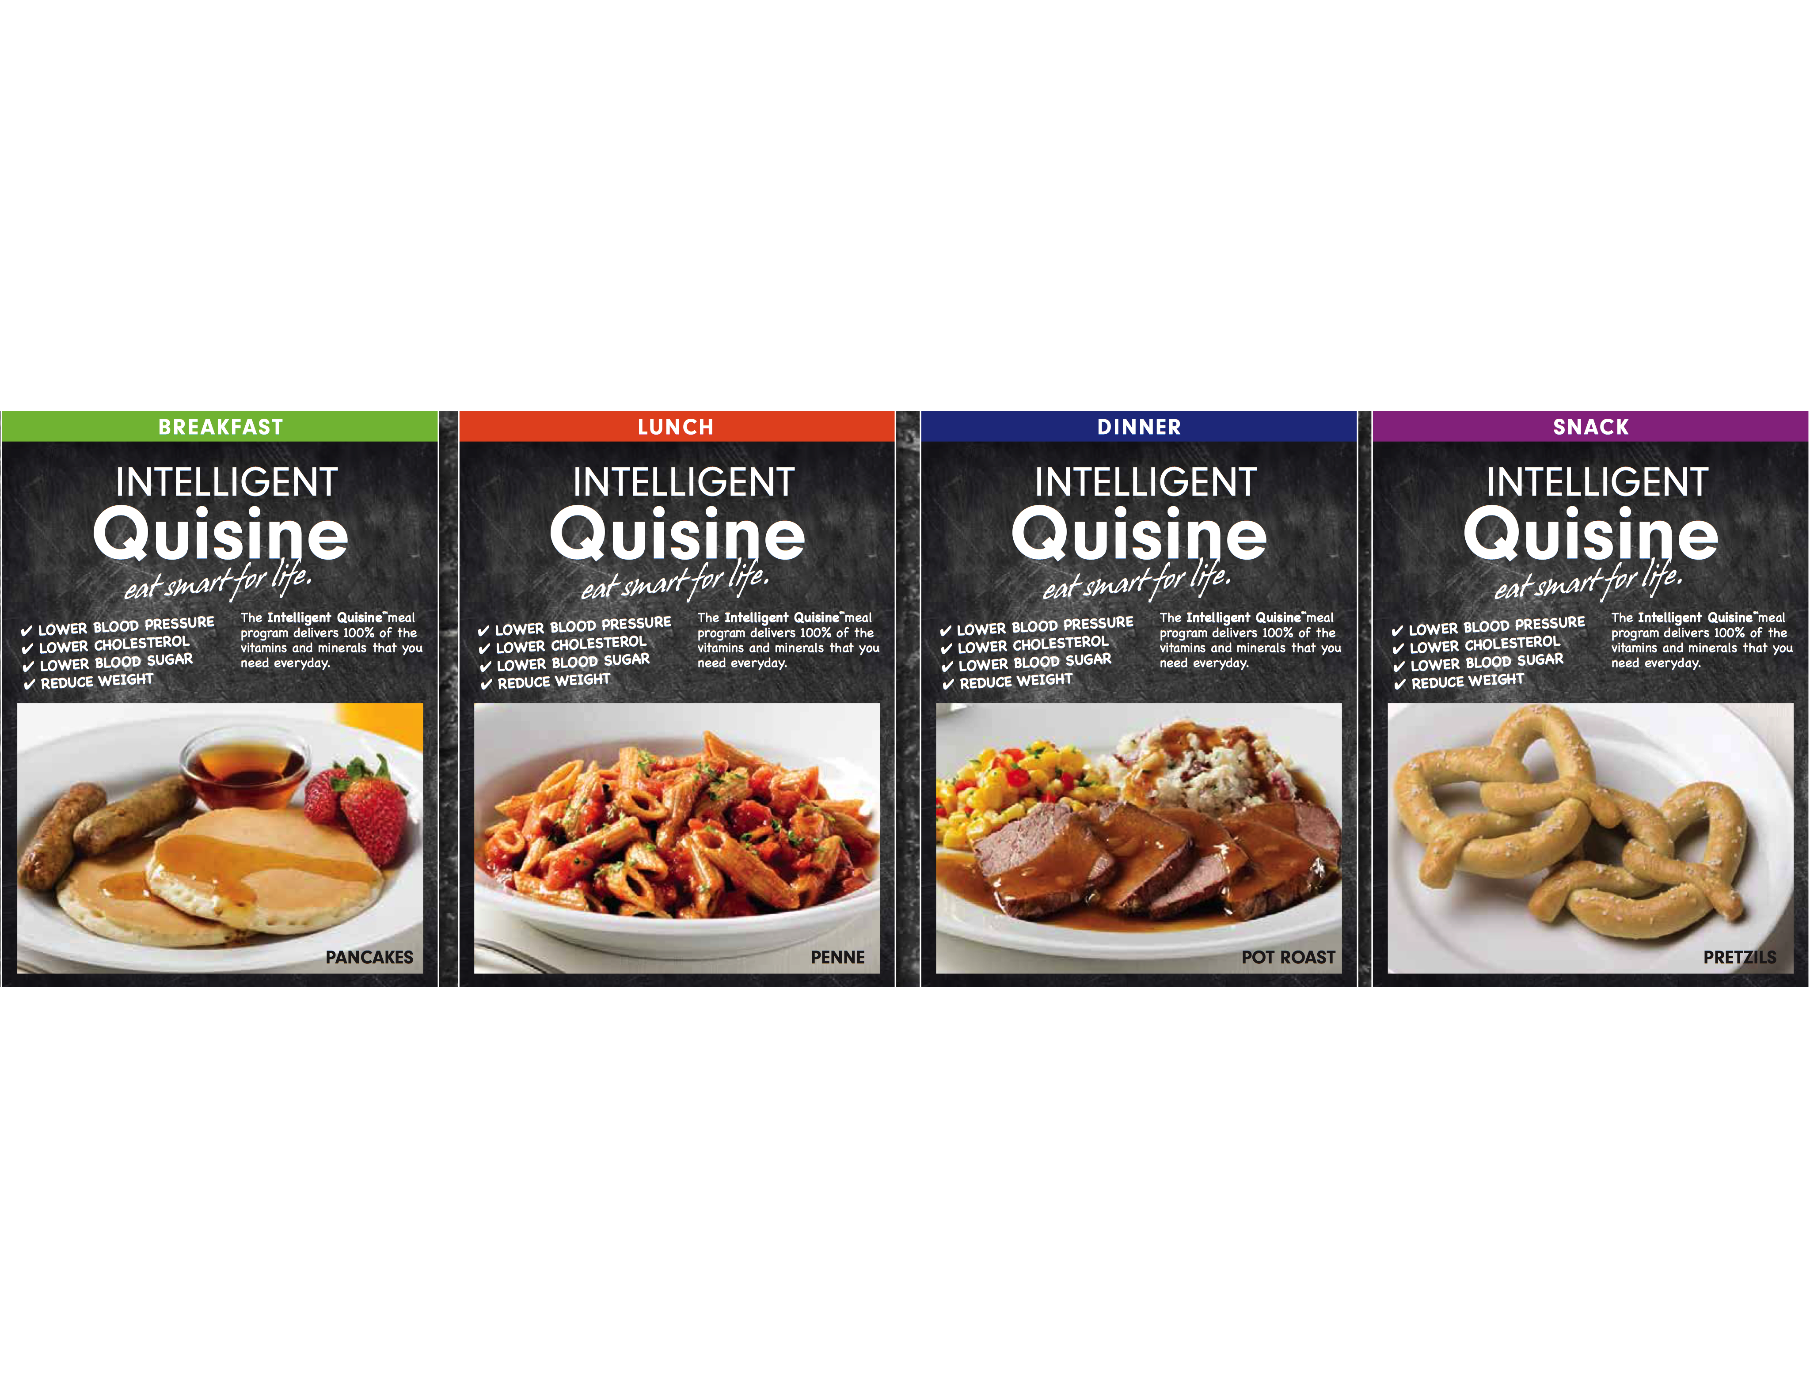
Our Mission & Philosophy
IQ’s mission is to provide people and those who care for them empowerment in choosing an affordable, safe, smart, and sustainable path to better health and living through food.
IQ is a complete and delicious three meal and two snack a day, fresh, flash-frozen food solution, which requires no additional food or supplementation to meet leading recommended daily nutritional allowances and health benefits.

Slide 29
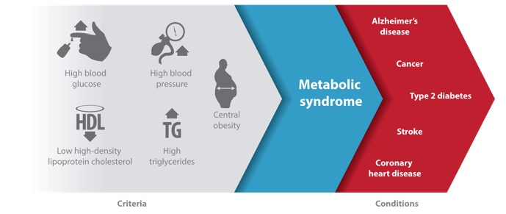
Metabolic Syndrome: Global Epidemic
Metabolic Syndrome Leads to the Most Pervasive and Expensive Medical Conditions

Slide 30
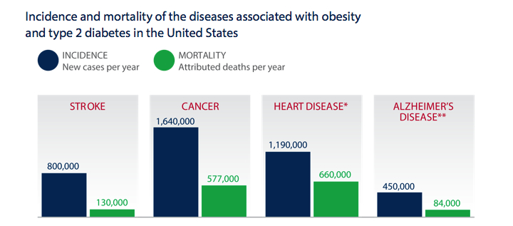
Metabolic Syndrome Epidemic in the U.S.
Source: Statistical Abstract of the United States, 2009. U.S. Census Bureau; Heat Disease Facts. Center for Disease Control;
2013 Alzheimer’s disease Facts and Figures, Alzheimer’s Association; Heat Disease and Stroke Statistics 2013. American Heart Association
Four million newly-diagnosed cases per year in the U.S.
80% of this disease burden is preventable

Slide 31
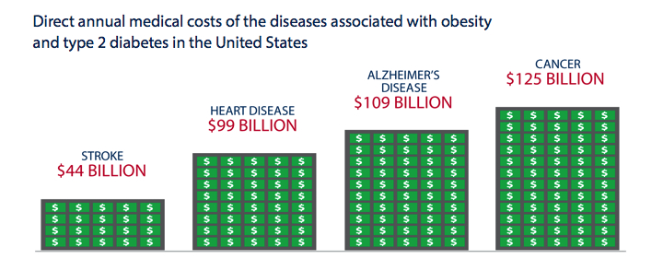
Metabolic Disease Epidemic in the U.S.
Source: DiCarlo A. Human and economic burden of stroke. Age and Ageing, 2009, Heart Disease and Stroke Statistics 2013. American Heart Association;
2013 Alzheimer’s Disease Facts and Figures. Alzheimer’s Association; Mariotto A8, Yabroff KR, et al. Projections of the Cost of Cancer Care in the United States 2010-2020. Journal of the National Cancer Institute, 2011
The direct medical costs associated with diabetes and obesity
total over $400 billion annually.

Slide 32
Food as Pharma IQ Market Opportunity
 | 2014 | 2020
Cost of Diabetes | $200 billion | $500 billion
Top Decile of Population | 65.6% of medical cost | 65.6%
Cost of Top Decile ($) | $127 billion | $328 billion
Reduction of 15% medical costs | $19.1 billion | $49.2 billion
Nutritional Opportunity | $4.8 billion | $12.3 billion
Health Savings @ 75% | $14.3 billion | $36.9 billion
IQ represents a $5 billion revenue opportunity that generates potential net savings of $14 billion to the health care system

Slide 33
Moving Beyond the Weight Loss Focus
TOTAL PREVENTIVE HEALTH
& WELLNESS MARKET
$6 - $10B
WEIGHT LOSS MARKET
$1 - $2B
The possibility to deal with metabolic syndrome by nutrition and behavior modification expands the total market opportunity by 500%

Slide 34

Drivers for the New Health Care Paradigm: Nutrition & Behavior Modification
Aging Population
Metabolic Syndrome
Health Care System Changes

Slide 35
Intelligent Quisine Value Proposition
Nutrition Behavior Modification
Science
Great Taste
“Do-ability”
Healthy
Habit
IQ: the only integrated solution in the nutrition and behavior modification market

Slide 36
IQ’s clinical effect leads to reductions in stroke, heart disease, mortality, and weight
33.2%
Lower
Risk of
Stroke
21.4%
Less Coronary Heart Disease
16.5%
Lower All Causes of
Mortality
15 Lbs
Average Weight loss
The blood pressure improvements seen after 12 weeks lead to
reductions in risk of stroke, clogged arteries, and mortality
These effects are maintained for at least a year

Slide 37
Intelligent Quisine leads to unprecedented improvements in quality of life
8%
Daily Activities
11%
Affect
8%
Mental Health
40%
Perception of Nutritional Health
12%
Perceived
Health
60% of participants reported improvements in their energy and vitality, resulting in their feeling clinically healthier, happier, and less anxious

Slide 38
Master Chef and Restaurant-Quality Ingredients
Assures Great Taste and Long-Term Customers
Over 70% of consumers were very or extremely satisfied with the meals
Average time on IQ for trial clients: 14 Months

Slide 39
Intelligent Quisine provides complete support for Customers and Channel Partners
Easy to use web portal
for customers
Channel partner back office
tracks customer orders,
commissions, inventory
Customer service located at
headquarters in Orlando
Delivered to Customer door
in 2 days
1. IQ Product Satisfaction Survey, August 2009

Slide 40
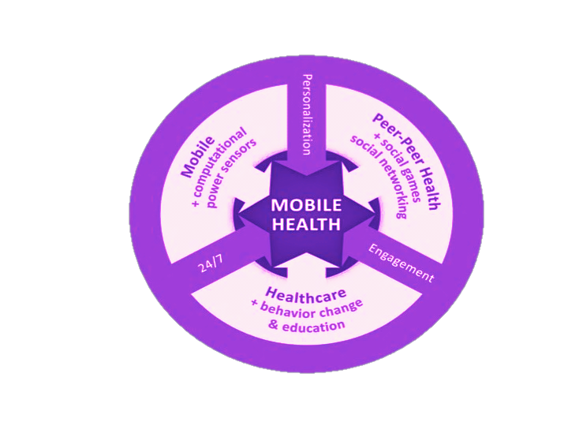
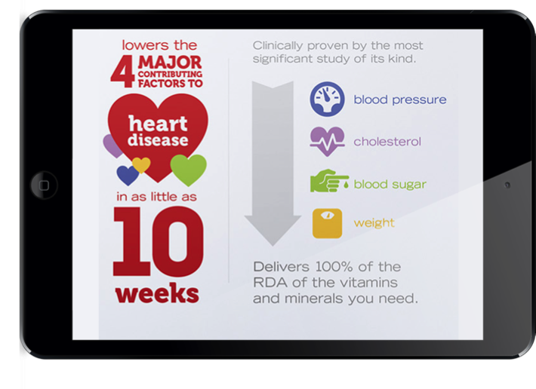
Social Media + Apps Drive Higher Compliance with All Age Groups and Demographics
IQ utilizes social media to engage users in groups to promote healthy lifestyles
Goals and incentives further reward healthy decisions even in senior populations
Extension of program drives clinical and cost outcomes at multiple levels of meal consumption

Slide 41
IQ’s Channel Strategy
Home Health Care | Medicare Advantage | Direct-to-Consumer
$750+ Million annually Universe of over one million customers IQ addresses pressing need for nutritionally complete meals for home bound seniors Pilot test and commercial launch 1Q 2016 with leading home care franchisor | $2.5+ Billion annually Universe of 14.4mm customers Provide meals as part of benefit to at-risk consumers to mitigate cost of care Pilot test and commercial launch 4Q 2015 and 1Q 2016 | $6-10 Billion annually Brand and demographic expansion Rapidly growing market for functional foods Partner discussions underway for specific DTC channels

Slide 42
IQ Marketing Plan
Buzz Generating
Influencer Seeding
PR on Pilot Test
Trade Shows
Digital/Social
Credibility Influencers
Infomercials
Mass Awareness
Home Health Care | Medicare Advantage | DTC/Retail
Caregivers Children Franchisee | Humana, Cigna, United Healthcare High-Profile Academic Hospitals | National DTC Partner Drug Stores
Results from Pilot Test Better Health Scores Increased Longevity | Results from Pilot Test Better Health Scores Lower Healthcare Costs | Media, Online and In-Store Drug-Store Promotional Partnerships
National Association for Home Health Care & Hospice | Medicare Advantage Strategic Symposium | Chain Drug Marketing Association
PPC Campaigns and SEO to Encourage Trial (Guarantee Results) Digital Ads on Health Websites and Blogs Web Content with Individual Consumer Case Studies
Doctors Sports Celebrities Nutrition Experts Media Stars
Individual Consumer Case Studies
Channel Appropriate Mass Market Strategy

Slide 43
Series B Private Placement
Initial pre-production and testing complete, now raising capital for full market launch:
$5mm to Accredited Investors
$30mm pre-money valuation
15% of Equity being sold @$5mm
Use of Capital: Inventory build +market penetration
No further anticipated capital requirement to reach profitability 3Q 2016

Slide 44
Critical Path & Use of Funds
Q4 2015 Q1 2016 Q3 2016
Brand Positioning & Digital Strategy Refinement
Mobile Apps
Data Portal & Analytics
$1.2M
Launch Inventory
$2.7M
Home Health Care Pilot & Launch
Managed Medicare Pilot & Launch
Direct to Consumer Launch
$0.5M
Sales, Service and Support
Call Center & Nutritional Counseling
Corporate Overhead
$1.1M

