Slide 1

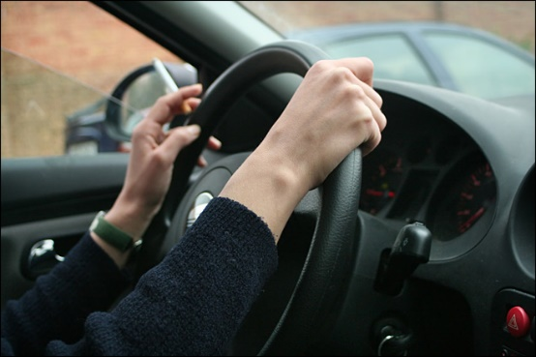
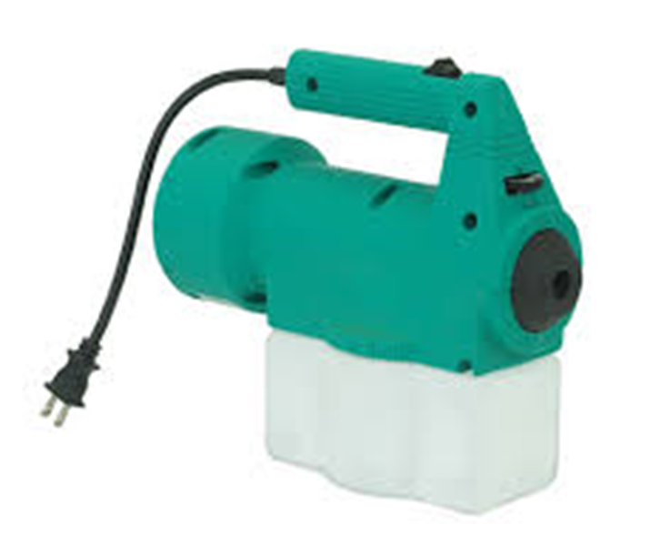
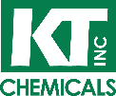
™
Smoke and Odor Control Spray
Did you know?
As of 2014, there were 2,073,000 rental cars in the United States.
The most challenging odor problems rental car providers face are: trash odors, pet smells, heavy fragrances and cigarette smoke.
15-20% of all rental vehicles are returned with a heavy smoke odor.
The average car rental cleaning costs $150 - $250 per vehicle.
In many cases WonderZorb™ can treat a car for under $10
Features and Benefits
WonderZorb™ Spray is a highly versatile and effective odor control spray. While most fragrances are only a short-term solution and briefly hide or mask odors, WonderZorb™
Spray controls and prevents odors from
returning.
WonderZorb™ is a fast and efficient solution for odor removal in commercial fleets. WonderZorb™
works well with smoke, pet odors, mold and mildew and other unwanted odors trapped in carpeting, upholstery and fabrics as well as hard surfaces.
Non-Toxic
Easy to Apply
No Harsh Chemicals
Application
Simply spray directly on effected areas using a KT Chemicals approved sprayer.
Spray in a criss-cross pattern to ensure full coverage. Repeat as needed.
Allow proper ventilation during application.
Call 855-932-2228 or email sales@kt-chemicals.com to order yours today
1002 N Central Expy. Suite 499, Richardson TX 75080
(855) 932-2228 ● info@kt-chemicals.com

