Slide 1



Slide 2
Why CCO?
The B2B healthcare marketing consulting and services firm with a proven track record of measurably improving organic growth.
We focus on working with innovative healthcare companies and organizations seeking to capitalize on the dynamic healthcare marketplace.
By leveraging our deep industry knowledge, proprietary methodology and peer-based benchmarking to inform and deploy custom content and experiences to influence those “most likely to buy.”

Slide 3
What We Believe
OUR MISSION
OUR PURPOSE
OUR BELIEF
To be the most respected B2B healthcare marketing services company in the world through the cultivation of superior talent and the relentless improvement of everything we do.
To help innovative healthcare companies and organizations transform marketing from an art to a science.
Marketing is measurable.
Without quantification, you can’t manage or systematically improve performance.
Notes:
Please change the title font color to match the blue in the CCO logo for all of the slides.

Slide 4





Our People
PETE
CUNNINGHAM CEO
MATT
MURRAY
Chief Content
Officer
CCO TEAM
Founded CCO in 2011
Presents regularly at healthcare industry and healthcare private equity conferences
Co-Founder of CeCe Cares Pediatric Epilepsy Foundation
Drake University,
BS/BA, Mktg & Economics
Joined CCO in 2014 to oversee all content development
Former political reporter for The Economist/ Congressional Quarterly (Roll Call)
Former Op-Ed writer for Fortune 500 CEO’s
Northwestern University, MS, Journalism
At CCO, we recruit our people from the top marketing & journalism programs in the country.

Slide 5











Our Experience
TARGET AUDIENCES
REPRESENTATIVE CLIENTS
Health System
Academic Medical Center
Community Hospital
Critical Access Hospital
Surgery Center
Physician Practice
Ancillary Service
Payer Organizations
ACO’s
Self Insured Employers

Slide 6
Our Results
TRADITIONAL RESULT
OUR RESULT
“Half the money I spend on advertising is wasted; the trouble is I don’t know which half.”
– John Wanamaker
Anesthesia Management Company – 138% growth in 24 months
Global RCM Company – Start-up to 4,000 employees in 4 years
ASC RCM Company – 25 to 450 employees in 5 years
Health IT Company – 50 to 400 employees in 3 years
ASC Management Company – 3x deal increase at 36% reduction in overall BD costs

Slide 7



What We Do
SUPPORT DECISION MAKING
GENERATE DEMAND
INTELLIGENT CONTENT

Slide 8
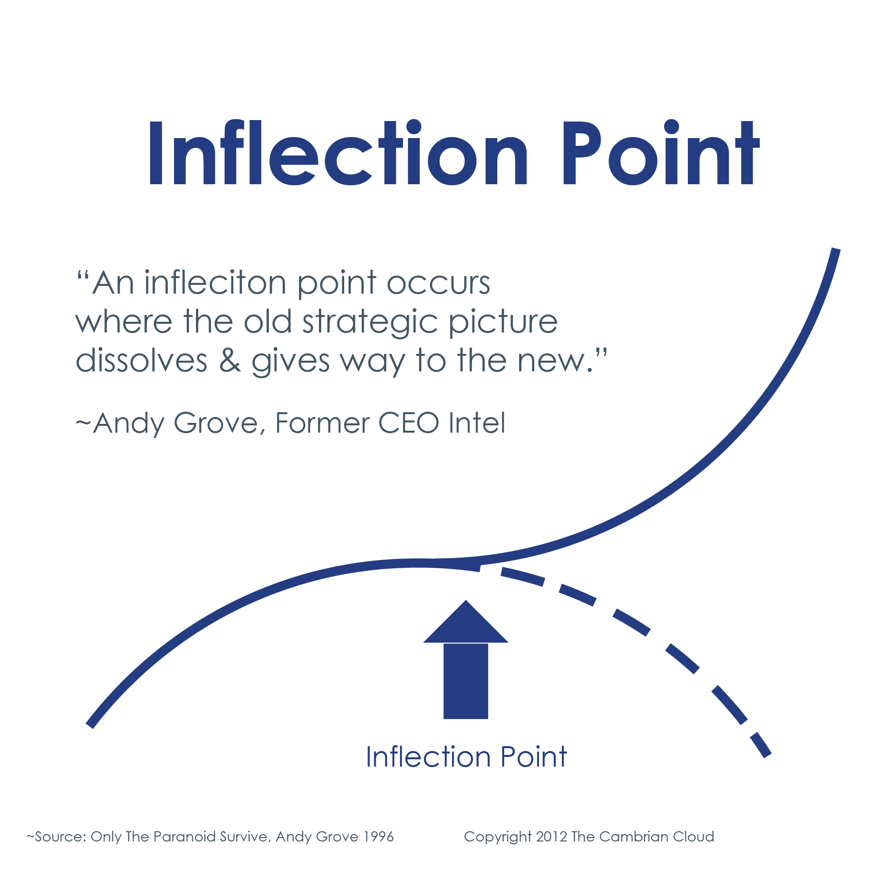
Support Decision Making - Competitive Intelligence - Market Intelligence - Predictive Modeling - Peer-based Benchmarking & Analytics - Special Situations
How We Do It

Slide 9
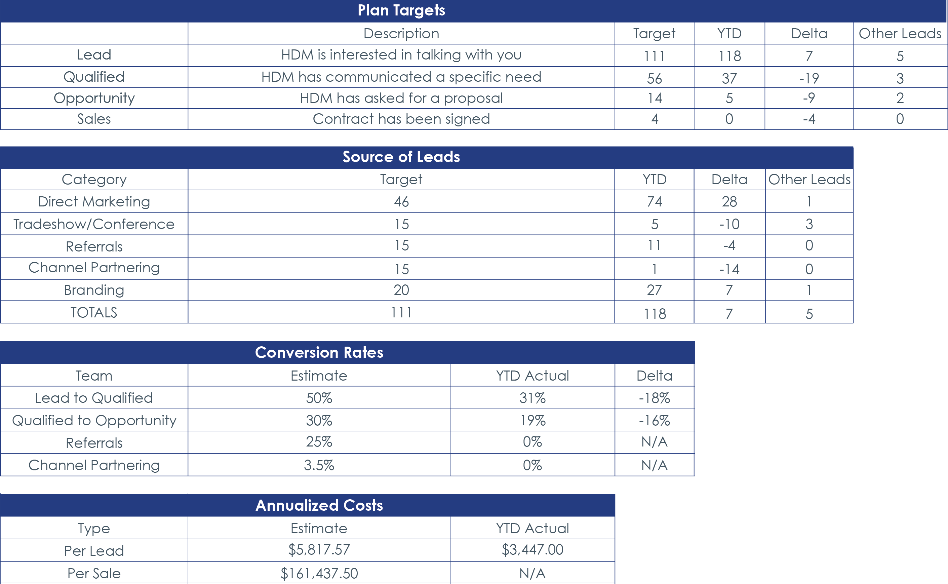
Notes:
Fix text up top.
HDM is interested in talking with you
HDM has communicated a specific need
HDM has asked for a proposal
Contract has been signed

Slide 10
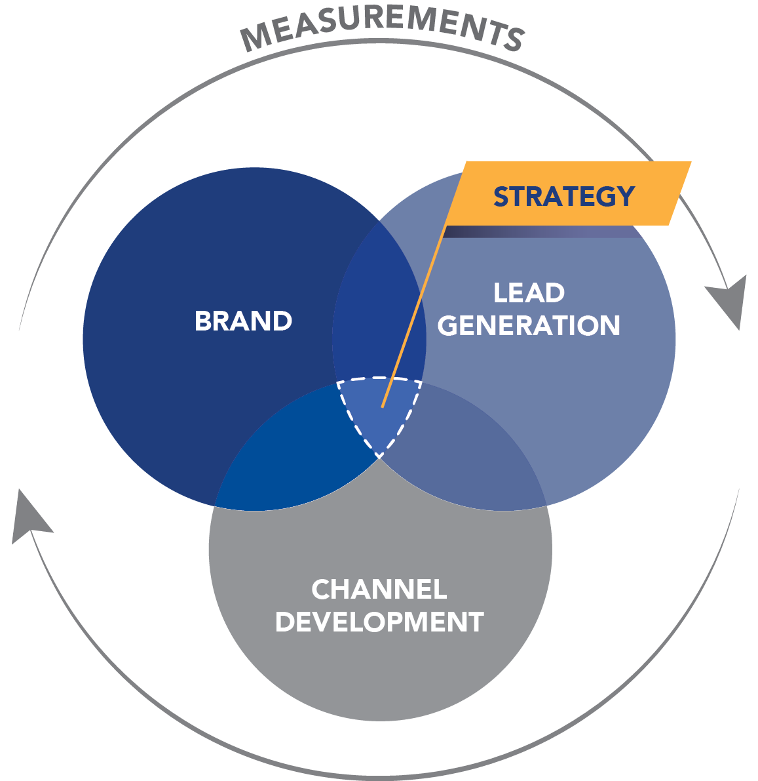
How We Do It Generate Demand - Brand - Content Marketing - Lead Generation & Nurturing - Digital - PR & Social Media
THE CCO METHOD™

Slide 11
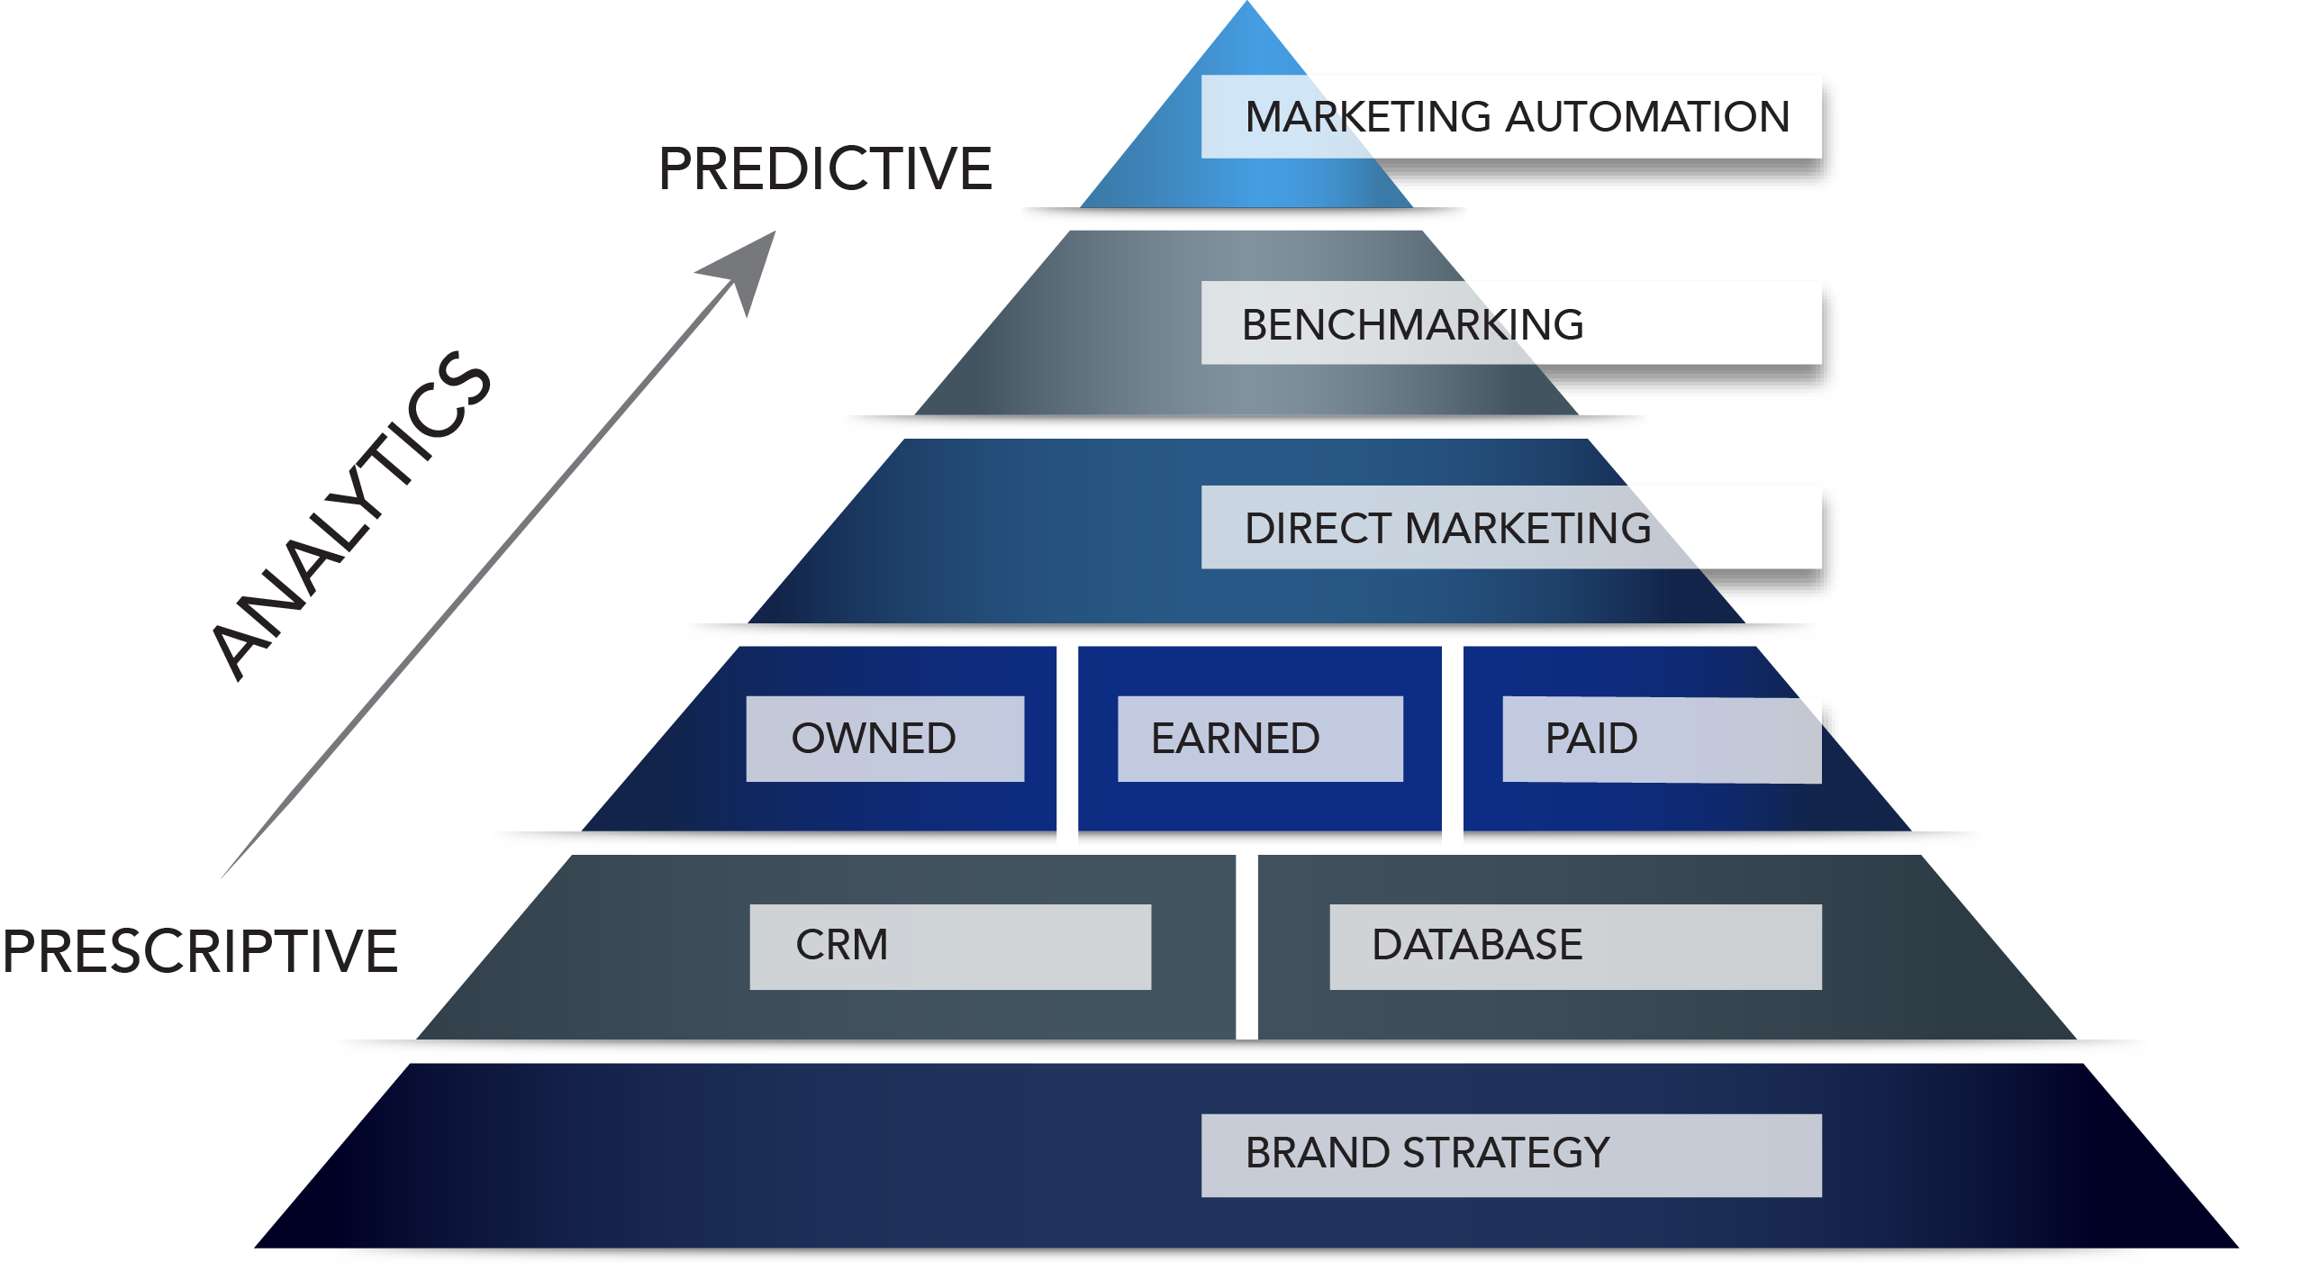
B2B Marketer Hierarchy of Needs
TM
TM
Notes:
Simplify the text box

Slide 12



How We Do It Intelligent Content
To DO: Extract…Develop…Promote
EXTRACT
- Subject Matter Expert
Interviews
- Surveys
- Industry Influencer Validation
DEVELOP
- White Papers
- Case Studies
- Infographics
- Sales Presentations
- Bylined Articles
- Press Releases
- Newsletters
- Blogs
- Website Content
Refresh
PROMOTE EARNED
- Media & Analyst Relations
- Speaker Bureau
- Awards Bureau
Owned
- Webinars
- E-blasts
- Blogs
Paid
- LinkedIn
- Google
- Trade
Notes:
Tighten up formatting

Slide 13










100+ Healthcare Industry Influencer & Content Distribution Relationships
Notes:
100+ healthcare influencer and content distribution relationships.
Logo’s of:
HFMA
HFM Magazine
Leadership Magazine
Health Leaders
Modern Healthcare
Beckers Healthcare
Health Data Management
Physician Executive
Medical Economics
ASCA
AHA
American College of Physician Executives (ACPE)
AHIMA
Etc…

Slide 15
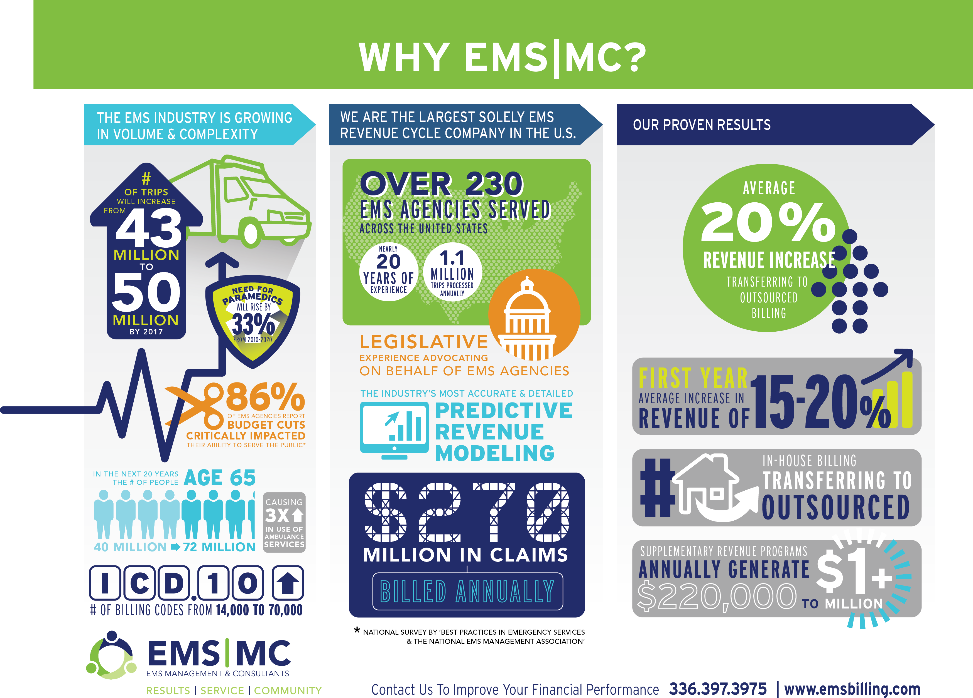
Proof of Performance

Slide 16

5.8%
$2.9 Trillion
Projected annual healthcare growth rate in the United States between 2014-24
U.S. healthcare expenditures in 2013
17.4%
$4 Trillion
19.6%
Healthcare share of U.S. gross domestic product in 2013
U.S. healthcare expenditures in 2015 (projected)
Healthcare share of U.S. gross domestic product in 2024 (estimated)

Slide 17

Xyz Company
Month, Day, Year

Slide 18
Accelerated Growth
Sales &
Service
Demand
Relevance
Sales & Fulfillment (People, Process & Performance)
Marketing Team (Internal & External)
Product/Service

Slide 19
“Strategy is choosing to run a different race because
it’s the one you’ve set yourself up to win.”
-Michael Porter, HBS Professor

Slide 20

Why Use CRM?
91%
Overall CRM Usage Increased In Recent Years, From
56% In 2012 To 74% In 2013
Of Companies With More Than 11 Employees Use A CRM System
CRM Offers An Average Return Of
$5.60
For Every $1 Spent

Slide 21
Key Performance Indicators
KPI Analysis
Cost Category | 2008 | 2009 | 2010 | 2011 | 2012 | 2013
Salary/Wages | $638,432.00 | $708,346.00 | $780,598.00 | $848,136.00 | $1,194,810.00 | $1,281,443.00
Benefits @ 20% | $127,686.00 | $141,669.00
Marketing/Business Development Costs | $371,322.00 | $419,707.00 | $316,737.00 | $228,337.00 | $283,881.00 | $237,421.00
Travel Costs | $151,179.00 | $188,098.00 | $157,464.00 | $171,000.00 | $43,000.00 | $59,267.00
Total Costs | $1,288,619.00 | $1,457,820.00 | $1,254,799.00 | $1,247,473.00 | $1,521,691.00 | $ 1,578,131.00
Qualified Leads | 52 | 78 | 79
Deals | 4 | 1 | - | 6.00 | - | 3 | Avg Cost Per Deal | Recoup Time
Cost Per Funded Deal | $322,154.75 | $1,457,820.00 | $1,254,799.00 | $207,912.17 | $1,521,691.00 | $526,043.67 | $881,736.76 | 16 months
Sample
Notes:
Regent

Slide 22
Our Experience
Single & Multispecialty Physician Management
ASC Management
Telemedicine
Technology
Revenue Cycle Management
Business Process Outsourcing
Electronic Health Records
Electronic Medical Records
Disease Management
Behavior Health
Population Health
Analytics
Management Consulting
Healthcare Private Equity
Etc.…

Slide 23
16% Marketing Automation
Usage Across All U.S. B2B Companies Today
65%
8%
4%
2%
Information Technology
Manufacturers
Financial Services
Healthcare

Slide 24

Marketing Automation
Proof Of Performance
451%
10%
15%
Increase in qualified leads by firms using marketing automation to nurture sales prospects
Increase in revenue over six to nine months for businesses using marketing automation to nurture sales prospects
Estimated reduction in creative production costs by using marketing automation

Slide 25
Owned Media
DEFINITION
EXAMPLES
THE ROLE
BENEFITS
CHALLENGES
Brand Controlled
Website
Mobile Site
Blog
LinkedIn Account
White Papers
Develop Longer-Term Relationships With Existing & Potential Customers
Control
Cost Efficiency
Longevity
Versatility
Niche Audiences
No Guarantees
Company Communication Not Trusted
Takes Time To Scale

Slide 26
Earned Media
DEFINITION
EXAMPLES
THE ROLE
BENEFITS
CHALLENGES
Placement or endorsements by third-parties
Modern Healthcare
Forrester Research
Validates products or services for existing and potential clients
Most Credible
Key Role In Most Sales
Transparent & Lives On
No Control
Can Be Negative
Scale
Hard To Measure

Slide 27
Paid Media
DEFINITION
EXAMPLES
THE ROLE
BENEFITS
CHALLENGES
Brand Pays To Leverage A Channel
Display Ads
Paid Search
Sponsorships
Distribution Channel For Delivering Messaging & Content
Immediacy
Scale
Control
Clutter
Declining Response Rates
Poor Credibility

Slide 28
Support Decision Making - Competitive Intelligence - Market Intelligence - Go-to-Market Strategy - Due Diligence - Predictive Sales Modeling - Peer-based Benchmarking
How We Do It
Notes:
Add The CCO Method ™

Slide 29
Generate Demand - Brand - Lead Generation & Nurturing - Digital - PR & Social Media - Analytics - Content Marketing
How We Do It
Demand
Sales & Service
Relevance
Notes:
Take out “The CCO Method”
Add Content Marketing to the services
Rework the Graphic

Slide 30
Generate Demand - Brand - Lead Generation & Nurturing - Digital - PR & Social Media - Analytics - Content Marketing
How We Do It
TM

