Slide 1
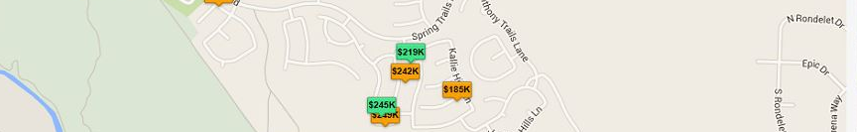

Spring Trails
Market Report of single family sold and active homes October Results 2015
Spring Trails 2014 Facts
Single Family Properties | 1,677
Median Square Feet | 2,568
Median Lot Square Feet | 7,689
Median Year Built | 2007
Dear Spring Trails Neighbor:
We expect that this information will be useful for you to learn about the Real estate market in your neighborhood.
There are 28 properties “Active for Sale” on the market, with an average price of $303,589 USD and $101.06 USD per sf.
Average time on market for sale 63 days.
In process, “Pending to Close” are 9 houses at average price of $252,808 USD with a sale price of $103.11 per sf. with 34 Days on market.
The past 6 Months market behavior was as follows: 97 Houses sold at average price of $263,545 with a sale price / sqf. of $100.50
“We will be glad to meet with you and have the opportunity to help you with your Real Estate requirements”
www.thegrijalvagroup.com

Slide 2
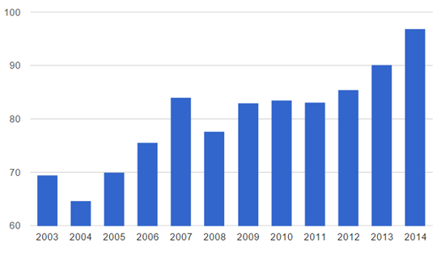
Updated information to help you make a smart decision!
If you are planning to sell or buy your home let us provide you with updated and accurate information.
Let us help to maximize your profit in the most effective way following a secure and smooth journey.
Active on the Market
The Historic Price per sqf. 2003 - 2014
 |  | Days on Market
 | Sold Price | 0-29 | 30-59 | 60-89 | 90-119 | 120-149 | 150-179 | 180-209 | Total
House Price Sold by range of $50K | $150 -$199 | 1 |  | 1 | 1 |  |  |  | 3
 | $200 -$249 | 2 |  |  | 1 | 1 |  |  | 4
 | $250 - $299 | 1 | 3 |  | 2 |  |  |  | 6
 | $300 -$ 349 | 5 | 2 |  |  |  |  | 2 | 9
 | $350 - $399 | 2 |  |  | 1 |  | 1 |  | 4
 | $400 - $449 | 1 |  |  |  |  |  |  | 1
 | $450 - $499 |  |  |  | 1 |  |  |  | 1
 | Total | 12 | 5 | 1 | 6 | 1 | 1 | 2 | 28
$ Price per sqf.
Sold Properties (Past 6 Months)
Trend
*Data from Houston Association of Realtors
 |  | Days on Market
 | Sold Price | 0-29 | 30-59 | 60-89 | 90-119 | 120-149 | 150-179 | 180-209 | 210-239 | Total
House Price Sold by range of $50K | $170 -$219 | 23 | 3 | 3 | 1 | 2 | 1 |  |  | 33
 | $220 -$ 269 | 11 | 5 | 5 | 1 |  |  |  |  | 22
 | $270 - $319 | 10 | 5 | 5 | 1 |  |  |  |  | 21
 | $320 -$369 | 9 |  |  |  |  | 1 | 1 | 2 | 13
 | $370-$ 420 | 3 | 3 | 1 |  | 1 |  |  |  | 8
 | Total | 56 | 16 | 14 | 3 | 3 | 2 | 1 | 2 | 97

