Slide 1
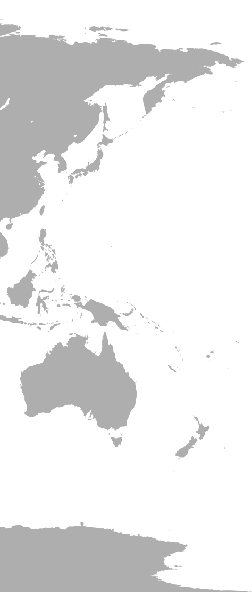



WILLIAM BROOKS
CEO/Founder

Slide 2
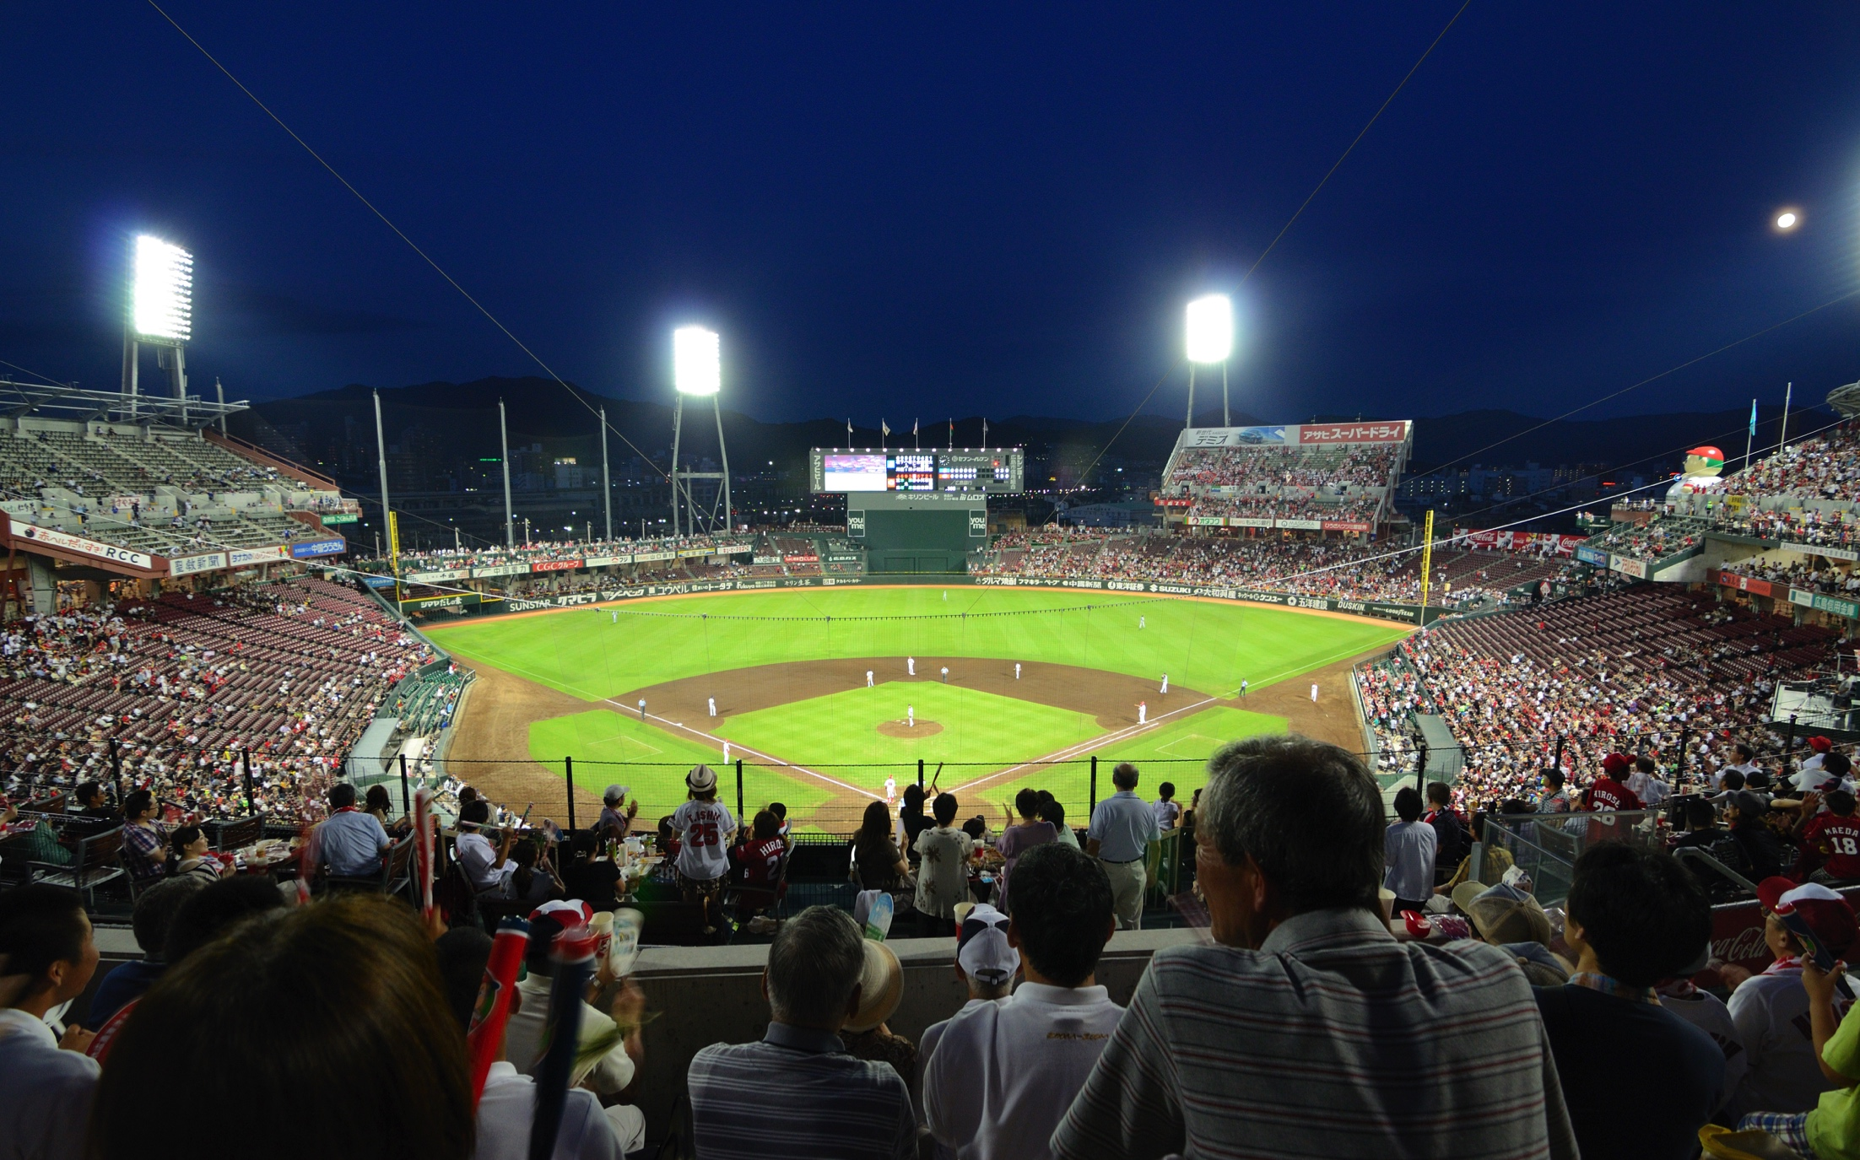

Slide 4
…AND OUR SOLUTIONS
1
.
2
3

Slide 5
KAKEHASHI’S TOP FEATURES
Great designs
Licensing relationships

Slide 6




A SIZEABLE MARKET
33,000,000
Japan-based baseball fans
32,780,000,000
Global apparel
market
110,000,000,000
Global e-commerce market

Slide 7
WHO WE’RE TARGETING
The target segments:
1
2
3
Foreign nationals in Japan (primary)
Japanese nationals in Japan
Overseas baseball fans, any nationality
The typical customer:
English or Japanese speaker
Male, 21-55
Spends $500+ per year
Attend 3-5 games/yr.
Fan of MLB and NPB

Slide 8

REVENUE MODEL

Slide 10

KEEPING US IN FRONT
We’re legal!
We’re the only e-commerce apparel shop who’s 100% legal
Foreigner-friendly business model
Bilinguality opens us up to plenty of markets
Licensing legality
The only foreigners with apparel licensing rights

