Slide 1
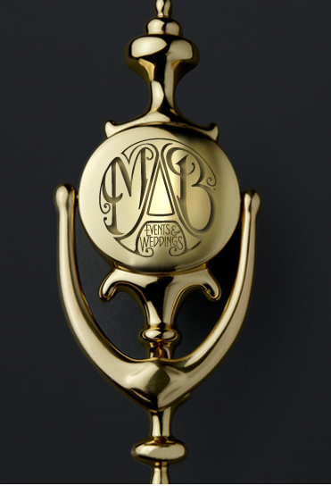

Slide 2
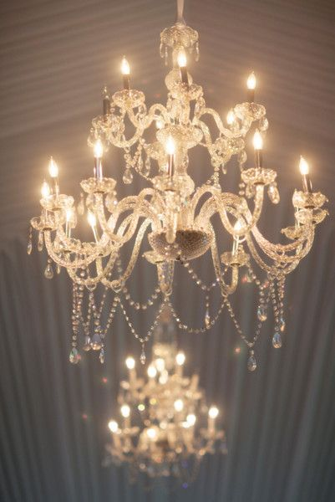
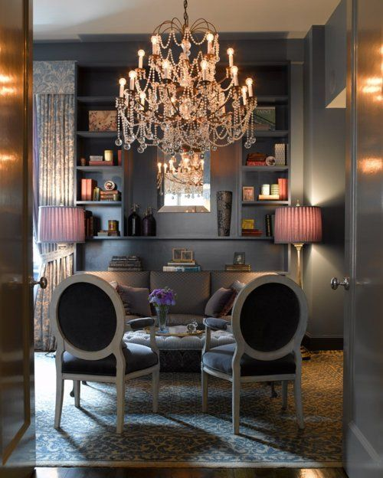
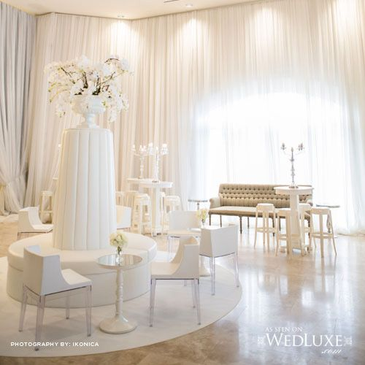
The Home Page should be white background, and have a warm, modern luxury and elegant feel.
The images above is not what we want. Please just refer to it for the colour tones and feel that we want for the Home Page/
The image above is not what we want. Please just refer to it for the style/ concept only. We do not like the colours or furniture used.

Slide 3
About Us
Diana Charles is a British luxury wedding and event planning consultancy providing bespoke, elegant and first-class service to our discerning clients in the UK and abroad. Our specialist team of event planning consultants will help elevate your vision and create impeccable designs for life's most important occasions with refinement and tasteful restraint. For us merely satisfying expectations is not enough, we aim to always surpass them.
We possess an extraordinary commitment to excellence and attention to detail. Whether you are planning a grand or intimate event, we will listen to your requirements and work with you to create a completely personalised and unforgettable occasion.

Slide 4
Luxury Weddings
The difference between an ordinary and extraordinary wedding is all in the detail. Each Diana Charles wedding seeks to indulge each of the 5 senses; sound, smell, sight, touch and taste, contributing to an experience that is tastefully executed to subtly create a memorable and lasting impression.
From small-and-intimate to large-and-lavish affairs in the UK or abroad, Diana Charles wedding consultants ensure that each wedding is perfectly tailored to every couple’s discerning taste and budget.
We believe having the right people working on your wedding is vital. That is why we are proud to work alongside the some of the most respected event professionals in the industry who share our passion, commitment and high standards of service. From catering to floristry and cake design to all the special touches, our flexible and bespoke approach to wedding planning ensures that every aspect of your day is first-class.

Slide 5
Services
Our approach to wedding planning is bespoke; we do not offer packages or try to shoe-horn you into an existing service.
Comprehensive Wedding Planning Service
This an end-to-end service that includes Concept, Design, Planning and Coordination.
By starting with an initial concept such as a colour, a pattern or an era, we can help identify a focus for the wedding design that will guide the overall style for the day. We will recommend complimentary colours, table settings, linens, glassware, lighting and furniture to help pull the overall look and feel together. To then help you visualise the aesthetic, our team will create graphical mood boards.
We will provide a full concierge service in collaboration with our trusted event professionals to arrange the important details such, flowers, cake, catering, photography, entertainment, transportation and much more. In addition, we organize dedicated styling sample meetings to enable you view and critique each element, namely floral design and food tasting.
Our comprehensive planning service offering is customised to align with the specific needs of each client.
Wedding Day Coordination Service
During an initial in-person consultation we will ascertain the progress made to-date and offer suggestions and remedies to any problems or missing elements. We will then liaise with and coordinate your wedding suppliers. We will ensure timings are realistic and produce and distribute a Wedding Day Production Schedule to vendors and wedding party. During the week of your wedding we will manage and oversee wedding rehearsal and any pre-wedding day set up. On the day of your wedding we will manage every aspect of the celebration from start to finish, ensuring that it runs seamlessly leaving you to relax and enjoy your day. These services are typically provided 8 weeks leading up to the wedding day.
Consultancy Service
Our one-to-one consultancy service is aimed at those who want to plan much of their event themselves, or just need advice on certain aspects of planning or supplier selection.

Slide 6
Other Special Events
Although we specialise in wedding planning, we are also able to help you plan your bridal shower, baby shower, christening, luxury parties including milestone birthdays or other special event.
From event concept design, event styling, production, floral design, catering, set building, lighting, pyrotechnics, sound and sourcing entertainment, our seasoned team will ensure element of the event will leave you and your guests suitably impressed.
We apply all the same principles, attention to detail and business practices whatever the event.

Slide 7
Gallery

Slide 8
Testimonials

Slide 9
Contact Us
info@dianacharles.com
www.weddingsbydianacharles.com
Add links to Twitter, Facebook, Instagram and Pinterest.

