Slide 1
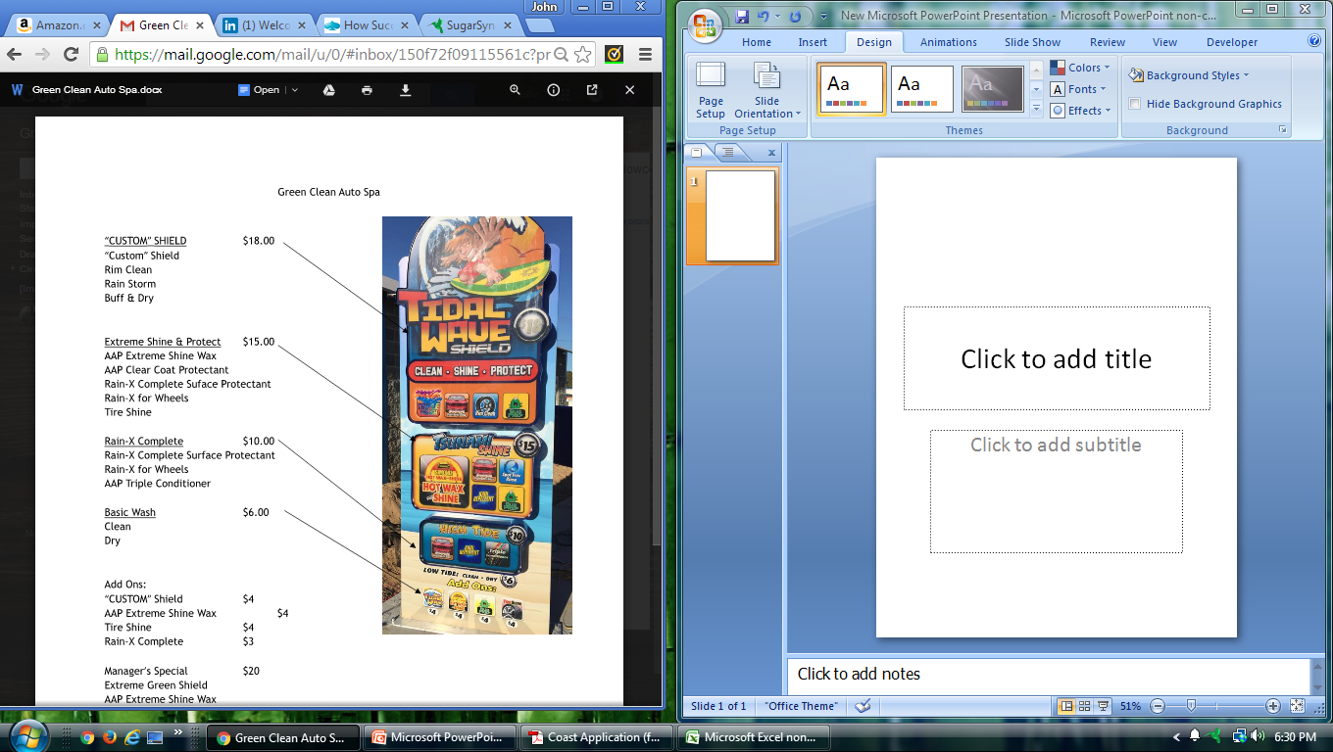
Spartan Shield (Custom) $18.00
The Ultimate Paint Sealant and Protection Technology
Spartan Fire Bath – CUSTOM ICON
Spartan Shine – CUSTOM ICON
Spartan Sealant– CUSTOM ICON
Spartan Shield - CUSTOM ICON
Ultimate Clean & Shine $15.00
The fastest way to wax!
Supreme Clean Plus:
-Fire Wax & Shine (Custom) – 3J Base
-Paint Conditioner – 4L
-Undercarriage Wash – 6C
-Clear Coat – 1J
-Buff N Shine - 4G
Supreme Clean $10.00
Quick Clean Plus:
-Tire & Rim Shine -7K
-Ice Instant Shine – 2D
-Triple Rain Polish – 4J
-High Pressure Blast- Pg83 –Design G
Quick Clean $6.00
Wash – Spotless Rinse – Jet Dry
Add Ons
-Fire Wax & Shine – 3J -$4
-Spartan Shield – CUSTOM -$4
Tire Shine – 7K- $3
Buff N Shine – 4G- $3
Manager’s Special $20.00
Spartan Shield +
Ultimate Clean & Shine
-Its everything we have!
*Icons in red denotes the headliner chemical for each menu group. Icon should be larger than others in group
*Branded chemicals should have brand logo at top right of icon i.e black magic, turtle wax, armor all

Slide 2
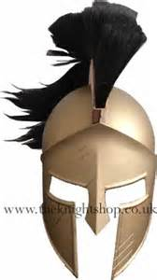
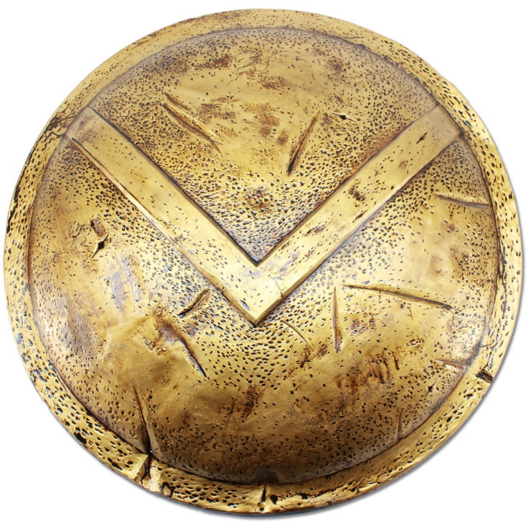
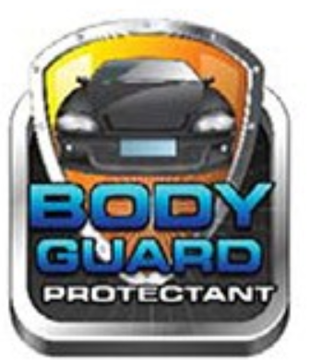
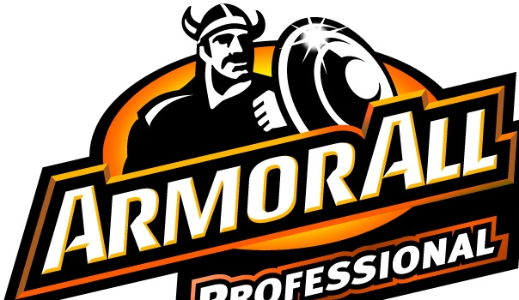
Spartan Shield – Custom Logo
The Ultimate Paint Sealant and Protection Technology
Use Spartan helmet on turtle logo head and body. Adjust as necessary.
Use round Spartan type shield instead of Viking shield
Replace shield with Spartan shield. Use appropriate graphics to match each type of service. For example, the fire bath could have red fire foam similar to fire on 5J
Spartan Shield
The Ultimate Paint Sealant and Protection Technology
Spartan Fire Bath
Spartan Shine
Spartan Shield
Spartan Sealant

