Slide 1

Dave Jasnos
Co-founder & CEO
dave@medcontroltech.com
508-479-8109
Notes:
Hi I’m Dave and I’m the co-founder and CEO of MedControl Technologies and we’re improving medication adherence in the patient setting. We’ve developed a patented prototype and are looking to raise $500K to move forward with a pilot study.
[LM]: Good! Anymore achievements you can mention on this intro slide?
[DJ]: Other than having verbal “interest” from people (clinic, congressman, pharma company) I’m not sure what to say. The prototype works and it’s not just on a benchtop? No FDA required?

Slide 2
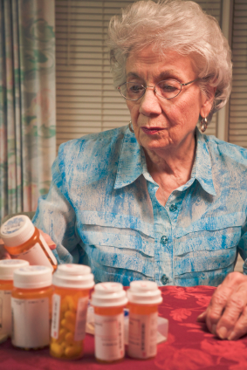
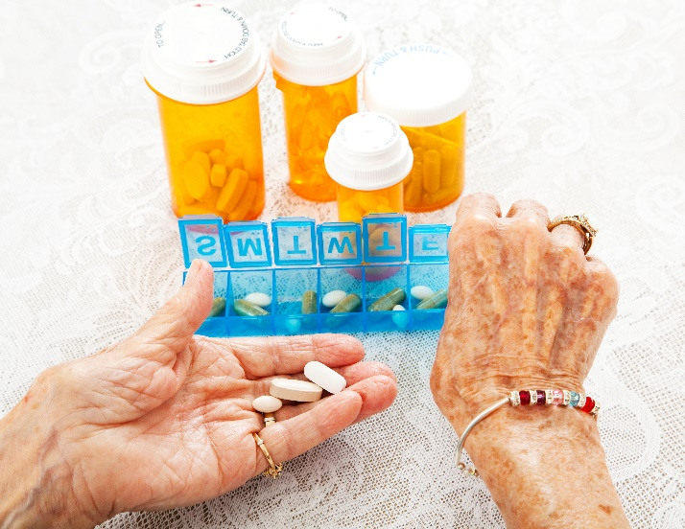
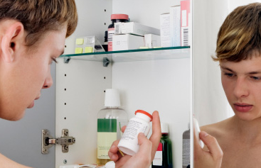

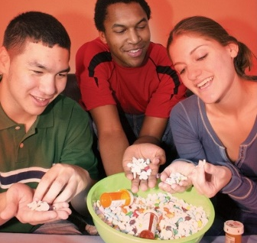
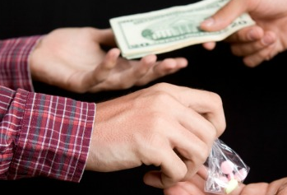

Medicine is out of control once it leaves the pharmacy
And it can affect anyone
25%
23K
Forgetfulness
Accidental under/overdose
Didn’t refill
Abuse & Addiction
Often begins innocently
Openly prescribed medicine is highly addictive
OF CASES
PRESCRIPTION
OVERDOSE DEATHS
(3X HEROIN)
Notes:
A major problem in the administration of prescription medicine is the lack of control and oversight once the medicine enters a patient’s hands.
Our product is capable of addressing the two predominant segments of the affected population.
The first is non-adherence that results from the patient simply forgetting whether or not they’ve taken or refilled their medicine and often affects the aging population.
The second is intentional non-adherence for recreational purposes that leads to abuse and addiction. This problem transcends all socioeconomic segments of society, has many causes, but often begins in innocent ways that spiral out of control.
Good.

Slide 3
General adherence/forgetfulness photos

Slide 4


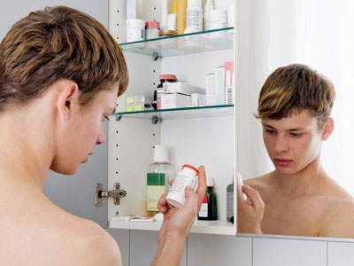

Abuse photos

Slide 5
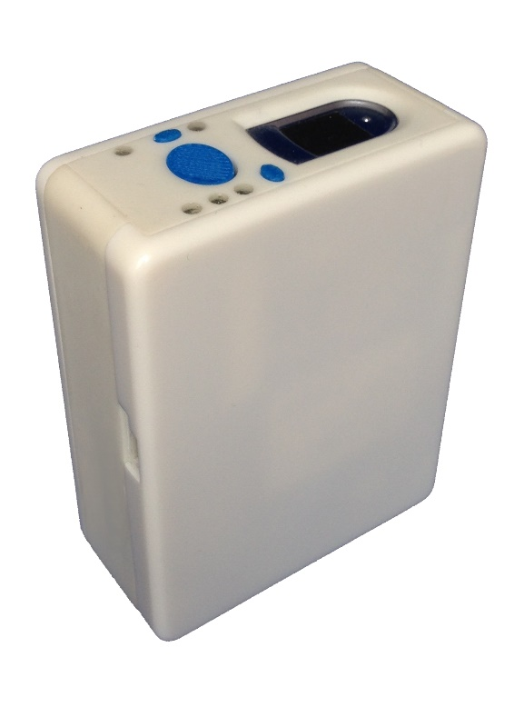

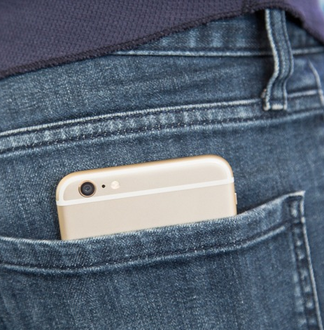
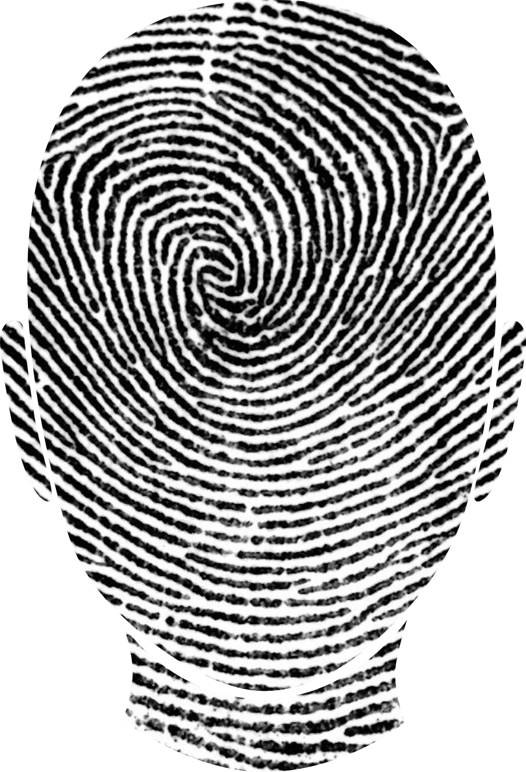

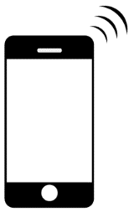


The pill bottle meets smart phone technology
Patient identification
Secure, controlled access
Portable, pocket-sized, but expandable
Pharmacy-friendly dispensing device that restricts and enables the consumption of medicine to a single patient as prescribed
Technology enabled
Notes:
Our patented product is a secure, compact, portable, patient-specific medication dispenser that employs a variety of technological capabilities.
The user must be present to scan their fingerprint and only receives a dose of medicine at a time according to their prescription, preventing over and under use.
Accessible by one user (biometrics – fingerprint)
Dispenses one dose at a time at a predefined maximum frequency
Compact and portable – pocket-sized
Tamper resistant & evident
Cellular communication capabilities depending on the application
OK

Slide 6
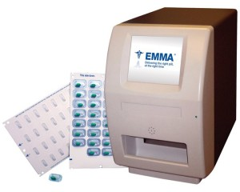
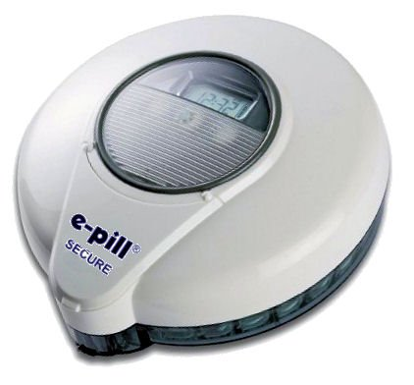
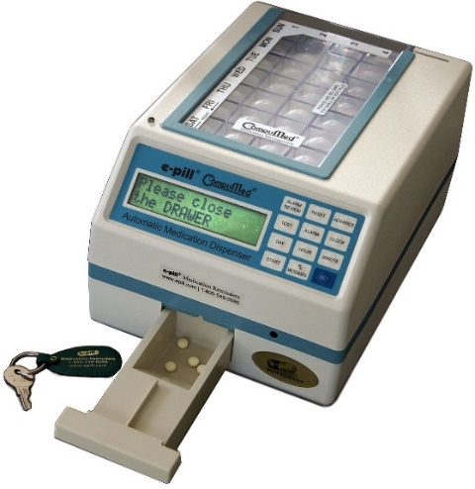
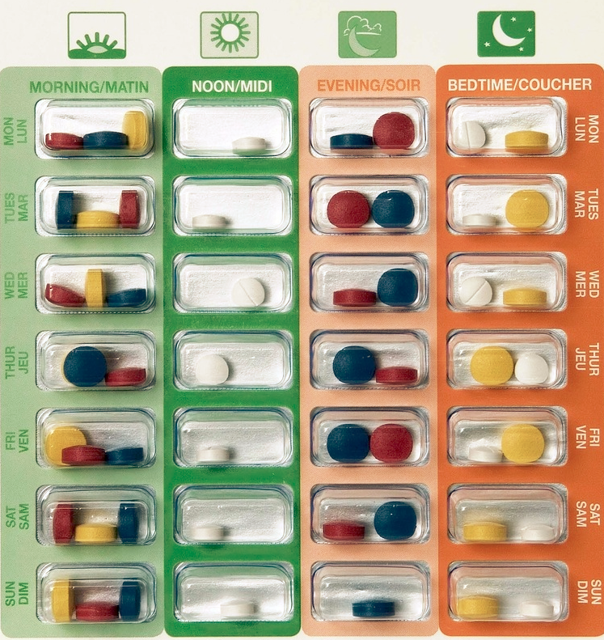
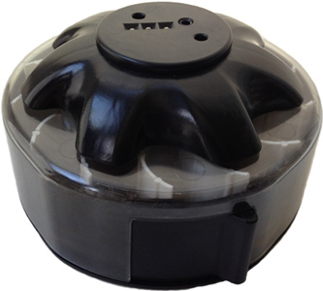
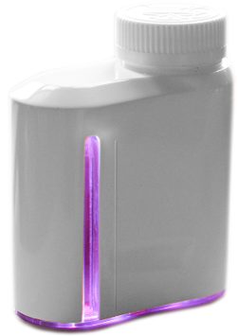
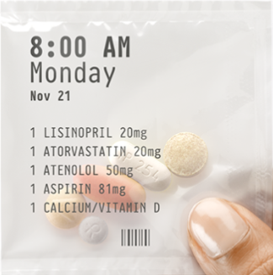
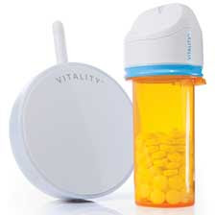
Uniquely positioned in the marketplace
Size & cost
$100B Market Opportunity
Security, control, capability
Notes:
Competing products vary in degrees of complexity, cost, and size exist, but none have the unique feature set of our device.
[LM]: Can you put the $ size of the market inside your market opportunity box?
[DJ]: Yes, this number is based on the total costs that result from prescription drug abuse/addiction.

Slide 7
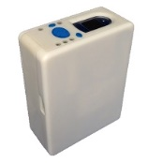
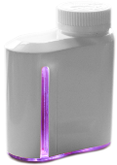
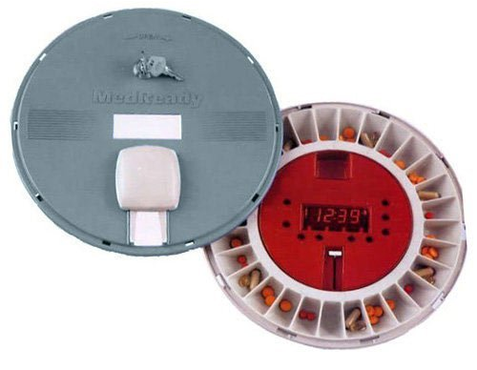
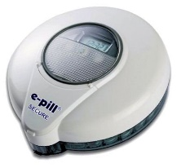
Secure, portable, and patient-specific
Wireless/mobile enabled
Identity verification
Restricted access
Tamper detection
Compact/portable
Low cost (<$200)
Bulk loadable
MedControl | ✓ | ✓ | ✓ | ✓ | ✓ | ✓ | ✓
Adheretech | ✗ | ✓ | ✗ | ✗ | ✓ | ✓ | ✓
Abiogenix | ✓ | ✗ | ✗ | ✗ | ✗ | ✓ | ✓
MedReady | ✓ | ✗ | ✗ | ✗ | ✗ | ✗ | ✓
E-pill | ✓ | ✗ | ✗ | ✗ | ✗ | ✗ | ✗
Notes:
[LM]: I would talk to the first 4 points a bit.
[DJ]: Done below.
This can be seen in further detail in this competitor feature comparison.
Our device is specifically distinguished from similar products because its secure while remaining pharmacy-friendly.
A pharmacists or prescriber can quickly bulk load the device similar to a standard bottle and lock it prior to issuing the prescription.
Once in the patients possession medicine can only be accessed according to a schedule by scanning a fingerprint.
Breaches can be detected using sensors that can flag and communicate a fault.

Slide 8
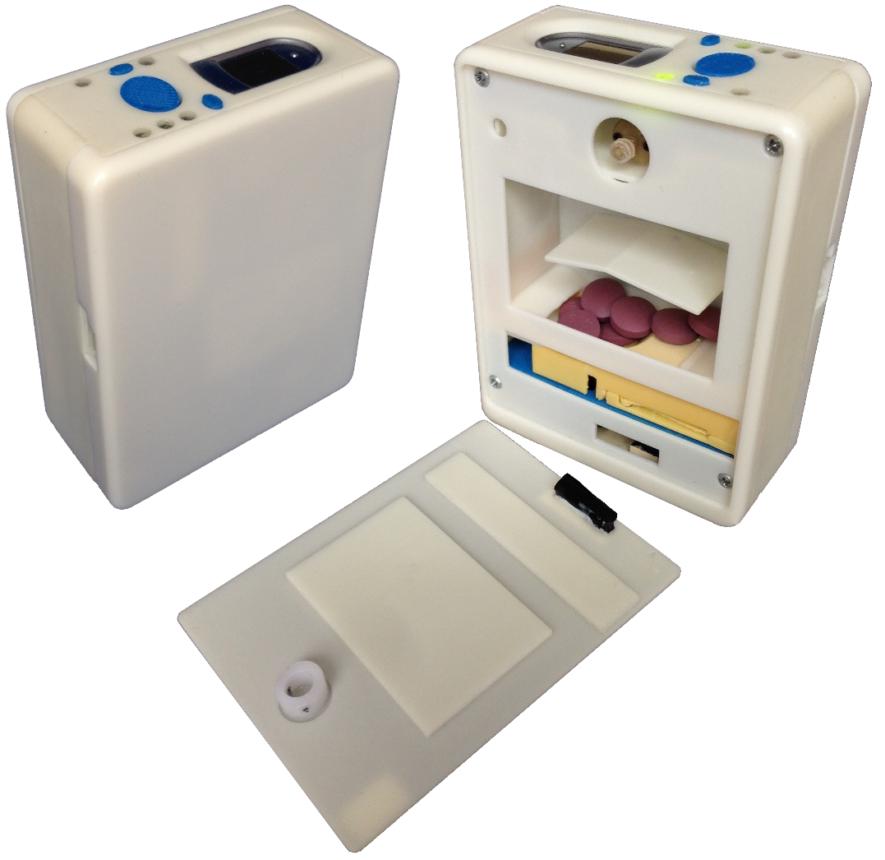
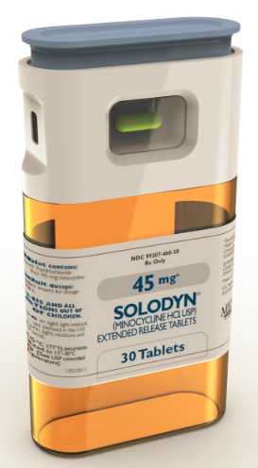
Refine functional prototype into commercial design
Next Generation Concept – Don’t put on website
Current Prototype, 4 Issued Patents
Notes:
Currently, we have a functional prototype the accommodates a variety of pills geometries, and can integrate with a pharmacy with minimal disruption to operations.
Our next product development step is to refine the prototype into a more consumer friendly product by reducing size, cost, and improving the aesthetic design.

Slide 9
Team
Dave Jasnos, Co-founder and CEO
Former COO of Proximedics Technologies – 1st employee to >$1M revenue in a year
Medical device engineering and general management at Medica Corporation
BS Mechanical Engineering from University of Massachusetts, MBA from Carnegie Mellon University
Arthur David, MD, Co-founder
25 years practicing medicine in private and hospital settings with a large addiction community
BS from the University of South Carolina, MD from Ross University School of Medicine
Steve Fleck, Advisor
Founder & current CEO of Proximedics Technologies
Co-founder and former CEO & CTO of ClearCount Medical Solutions
On the Board of Directors of REBIScan and Advisory Board of Accel Diagnostics
BS Applied Physics from Cornell University and MBA from Carnegie Mellon University
Lawrence Dunn, MD, Advisor
25 years of experience as psychiatrist, medical research director, professor, and inventor
BA Health Sciences from Kalamazoo College and MD from the University of Michigan in Ann Arbor
Bally Designs, Contracted design services | Virtec Enterprises, Contracted engineering services
Notes:
We have a founding team of experienced doctors, inventors, engineers, and successful entrepreneurs and we’re looking to take this company to the next level.
Thank you.
[LM]: I would end on the comparable slide. Put this slide right after the financial slide.
[DJ]: Done.

Slide 10
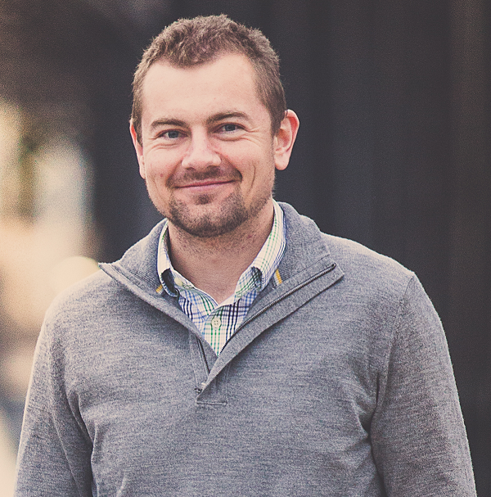
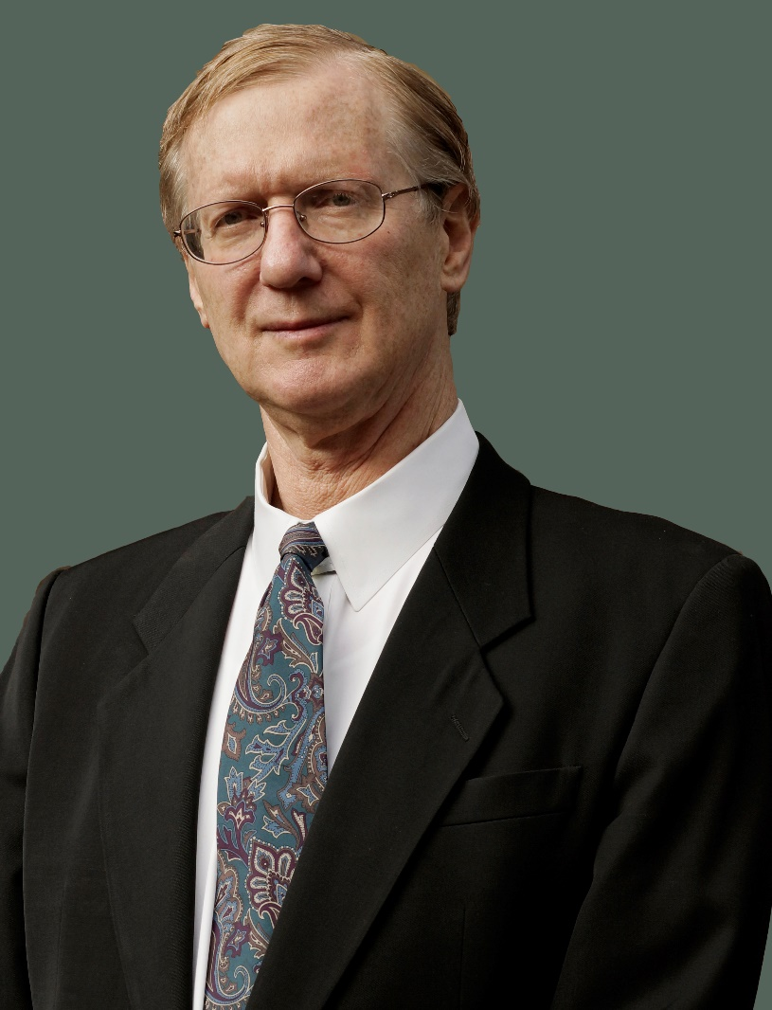
Dave
Art

